Slide 1
Чумхурии Точикистон Республика Таджикистан Republic of Tajikistan

Slide 2
Agricultural-Production Cooperative “DEHKON”
Presenter:
Chairman of APC «DEHKON»
Dodojonov Haydar Hamdamovich
Republic of Tajikistan,
Sughd region,
Zafarabad district.

Slide 3
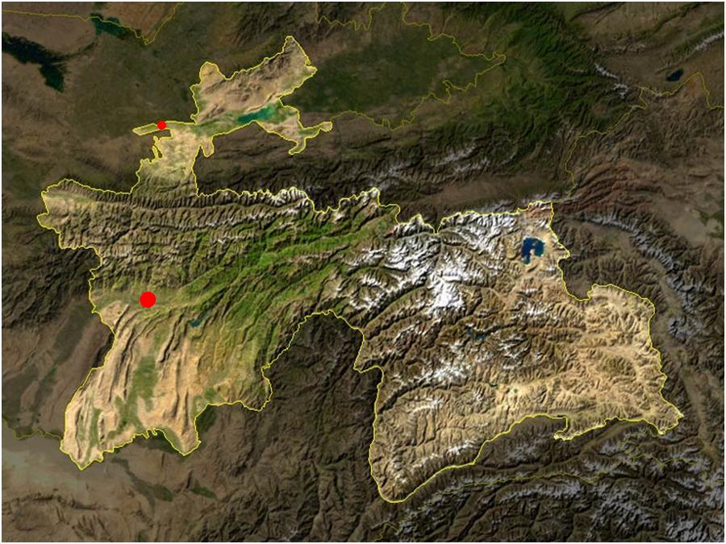
Location of APC «DEHKON»
on the map of Tajikistan
Zafarabad district
DUSHANBE

Slide 4
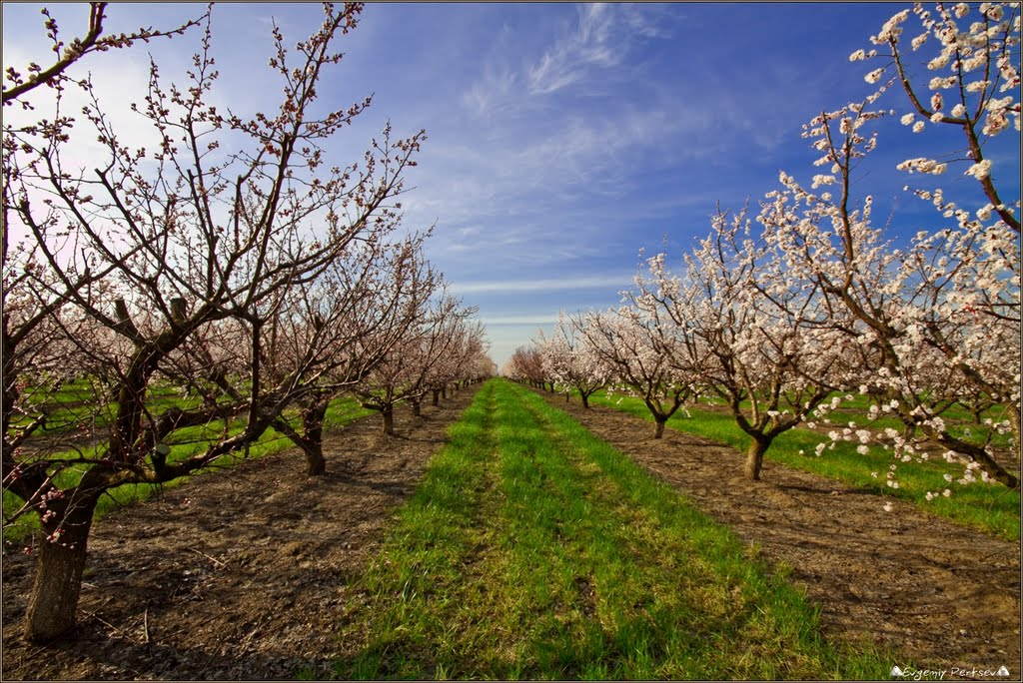
Agricultural-Production Cooperative “DEHKON”
Brief information about APC «DEHKON»:
Agricultural-Production Cooperative «DEHKON» was founded in 1990.
It is one of the first Agricultural-Production Cooperatives which was founded in Tajikistan.
The main activity of the production is growing and agrotechny of agricultural production.
It has its own fruit gardens (plantations) – grapes, pomegranates, figs.
It produces different agricultural equipment and parts to them.
Also it works on delivery of agricultural machines, agricultural equipment, agricultural parts, electricity metric equipment,
laboratory and other equipment to the customers of its region.
From 1993 our APC works on scientific research on social and ecological spheres.
It is the official representative of big companies from Commonwealth of Independent Countries to Republic of Tajikistan.

Slide 5
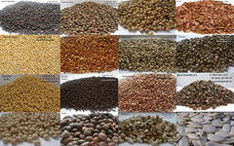
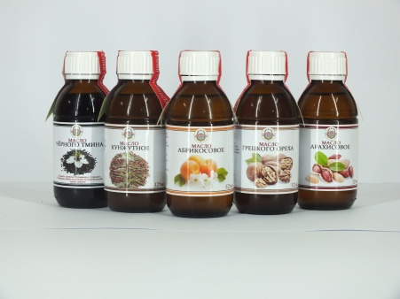
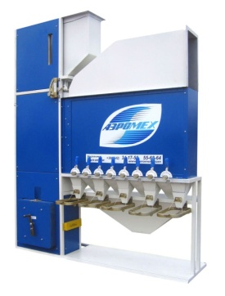
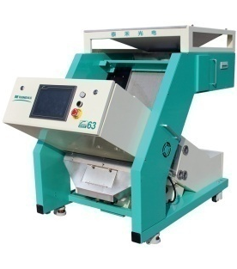
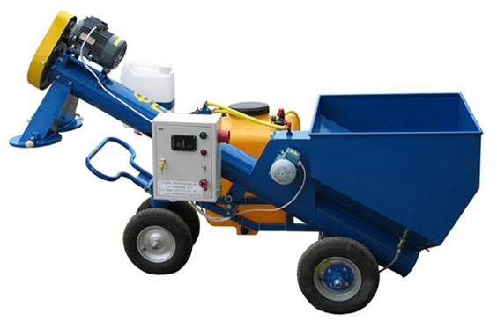
Agricultural-Production Cooperative “DEHKON”
Currently our cooperative has created
11 investment projects
1. Environmental project - Production, procurement and processing of oilseeds and other crops.
2. Environmental project - Mini-plant for production of natural oils from seeds oil crops by the method
of cold pressing.
3. Social project - Processing of all kinds of seeds for obtaining elite seed the material and Processing
of all kinds of seeds of agricultural crops pesticides to destroy the outer and inner
infections and their mixtures with micronutrients and growth stimulants.
Project 1 Project 2 Project 3
1- Project. The volume of investments: 2193975 US$ - including borrowed - 2063975 US$ – own 130000 US$.
2- Project. The volume of investments : 1994000 US$ - including borrowed - 1704000 US$ – own 290000 US$.
3- Project. The volume of investments : 4098190,91 US$

Slide 6
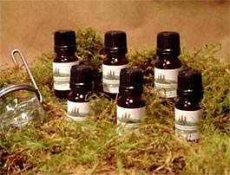
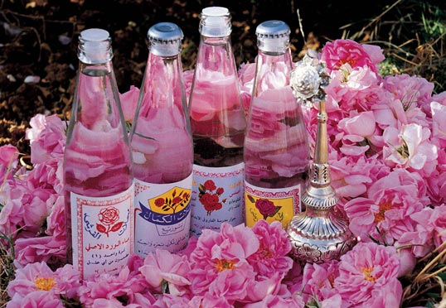
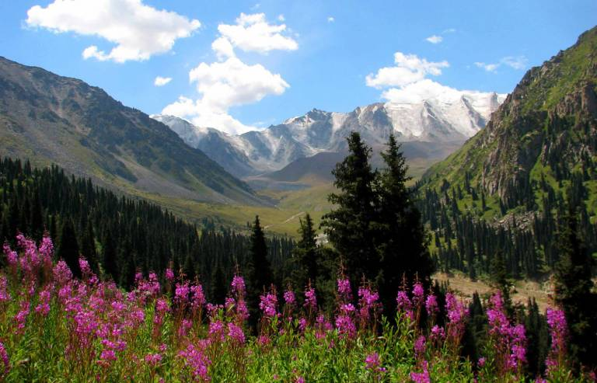
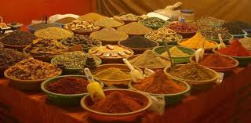
Agricultural-Production Cooperative “DEHKON”
Currently our cooperative has created
11 investment projects
4. Environmental project - Mini-plant for production of essential oil from oilseed crops and medicinal plants
of Tajikistan.
5. Environmental project - Growing of roses and production of rose oil.
6. Environmental project - Shop for preparation and packaging of a medicinal plant and harvesting of medicinal
plants of Tajikistan.
7. Environmental project - The Plant for processing and packaging spices, herbs and seasoning.
Project 4 Project 5 Project 6 Project 7
4- Project. The volume of investments: 1122000 US$ - including borrowed 872000 US $ – own 250000 US $.
5- Project. The volume of investments : 2210000 US $ - including borrowed 2120000 US $ - own 90000 US $.
6- Project. The volume of investments : 650000 US $ - including borrowed 530000 US $ – own 120000 US $.
7- Project. The volume of investments : 600000 US $ - including borrowed 480000 US $ – own 120000 US $.

Slide 7
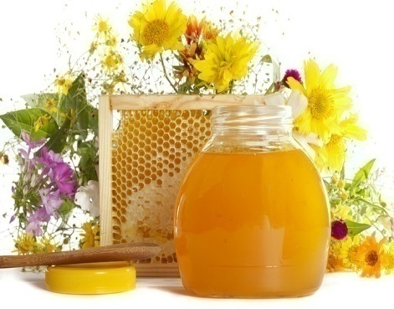
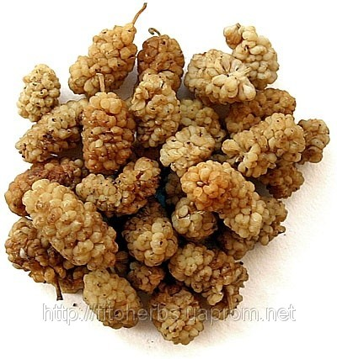
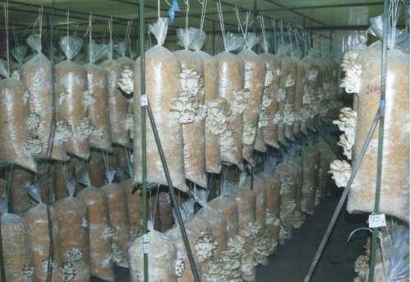
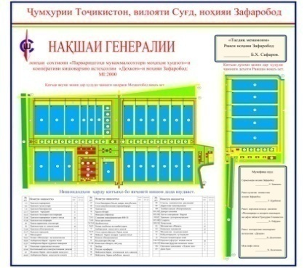
Agricultural-Production Cooperative “DEHKON”
Currently our cooperative has created
11 investment projects
8. Environmental project - Mini-plant for processing, filling and packaging of honey.
9. Social project - Vaccinations 10% of the existing trees throughout mulberry the territory of the
mulberry trees and the forest areas of Tajikistan on cultivated varieties.
10. Environmental project - Opening of the enterprises of industrial cultivation mushrooms.
11. Environmental project - Construction of a breeding of the fish farm.
Project 8 Project 9 Project 10 Project 11
8- Project. The volume of investments: 3870000 US$ - including borrowed 3585000 US$ – own 285000 US$.
9- Project. The volume of investments : 5300000 US$.
10- Project. The volume of investments : 6000000 US$ - including borrowed 5500000 US$ США – own 500000 US$.
11- Project. The volume of investments : 8100000 US$ - including borrowed 4500000 US$ США – own 3600000 US$.

Slide 8
Agricultural-Production Cooperative “DEHKON”
Ecological investment project:
Producing, provision, agrotechny and realization of seeds and producing natural oils of cold extraction.

Slide 9
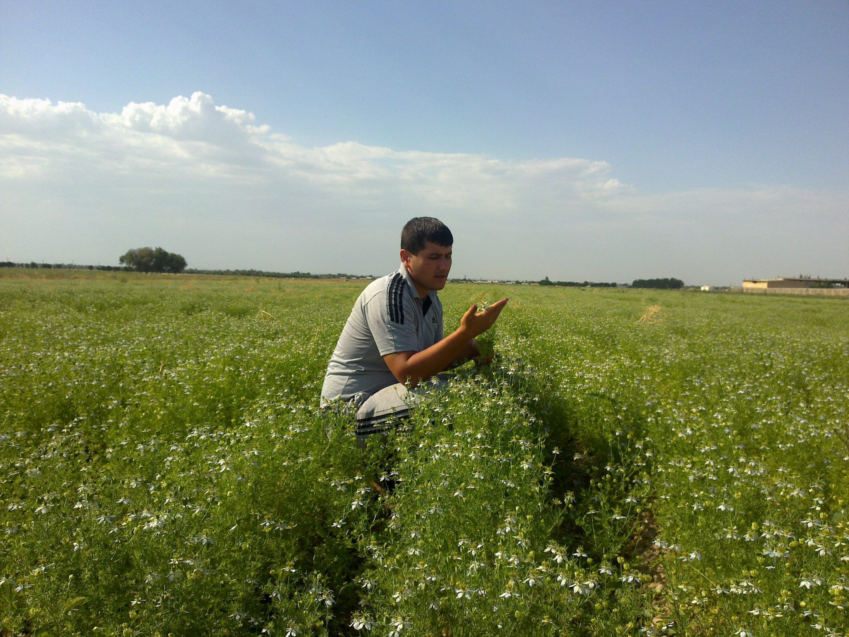
Agricultural-Production Cooperative “DEHKON”
Since 2012 we grow and agrotechny the seeds of black caraway (cumin), sesame (til) and other oil plants air dynamic separator SAD, and provide clean seeds to local market and to the countries of CIS.
This year we intent to produce natural oils from the seeds of oil plants with the method of cold extraction using the advanced technology.

Slide 10
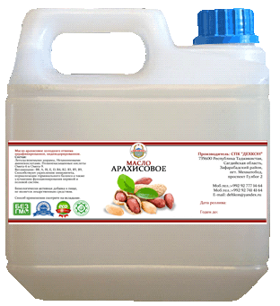
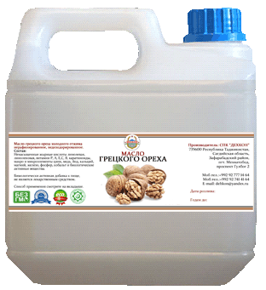
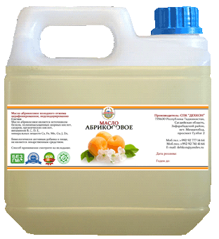
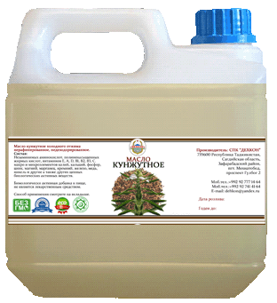
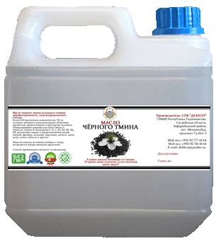
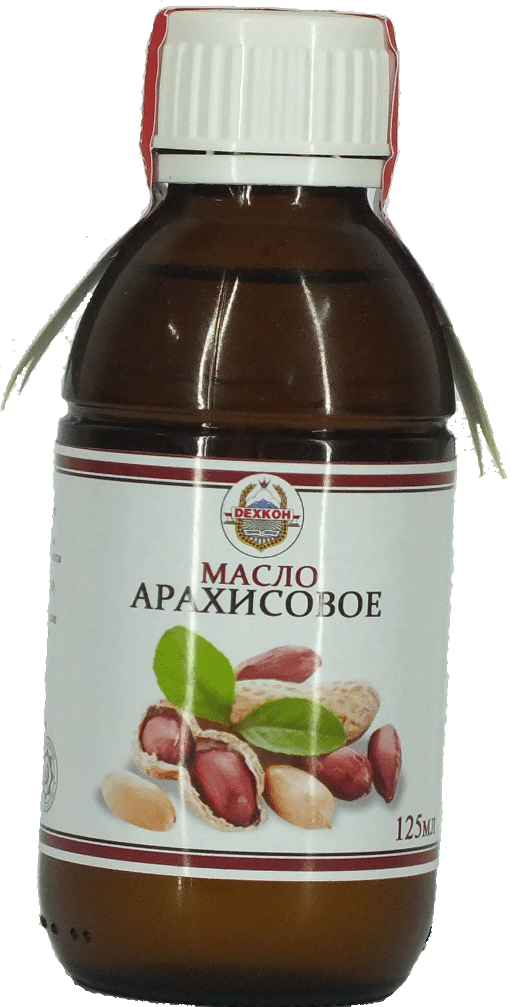
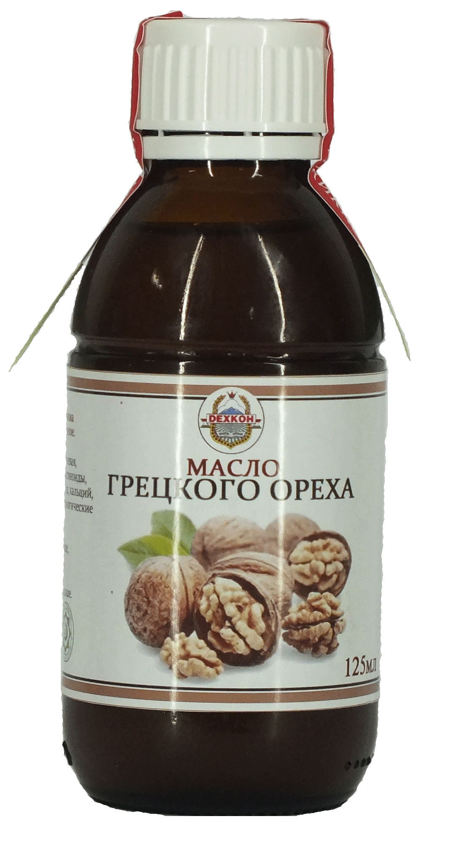
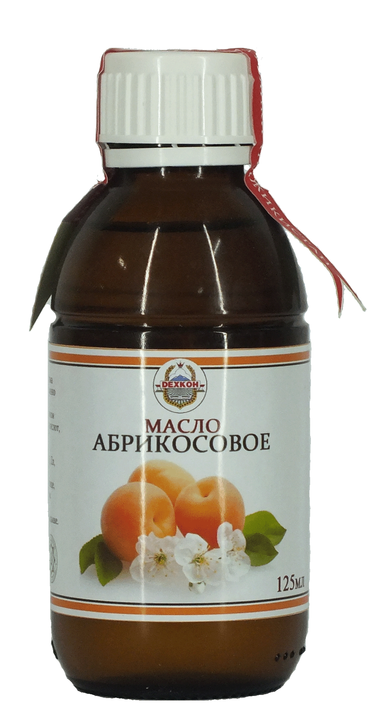
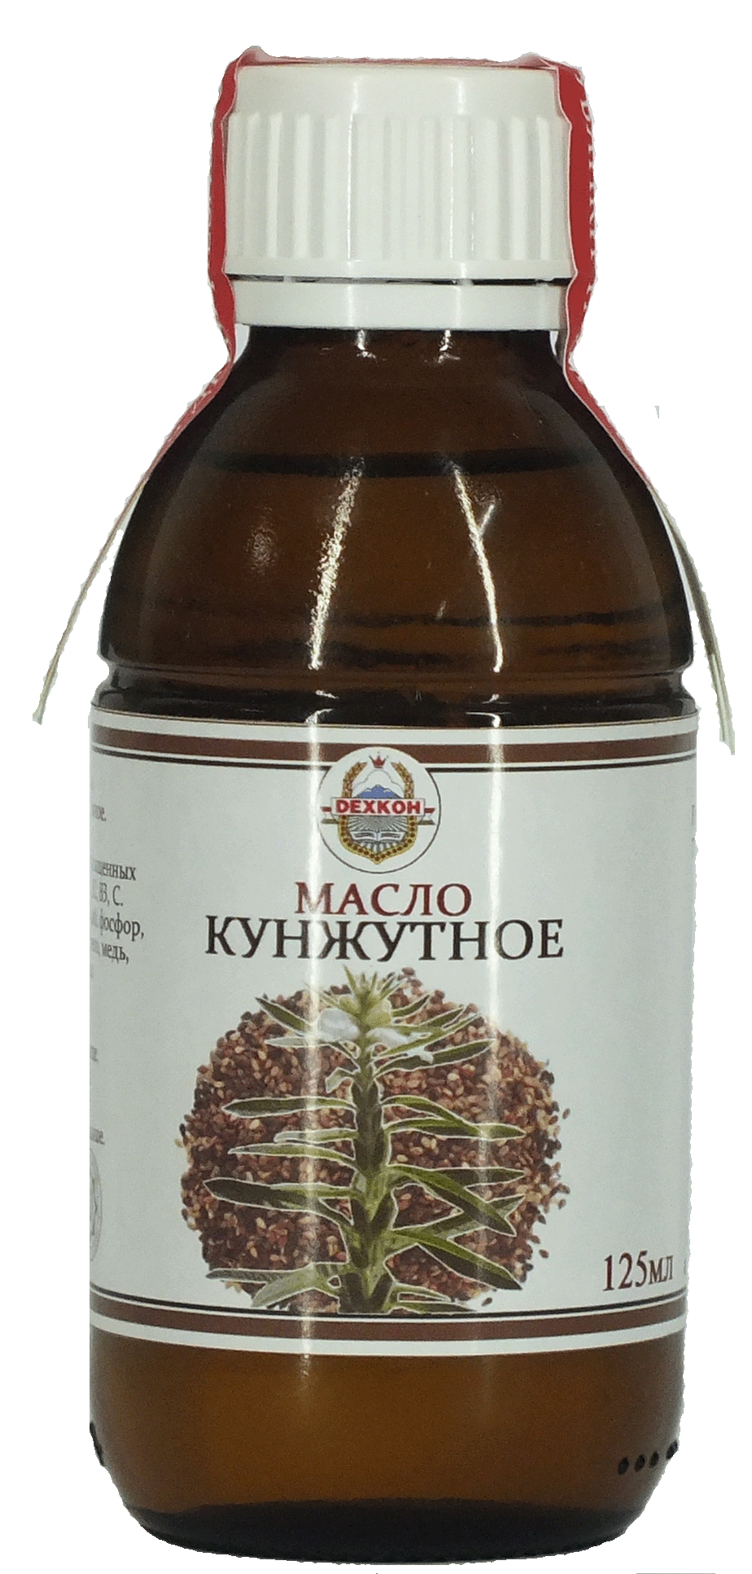
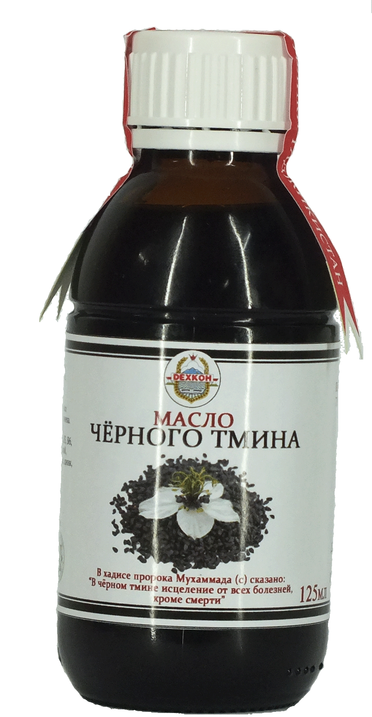
Agricultural-Production Cooperative “DEHKON”
At the first phase we plan to produce 5 kinds of products.
Annual production of natural oils is more than 120 tons.
Annual amount of oilcake is more than 240 tons.
.

Slide 11
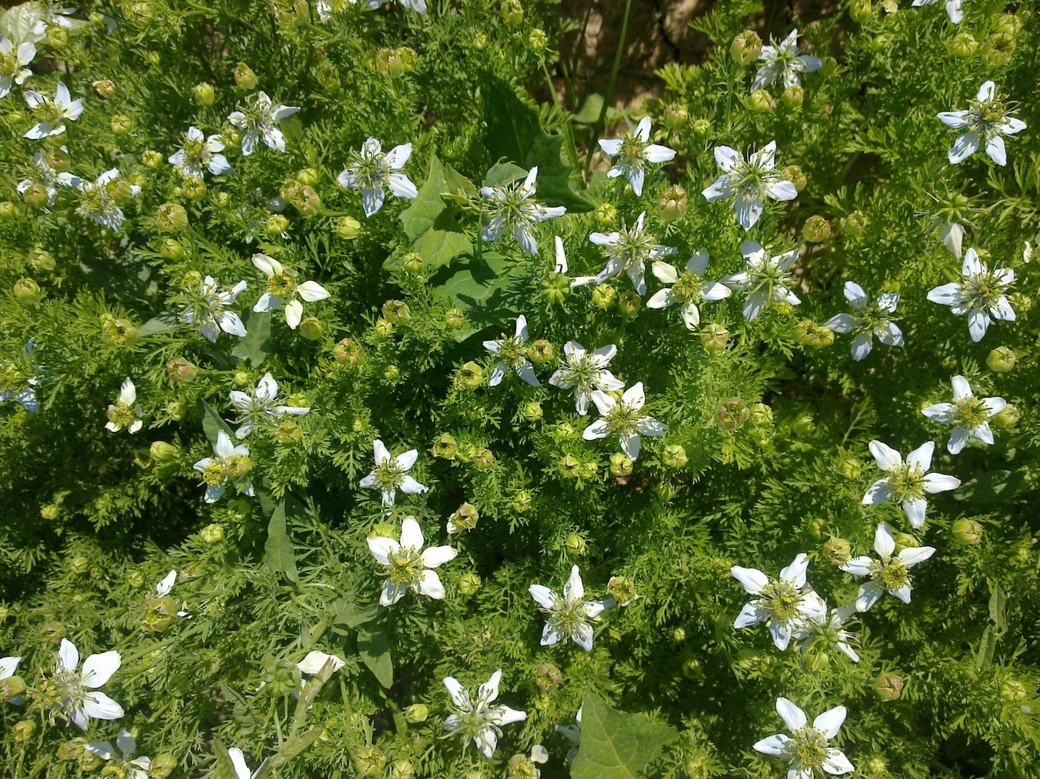
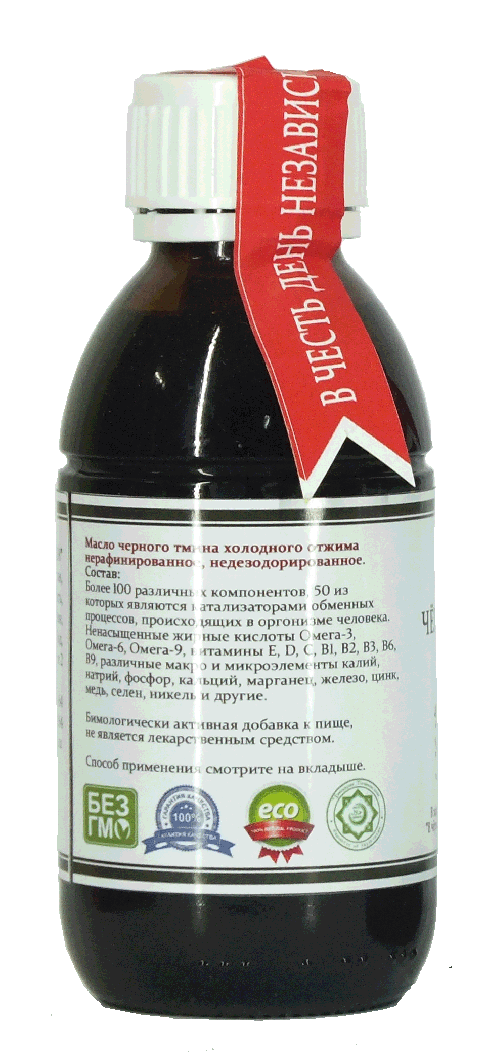
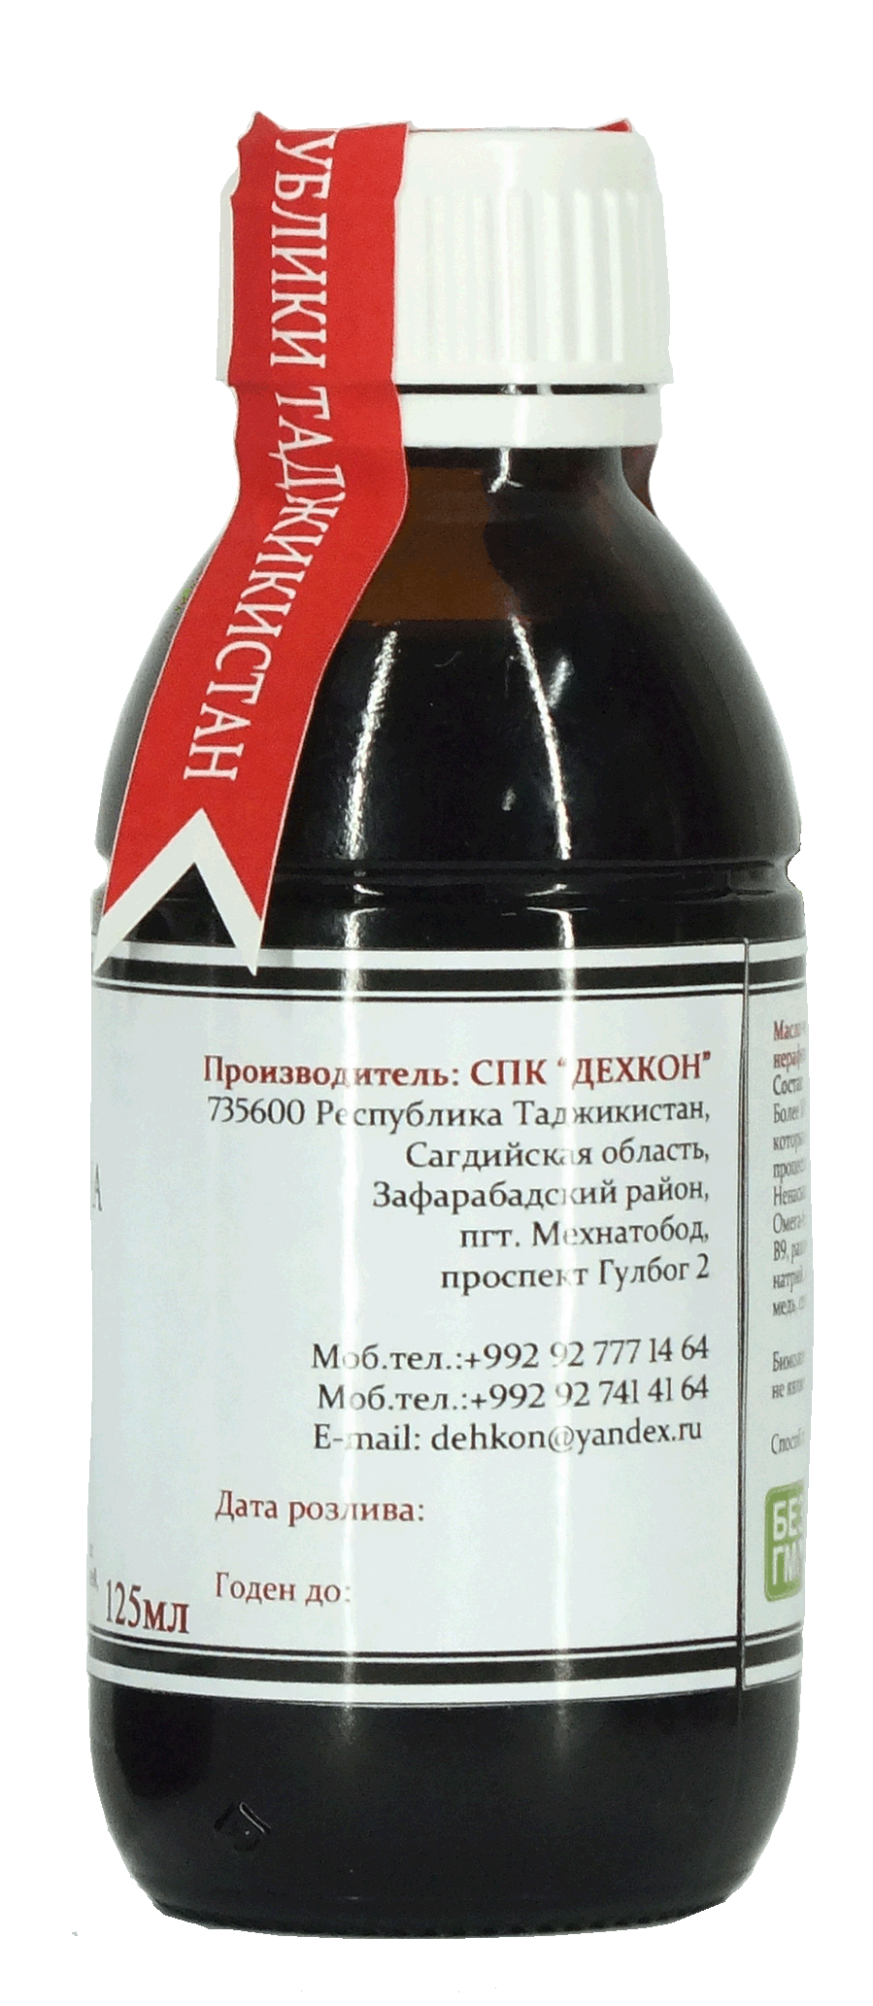
Agricultural-Production Cooperative “DEHKON”
. At the second stage we plan to produce more than 11 kinds of natural oils,
with the annual amount of more than 250 tons and 500 tons of oilcake.

Slide 12
Agricultural-Production Cooperative “DEHKON”
Project goal:
Providing the local agricultural producers with selective and clean sowing
stuff.
Providing the population of the republic with remedial, cosmetic and food
natural oils.
3. Organization of new permanent and seasonal job.
4. Organization of additional resources of state budget revenue.

Slide 13
Agricultural-Production Cooperative “DEHKON”
Project 1
Project 2
1. Project. The volume of investments: 2193975 US$ including borrowed - 2063975 US$ – own 130000 US$.
2. Project. The volume of investments: 2244000 US$ including borrowed - 1704000 US$ – own 540000 US$.
Total: The volume of investments: 4437975 US$ including borrowed - 3767975 $ США – own 670000 US$.
While conjoining the first and the second projects the effectiveness will increase and the amount of investment
will decrease.
+
The combination of two projects is reduced to the sum of the project 1560000 US$.
1. Project. The volume of investments: 2193975 US$ including borrowed - 2063975 US$ – own 130000 US$.
2. Project. The volume of investments : 684000 US$ including borrowed - 144000 US$ – own 540000 US$.
Total: The volume of investments: 2877975 US$ - including borrowed 2207975 US$ – own 670000 US$.

Slide 14
Agricultural-Production Cooperative “DEHKON”
CO-RELATION OF OWN AND LOAN FUNDS IN CASE OF SEPARATE REALIZATION OF TWO PROJECTS
The amount of investment for 1 project
The amount of investment for 2 project
Own fund
loan fund
own fund
loan fund

Slide 15
Agricultural-Production Cooperative “DEHKON”
CO-RELATION OF OWN AND LOAN FUNDS IN CASE OF JOINED REALIZATION OF TWO PROJECTS
The amount of investment for 1 project
The amount of investment for 2 project
own fund
own fund
loan fund
loan fund
Total amount of investment-
own fund
loan fund

Slide 16
Agricultural-Production Cooperative “DEHKON”
Project readiness:
- There is the passport of investment project.
- There is aready business splanof project.
- The technical and economic rationale of the project is ready.
- The field for the project is 2 hectares
- There are 2 producing buildings of APC “DEHKAN”
1. buildingitself 450 sq.m. and useable space 420 sq.m.
2.buildingitself 1108,6sq.m. and useable space 1124,6 sq.m.
Producing buildings consist of these rooms.
1. Depository for raw (stock) products coming and keeping them
2. Producing house
3. Room for keeping oil
4. Room for packaging
5. Depository for ready products
6. Depository for oilcake keeping
7. Depository for receptacles and other material values
8. House for laboratories
9. Office
10. Customer rooms
11. Guardrooms
12. Outdoor producing grounds
13. 2 own electric transformers
14. Separate artesian well

Slide 17
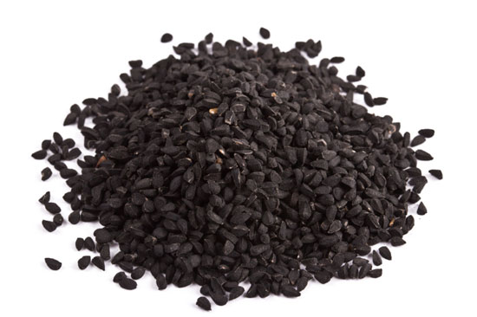
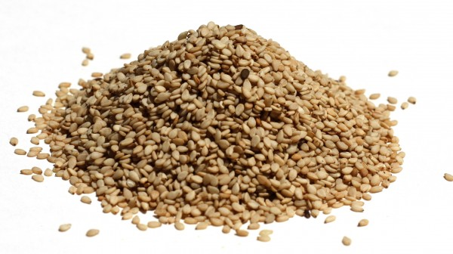
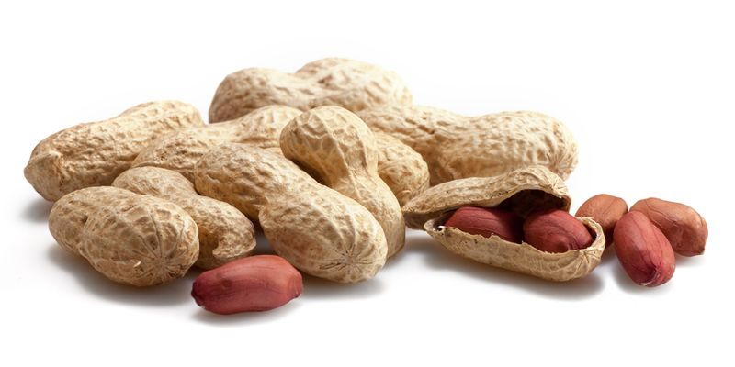
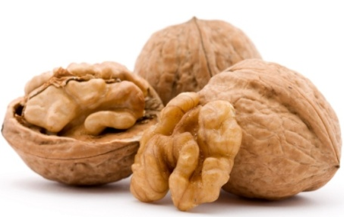
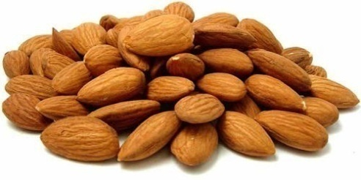
Agricultural-Production Cooperative “DEHKON”
Production and raw (stock) base:
Annual amount of agrotechny production is 500 tons of seeds.
Annual amount of output is 390 tons of selective and clean seeds from which we produce 120 tons of natural oils and 240 tons of oilcake.
We have own raw (stock) for production and also according our contracts and requests our local agricultural producers grow plants for us for natural oils production.
Nowadays there are 4000 farms in Zafarabad who deliver us seeds of black caraway (cumin) and sesame.
We purchase peanuts from the farmers from Mastchoh district.
We purchase apricot nuts from agricultural producers from Asht, Konibodom, Isfara, Khujand and B.Gafurov districts.
We purchase walnuts in Istaravshan, Isfara and Muminobod districts
Also we work on selective research and adaptation of several plants for growing in our region aiming on huge crop yield and high quality products

Slide 18
Agricultural-Production Cooperative “DEHKON”
Competitors:
The analysis of the market shows that there is no company working on agrotechny of oil plants and production
of natural oils of cold extraction in our republic yet.
Russia:
PFK “Aromavita” Ltd, Moscow founded in 2009
“Oil king” Ltd Moscow, production in Great Novgorod city “Victoria”Ltd. Founded in 2003
Kazakhstan:
“Masloprom” Ltd Ordabasyn district, Temirlan village
“SesameEco” Ltd Almaty founded in 2010
Uzbekistan:
“Almaz Oil” Ltd Bukhara city – founded in 1997
“Netek” Ltd Tashkent – founded in 1999
“Rustam” Ltd Tashkent – founded in 1990
wholesale trade dealer company “ORZU PLUS” "BEKOBOD QO'RG'ONI" Ltd Tashkent – founded in 2012
«Fito product» Ltd Tashkent – founded in 2011

Slide 19
Agricultural-Production Cooperative “DEHKON”
Sale market:
Local market, pharmacy and food industrial companies of Russia and CIS.
Jobs:
On realization of the project 120 permanent and 240 seasonal jobs will be organized.
Project realization territory:
Soghd region, Zafarabad district, Mehnatobod village.
Franchise loan for 5 years, under governmental guaranties, grants and other resources of funding, also
foundation of joint companies.
The form of investment in the project:
Recoupment (pay back) terms of the project:
3 calendar years

Slide 20
Agricultural-Production Cooperative “DEHKON”
THANKS FOR YOUR ATTENTION!
Project developer and author:
Chairman of APC«DEHKON»,
Dodojonov Haydar Hamdamovich
735600, Republic of Tajikistan, Sughd region,
Zafarabad district, urban town Mehnatobod, avenue Gulbog #2.
mob. tel: +992 92 777 14 64
e-mail: dehkon@yandex.ru

