Slide 1
FIRST INVESTMENT FORUM ON OIC PLAN OF ACTION FOR COOPERATION WITH CENTRAL ASIA
Working Session III: Capacity Building and Export Promotion in the Agro Food Processing Sector
Dushanbe, 28 October 2014
Mayoro Niang
Agriculture and Rural Development Department
Notes:
Assalamou Aleikoum
Thank you Chairman for giving me the opportunity to share with the audience a couple of slides to present what the IDBG is doing in supporting Capacity Building and Export promotion in the Agro Food Processing sector.

Slide 2
Outline
Strategic alignment
AGR - Areas of focus - Organization
IDB investment in Agriculture
AGR footprint in Agribusiness development – Case of Halal Meat Processing in Kyrgyz Republic
Conclusion
Notes:
Strategic fit and alignment to show how the working session theme is addressed in the Bank strategy.
Area of focus – Organization to illustrate how AGR is organized to respond to the need of developing capacity building and supporting export in the Agro Food processing sector.
Investment in Agriculture – to illustrate how and to what extent AGR is supporting this sub sector.
Footprint – just to showcase of one example

Slide 3
Strategic alignment Agriculture & Rural Development
3
Alleviate Poverty
Intervention Areas
Community Driven Development (CDD)
Value Chain Enhancement
Water Infrastructure Program
Addressing the Manpower Needs and Staff Skill Mix Requirements
Pillars
Improvement of Agro-technologies & Natural Resources Management
Objectives
Build Sustainable Livelihoods
Developing a Comprehensive strategy for Agriculture and Rural Development
Three Focus Areas
Enhance Agricultural Productivity
Three Cross- Cutting Themes
Improve Market Access
Microfinance | Special Initiatives – flagship programs | Capacity Building
Sustainable Water Management
Notes:
IDB has gone through a reform which culminated with the creation of new departments such as the AGR, which mandate is to provide effective development assistance for sustainable, equitable and inclusive agricultural growth, and food and nutrition security; and Promote south-south collaboration and solidarity.
This mandates has been articulated into the following 6 sector objectives: Alleviate poverty ---
And 3 focus areas and 3 cross cutting themes.
Each of the focus areas is being supported by a division as follows:

Slide 4
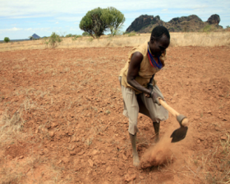
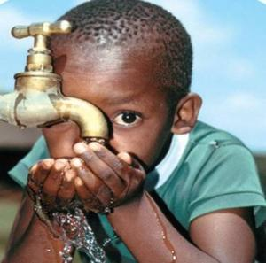
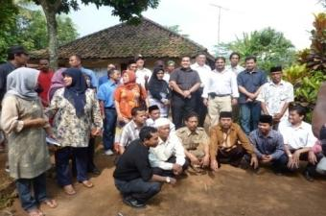
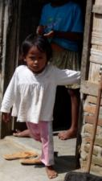
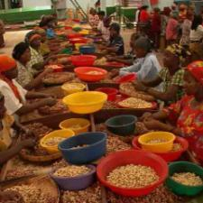
AGR Department Structure
Agriculture & Rural Development Department
Integrated Rural Development
(IRD)
Water Resources and Environment
(WEN)
Agriculture and Food Security
(AFS)
Notes:
IRD dealing with CDD as main focus area
AFS coping with Value Chain enhancement difficulties and
WEN being responsible for the Water Infrastructure program.

Slide 5
IDB areas of focus in Agriculture
Water and Environment
Rural Development
Food Security
Water infrastructure
Livelihood diversification
Crop diversification
Managing shocks
Productivity
Skills and employment
Rural Non-farm Economy
Water and Sanitation
Microfinance
Value chains
Environment and Climate Change
Water management
Capacity building AND RURAL INFRASTRUCTURE
Notes:
Themes:
climate-smart agriculture and building resilience of smallholders
linking farmers to markets (value chain incl. agro-processing)
farmers-extension-research linkages for transfer of appropriate technologies to enhance smallholders’ crop and livestock productivity,
Farmers access to credit through development of innovative Islamic financial products and services for stallholders
strengthening rural institutions for inclusive and equitable economic growth.

Slide 6
IDB Investment in Agriculture
IDB invested more than USD 13 billion in agriculture since 1976.
The share of Agriculture in total IDB investment increased from 3% to 17% during 2009-2013
Current active investment in Agriculture is about USD 4 billions
Notes:
Increase investment in Agriculture with the reform – with a share jumping from 3 to 17 % recently.

Slide 7
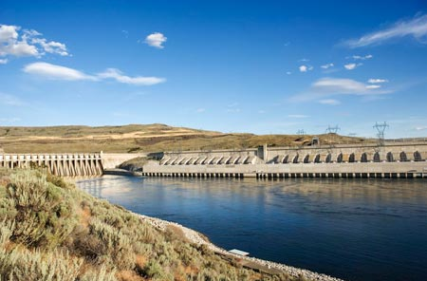
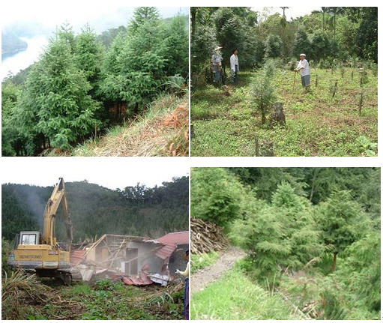
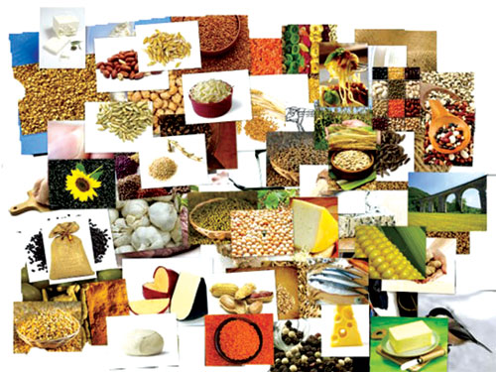
Focus Sub-Sectors and Thematic Areas
Infrastructure: A key component of IDB investments
Notes:
Importance of irrigation and drainage
Relative importance of Agro-industry in terms of amount.

Slide 8
AGR Footprint in agribusiness
Case of HALAL RED MEAT PRODUCTION
AND PROCESSING ENHANCEMENT PROJECT for Kyrgyz Republic
(under preparation - 2015-2019)
A new Agro-processing project being developed by IDB to unlock country’s livestock potential
Notes:
Existing Agro industry projects are widespread and include: White Nile Sugar in Sudan – Cotton Ginning plants in Sudan – Olive Oil in Morocco and Palm oil production in Sierra Leone-
Three (3) agro processing proposals under review by IDB in the region
2 Horticulture development Projects in Kazakhstan and Uzbekistan for respective amount of US$ 130 and 200 million.
1 Livestock / Halal Meat Chain Enhancement project in Kyrgyzstan for 30 million US$ with the view of unlocking the country’s livestock potential

Slide 9
Halal Meat Value Chain (Kyrgyzstan)
Project Objective
To contribute to the poverty alleviation effort and enhance economic growth in Kyrgyz Republic by Unlocking the potential trapped in the red meat value chain.

Slide 10
halal Meat Value Chain (Kyrgyzstan)
The Country is able to export Certified Halal Red Meat to international markets (within the common custom region and Middle East Countries) by 2020
Contribute to increased production and productivity of cattle, sheep, and goat through access to finance, training, and innovation.
Increase in the contribution of livestock sector to the GDP .
Reduction of population living below poverty line in rural areas.
Increase population awareness about food safety.
Notes:
Outcomes to be achieved through the following 5 components:
(A): Construction of Slaughterhouses and meat processing plant. (building 2 facilities)
(B): Feedlot Operations Establishment (Feedlot for growing and Finishing feeder calves and lambs)
(C): Small Producers and organization development (human capital development – Halal certification)
(D): Access to Finance (support small herds holders to enhance livestock value & feed slaughterhouses)
E: Project Management and Coordination (put appropriate corporate project management)

Slide 11
Conclusion
According to FAO, about 1.3 billion tons of food is lost or wasted every year, which amount to roughly one third of all food produced for human consumption.
About fifty percent of the global food loss can be curbed by enhancing agro-processing capacities of small and medium sized farmers who produce 80 percent of the food consumed in the developing world.
IDB member countries produce 18 out of the 20 most important agricultural commodities produced world wide. Therefore, value-addition and agro-processing industries are important economic sectors that could significantly contribute to poverty alleviation and food security in IDB/OIC member countries.
It is part of IDB strategy to increase its support to member countries build their agro-processing industries.

Slide 12
Thank You

