Slide 1
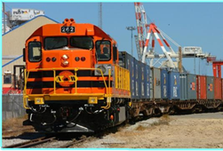
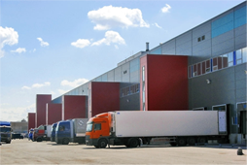
Public Private Partnership in Transport Sector of Tajikistan
PUBLIC PRIVATE PARTNERSHIP IN TAJIKISTAN
State Committee on Investment and State Property Management of the Republic of Tajikistan
State Institute «Projects Implementation Unit of Public Private Partnership»
Sharafjon Sheraliev – Director of State Institute
Projects Implementation Unit Public Private Partnership
Dushanbe, October 27, 2014

Slide 2
Legal acts that have been adopted for the PPP development
Government Regulation "On the determination of the authorized government body on РРР of the Government of the Republic of Tajikistan» "№ 250, June 3, 2013,
Government Regulation "On the establishment of the State Institution" Projects implementation Unit of PPP» July 2, 2013, № 289
Government Regulation "About Public-Private Partnerships Council» July 2, 2013, № 290
PPP Law approved December 28, 2012

Slide 3
INSTITUTIONAL ARRANGEMENTS OF PUBLIC PRIVATE PARTNERSHIP
INSTITUTIOInstNAL MECHANISM OF PPP
GOVERNMENT OF THE REPUBLIC OF TAJIKISTAN
AUTHORIZED GOVERNMENT BODY-SCISPM- PPP CENTER
PPP COUNCIL
THE LINE MINISTRIES AND AGENCIES, WHICH IMPLEMENT PPP PROJECTS AND AGREEMENTS (CONTRACTING AUTHORITIES)

Slide 4
PROJECTS WITH THE PPP FEATURES IN
TRANSPORT SECTOR
Operation highway Dushanbe - Khujand , given to private company
2 Performance Based Maintenance (PBM) contracts

Slide 5
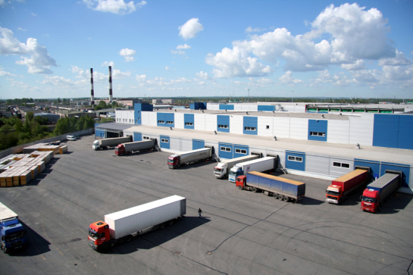
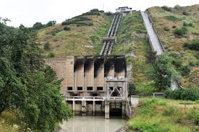
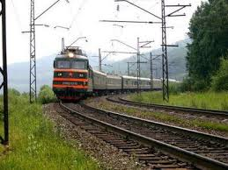
PPP COUNCIL MEETING
June 13, 2014, was held the 1st PPP Council meeting, where the following projects were presented: Construction of a logistics center, railway line, mini-hydro power plant, basic infrastructure, drinking water systems, and etc.

Slide 6
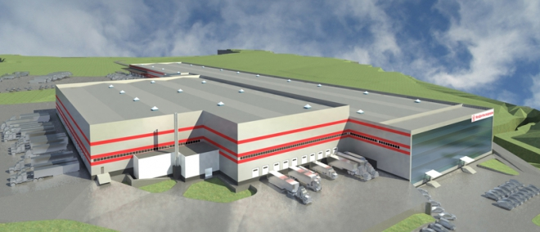
Construction of Logistics Center Tursunzoda city
Total cost of the Project -
$ 10 mln. USD
Current Status:
Developed a preliminary feasibility study, but it is necessary to update it for the actual date and the PPP requirements

Slide 7
LOGISTICS CENTER PROJECT DESCRIPTION
Location – Tursunzoda city Contracting Authority – Ministry of Transport Preliminary cost – 10 mln. USD Payback period – 10 years Pre-feasibility study is ready

Slide 8
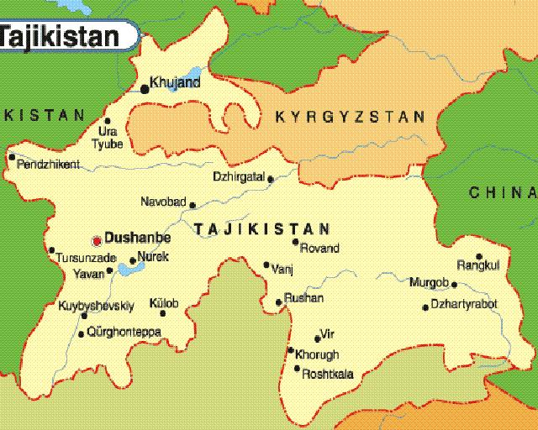
LOСATION OF LOGISTICS CENTER
TURSUNZODA CITY
http://gki.tj/

Slide 9
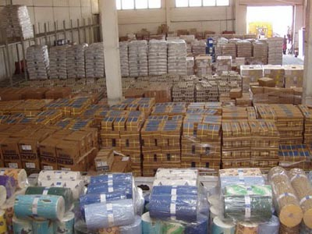
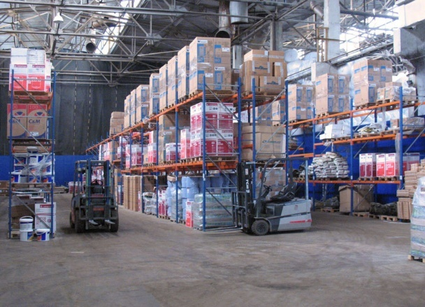
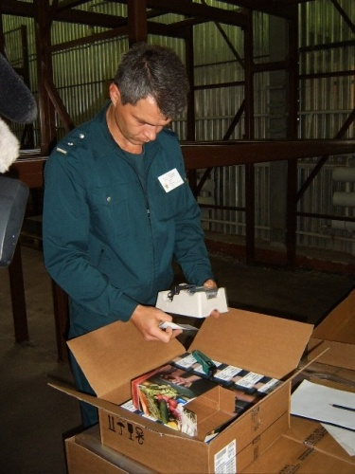
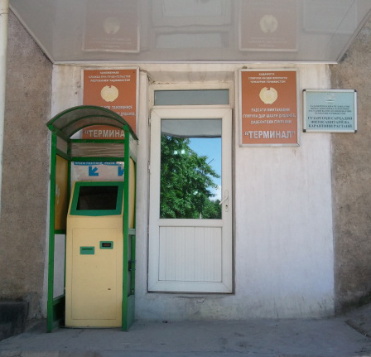
LOGISTIS CENTER SERVICES
Logistics center will provide full period services joint activity of customs , sanitary quarantine services, temporary storage area and customs storages
http://gki.tj/

Slide 10
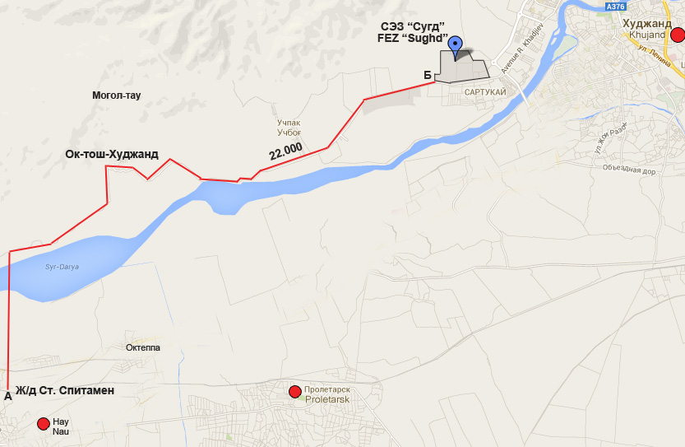
Construction Branch Railroad - «Spitamen» - FEZ«Sughd»
Description:
Railroad branch "Spitamen"Station - FEZ "Sughd" will be in the long term prospects component part of the railroad branches stretching over 140 km to the largest silver mine Big Koni Mansur
Length of railroad branches:
22 km
http://gki.tj/

Slide 11
PROJECT DESCRIPTION
Cost of projects:
$ 150 000 – Feasibility study development
$ 120000 –Select the direction and execution of works on preparation of project documentation
$ 45 mln. – Preliminary cost
Description:
Railroad branch "Spitamen"Station - FEZ "Sughd" will be in the long term prospects component part of of the railroad branches stretching over 140 km to the largest silver mine Big Koni Mansur
Current status of the project:
Project is included in country strategy papers;
Project is approved by the PPP Council;
Preliminary negotiations with potential investors and development partners to develop a feasibility study in progress
http://gki.tj/
http://gki.tj/

Slide 12
KEY PARTICIPANTS OF PPP
PPP Council
Authorized government body (AGB)
Contracting Authority (CA)
Regulatory body (RB)
Expert/Consultants
Private sector
http://gki.tj/

Slide 13
SUPPORT FOR PPP-s IN TAJIKISTAN
Clear legal framework (PPP Law and Regulations)
Clear institutional responsibilities
PPP contracts meeting international requirements
Templates and guidelines provided
Project Development Fund to be setup to support preparing projects
http://gki.tj/

Slide 14
KEY STAGES OF PPP PROJECTS
IIDENTIFICATION STAGE AND PREPARATION
ТЕNDER
AGREEING AND SIGNING CONTRACTS
IMPLEMENTATION
MONITOR
м
м
м
Selection
Organization
Agreeing
Construction
Reports etc.
м
м
Initiation
Pre-selection
Revising
Service providing
м
м
Development
Signing
м
Final selection
Agreeing
http://gki.tj/

Slide 15
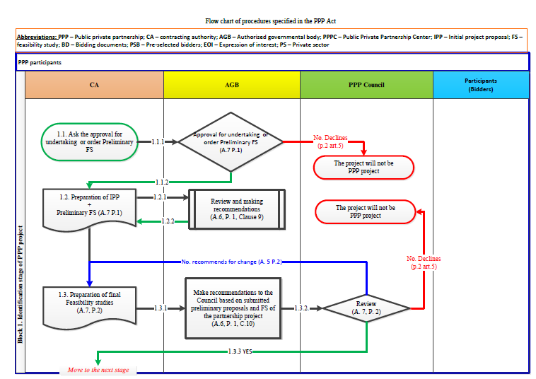
IDENTIFICATION OF PPP PROJECT
Clear legal framework (PPP Law and Regulations)
o Clear institutional responsibilities
o PPP contracts meeting international requirements
o Templates and guidelines provided
o PDF to be setup to support preparing projects

Slide 16
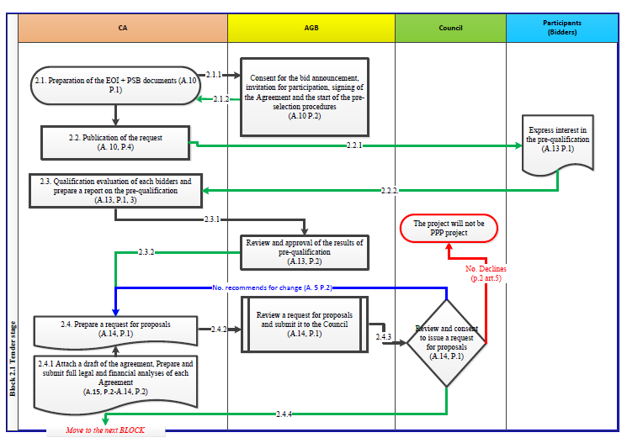
PRESELECTION
Support for PPPs in Tajikistan

Slide 17
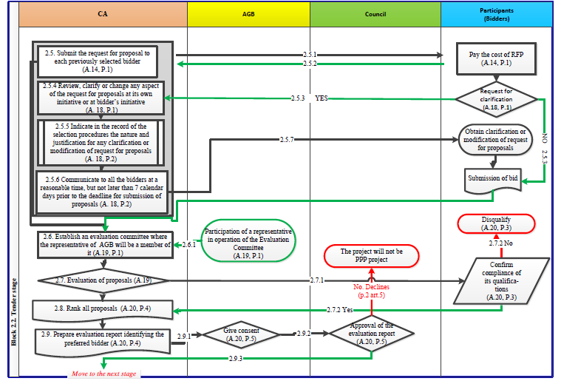
FINAL SELECTION
Support for PPPs in Tajikistan

Slide 18
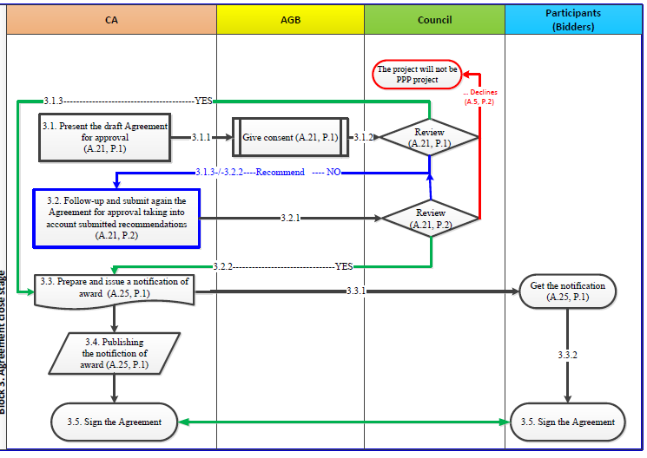
Support for PPPs in Tajikistan
AGREEING & SIGNING CONTRACTS

Slide 19
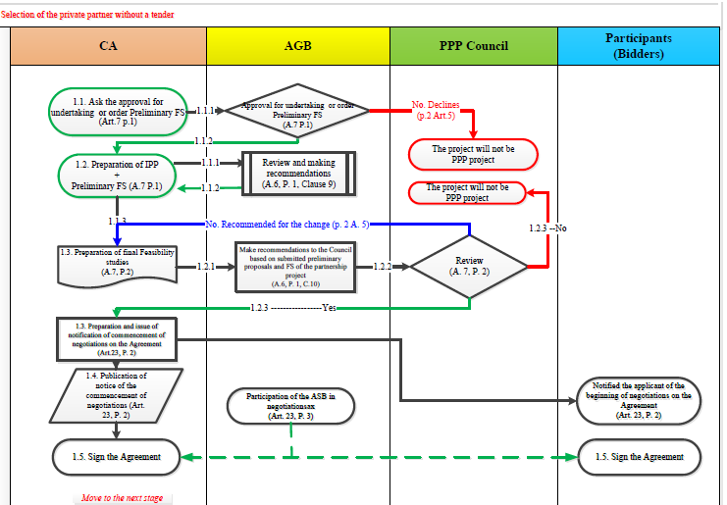
SELECTION WITHOUT COMPETITIVE PROCEDURES

Slide 20
THANKS FOR YOUR ATTENTION !
OUR CONTACTS
PIU PPP CENTER:
44, Rudaki avenue
web-site: www.gki.tj
e-mail: pppcenter@gki.tj
sh.sharaf@mail.ru
Tel:(992-37) 221-11-56
http://gki.tj/

