Slide 1
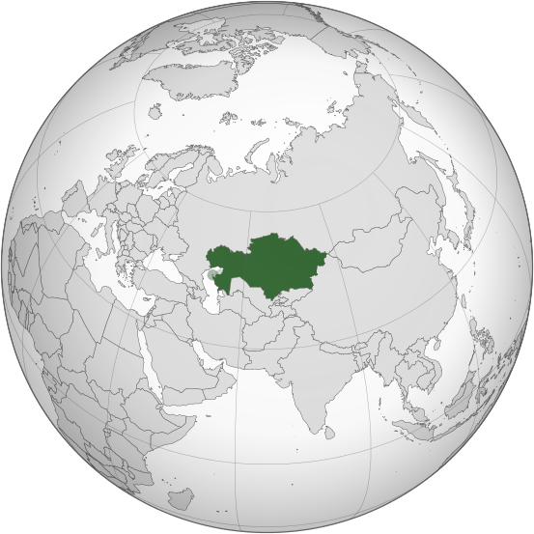
«Development of transit and transport potential»

Slide 2
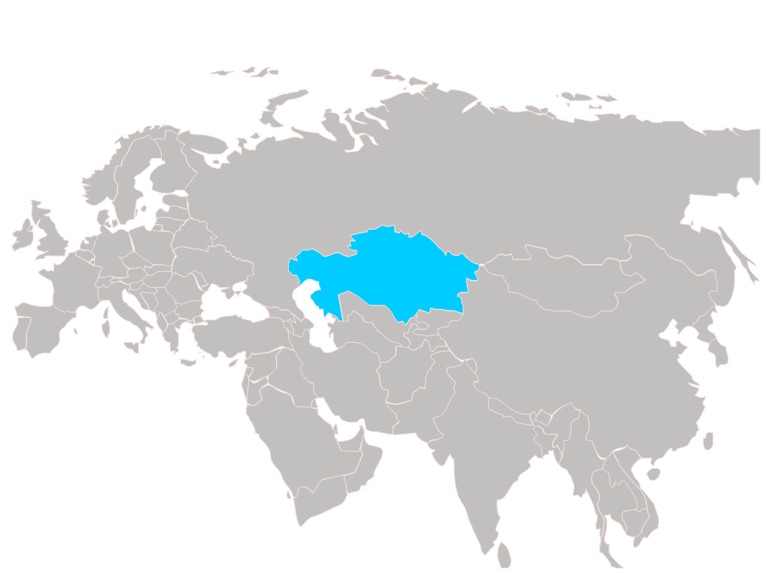
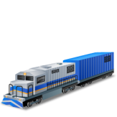
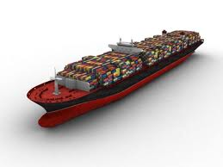
Kazakhstan – transit country, revival of GREAT SILK WAY
In the short term the essential and qualitative increase in transit freight traffic through Kazakhstan is supposed at the expense of increase in freight traffic between Asia and Europe
Current situation
in global commodity turnover
Baltic Sea
15-17 days
Goods turnover between China and Europe - 11,7 mln. TEU (120-150 mln. tons)
Share of the Kazakhstan transit in EU-PRC-EU commodity turnover is less than 0,1%
Not used potential of a cargo transportation in the EU-PRC-EU direction - 1,5 mln. TEU
(15-20 mln. tons)
12-15 days
ASTANA
Black Sea
Dostyk
Astrakhan
Aktau
Khorgos
Ürümqi
Istanbul
BAku
35-45 days
45-60 days
Central Asia
Serakhs
INCOME FROM TRANSIT
Bandar Abbas
2013 - 853
mln.$
2020
-
For about 2 bln.$
The Pacific
Coast
TRANSIT OF FREIGHTS
Goal:
Increase of the Kazakhstan share in EU-PRC-EU transportations
by 2020 to 5%,
and by 2030 to 10%
2013
-
17,8
mln.tons
2020
-
30 mln. tons
TRACECA
North corridor
TAR
North- South
South corridor
TAR
Middle Asian (Central) corridor
WE- WC
2

Slide 3
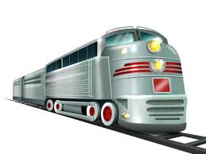
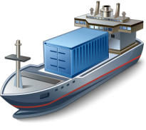
Development of transport and communication complex for the last 5 years
2013
1 | The share of transport branch in GDP of the country ----------------------------------------- | 7,5 %
2 | In 5 years in the development of TCC was invested------------------------------------------ (motor roads - 10,2 bln. US dollars, railway transport - 9,3 bln. US dollars) | 20,3 bln. $
3 | Attracted loans of the international financial institutions---------------------------------- | 5,4 bln. $
4 | Transportation of goods for 2013 has increased up to--------------------------------------- (2013 – 3 bln. 280 mln. tons, 2009 – 1 bln. 940 mln. tons) | 70 %
5 | Goods turnover by all means of transport has increased up to---------------------------- (2013 – 377,1 bln. tkm, 2009 – 265,3 bln. tkm) | 70%
6 | Stable growth of a passenger traffic on the air transport----------------------------------- (growth by 1,5 times) | 11 % every year
7 | Kilometers of roads provided to a good and satisfactory condition---------------------- | 19 thousand km of roads
8 | Constructed railways--------------------------------------------------------------------------------- | 1700 km
8 | Reconstructed airports------------------------------------------------------------------------------- | 9
2009
3

Slide 4
State program of development and integration of infrastructure of transport system till 2020.
Address by the President of Kazakhstan "Strategy "Kazakhstan 2050": New political course of the established state:
1) "… transit transportations through Kazakhstan by 2020 have to increase twice. By 2050 this figure has to increase by 10 times …";
Main directions
Development of transport infrastructure of the Republic of Kazakhstan
Integration of transport infrastructure of Kazakhstan into the world transport system
Tasks
Large-scale modernization of transport infrastructure;
Construction of own terminals;
Integration of all means of transport;
Diversification of transit corridors;
Creation of the multimodal logistic company.
Launch of container block trains in China – Europe – China direction.
4

Slide 5
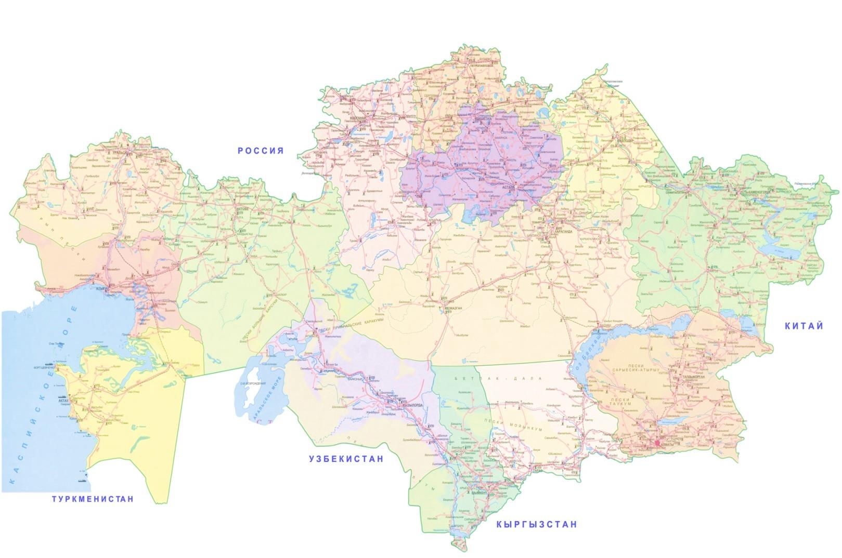
1. «Western Europe – Western China» / 2. CENTER-SOUTH, CENTER-WEST AND CENTER-EAST
Western Europe – Western China
Astana– Ust’-Kamenogorsk
2009-2015
2 452
km, including:
2013-2020
948
km, including:
I – technical category – 1 391 km
I I - technical category – 1 061 km
I – technical category – 427 km
I I – technical category – 521 km
Pavlodar
ASTANA
Ust’-Kamenogorsk
Aktobe
Semey
Karabutak
Astana– Almaty
2013-2019
I – technical category - 1 318 km
Beineu
Aralsk
Aktau
Kyzylorda
Taraz
Khorgos
Astana– Aktau (construction of new 500 km)
2013-2020
1 527
km, including:
I – technical category – 140 km
I I - technical category – 1 387 km
Almaty
Shymkent
By 2020 the volume of automobile transport transportations will increase by 1,5 times (1,56 mln. tons).
Ending:
Western Europe – Western China – 2015
CENTER-SOUTH – 2019
CENTER-WEST - 2020
CENTER-EAST – 2020
5

Slide 6
Concession project - Big Almaty Ring Road
Length – 65,5 km;
Technical category – Iа with 4/6 band movement;
Expected intensity – 38 628 vehicle/day
Estimated speed of movement – 150 km/hour
As a part of the project: traffic intersections - 8 bridges – 21 platforms - 2 overpasses – 18 water throughput pipes - 168 crossings with highways – 19 crossings with railway - 2 power lines – 78 flattening of water utilities – 2 км communication lines – 47 gas pipelines – 10 water supply systems – 20 sewerages – 3 slime pipelines – 3
Kapshagai
Project parameters
KHORGOS
Almaty
Talgar
Bishkek
Big Almaty Ring Road
Republican roads
Western Europe – Western China
Structure of concession
BTO (construction-transfer-operation)
Terms of concession – 30 years:
2015-2019 construction
2019-2044 operation
6

Slide 7
Railway transport
ZHEZKAZGAN – BEINEU
ARKALYK – SHUBARKOL’
5,6 thousand km of railways will be modernized till 2020
ЖЕЗКАЗГАН – БЕЙНЕУ
Length– 1036 km
Volume of transportations by 2026 – 21,3 mln. tons
Realization term– 2016
АРКАЛЫК – ШУБАРКОЛЬ
Length– 214 km
Volume of transportations by 2023 – 8,6 mln. tons
Realization term – 2015
ASTANA
Arkalyk
Shubarkol’
Shalkar
Aktogai
Moiynty
Zhezkazgan
Beineu
Saksaul’skaya
Dostyk
New second transition with China
Yeraliyevo
Korgas
Kuryk
Zhrtygen
Uzen
ALMATY
UZEN’ – BOLASHAK
ZHETYGEN– KORGAS
Exit to the Persian Gulf
Total length – 926,5 km, including:
Kazakhstan– 146 km;
Turkmenistan – 700,5 km;
Iran – 80 km.
Total length– 579 km, including:
Kazakhstan– 293 km;
China – 286 km.
existing
realizing
realized projects
6

Slide 8
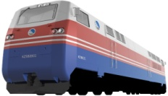
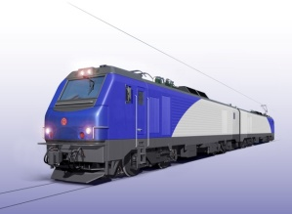
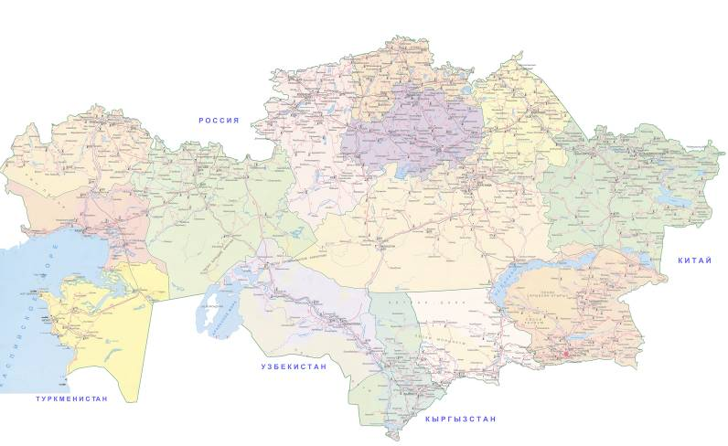
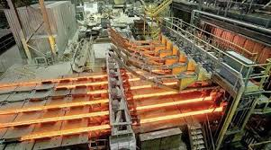
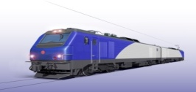
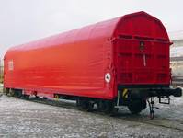
MECHANICAL ENGINEERING PROJECTS IN RAILWAY SECTOR
Locomotive assembly plant
Electric locomotives production plant
Freight cars production plant in Petropavlovsk
Talgo Passenger cars production plant
launch– December, 2012
investments volume– 18,2 bln. KZT
localization level by 2016 – 50%
design capacity – 100 sections
was produced in total – 16 units
launch– 2009
investments volume– 1,5 bln. KZT
localization level by 2016 – 40%
design capacity – 900 units
was produced in total – 1401 units
launch– December, 2011
investments volume– 9,8 bln. KZT
localization level by 2016 – 58%
design capacity – 150 units
was produced in total – 212 units
launch–July, 2009
investments volume– 16,6 bln. KZT
localization level by 2016 – 52%
design capacity – 100 units
was produced in total – 258 units
investments volume – 49,4 bln. KZT
design capacity – 430 thousand tons ( 200 thousand tons - rails, 230 thousand
tons – sort hire)
realization term – IV quarter, 2014
Rails production plant in Aktobe
Freight cars production plant in Ekibastuz
Petropavlovsk
Ekibastuz
launch– 2011
investments volume– 7,2 bln. KZT
localization level by 2016 – 54%
design capacity – 2500 units
was produced in total – 3488 units
Aktobe
Astana
2008 – 2013
2013 – 2020
Locomotives
Purchased
913 units
Will be purchased
632 units
By 2020 decrease in wear of a rolling stock will be up to
40 %
(standard level)
Freight cars
Purchased
35 thousand
units
Will be purchased
18,5 thousand
units
Passenger cars
Purchased
937 units
Will be purchased
1 201 units
7

Slide 9
Development of civil aviation
Geography of flights
Reconstruction of all
18 airports
EU – 8 routes
CIS – 49 routes
Aircraft park will be modernized by new aircrafts
Asia-South - 27 routes
Development of the airports
12 from 18 airports have an ICAO category
By 2020 all 18 airports will have ICAO category
In 2013 14 new international routes were opened;
In 2014 it is planned to open 13 new international routes;
In 2015 it is planned to open 13 new international routes.
By 2020 75 new international routes will be opened
8

Slide 10
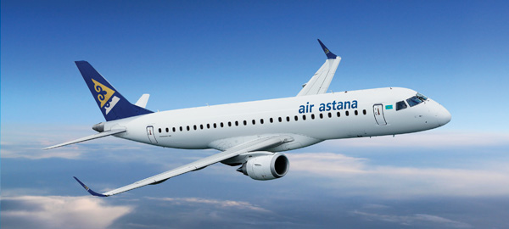
“Air Astana” air company
Aircraft park – 30 units
Average age – 6,5 years
Route network: domestic – 19 routes international – 41 routes
Staff – 4198 people.
4 stars rating and the Best Airline of Central Asia and India by Skytrax World Airline Awards 2013 (repeatedly after 2012)
Successfully certified IOSA for the fourth time (the IATA Operational Safety Audit)
Since April 10, 2014 the limits on flights to EU countries are lifted
РОСТ ПАССАЖИРОПОТОКА
3,6 млн.
2,8 млн.
3,2 млн.
12,5%
14%
9

Slide 11
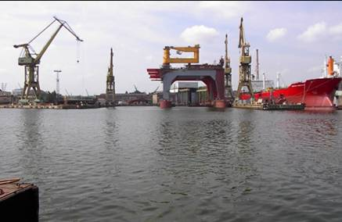
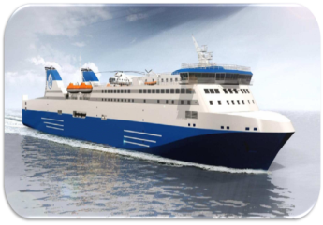
Water transport
Extension of Aktau port in the northern direction
Dredging of the water area
Construction of 3 Dry-cargo Terminals
Cost: $ 20 mln.
(own means)
Ending: March, 2015
Cost : $ 126 mln.
(private investments)
Ending: 2015
Finishing of power of port to 20,5 mln. tons by 2020
Purchase of vessels of navy
3 dry-cargo vessels
2 universal ferries
Period of realization: 2014-2020
Cost – $ 110 mln.
Increase in a share of Kazakhstan in sea transportation of freights to 70% by 2020 (58% - 2012 )
10

Slide 12
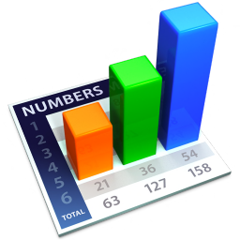
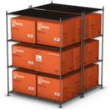
Economic efficiency of development of transport sector
Reconstruction and repair of 30 thousand km of motor roads and 5,6 thousand km of railways
40
100 % of bus stations, autostations, railway stations will conform to standards
LPI
86
Realization of about 200 projects, for 28,6 bln. US dollars
Motor roads $ 13 bln.
Railway sector $ 12,6 bln.
Civil aviation $ 2,4 bln.
Water transport $ 0,57 bln.
Automobile transport $ 12 mln.
100% ensuring transfer of all types of freights through Aktau port
On period of realization of project
220 thousand
people
100%
of the airports of the regional centers, Astana, Almaty, Semey and Zhezkazgan will conform to ICAO requirements
788
Increase of goods turnover
(bln. tkm)
30
Mln. tons
Transit
For about 2
bln. US dollars
1,6 times
100% ensuring requirement of economy in TLC of A class
478
345,8
Increase of passenger turnover
(bln. tkm)
Twice
1,5 times
231,1
11

Slide 13
Thank You for attention!
Автор: Олжас Баржаксынов

