Slide 1
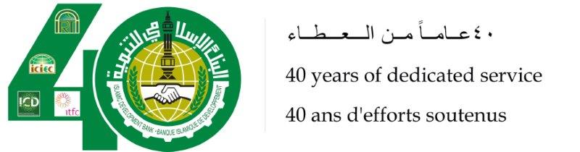
Developing Transport Corridor and Energy Infrastructure in Central Asia
Dushanbe, Republic of Tajikistan
Monday October 27th, 2014 (Muharram 3rd, 1436H)

Slide 2
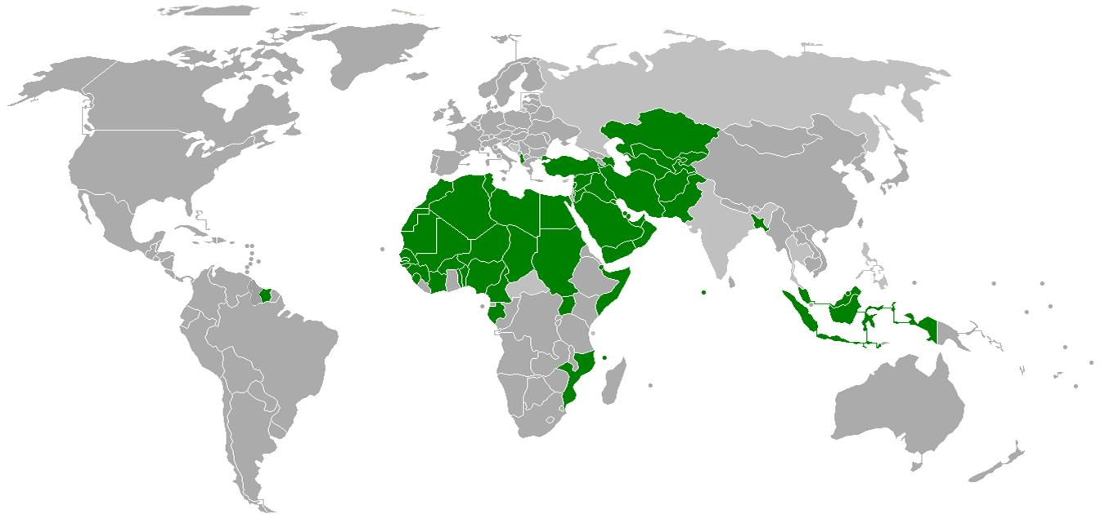
IDB Membership
Europe: 2
Asia: 26
Africa: 27
Africa: 27
Latin America: 1
IDB Member Countries are 56 countries
In Central Asia (Afghanistan, Azerbaijan, Kazakhstan, Kyrgyz Republic, Tajikistan, Turkmenistan and Uzbekistan)

Slide 3





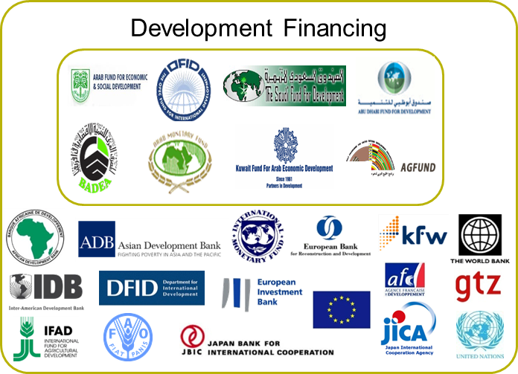
























IDBG Partners
Economic Development Cooperation
Islamic Finance-Economy
Working with over 100 Partners world-wide

Slide 4
IDB Infrastructure: Key Focus Area
Transport:
Development of International Transport Corridors
Improve Transport Infrastructure
Increase Accessibility
Energy:
Regional Interconnection
Energy Efficiency Enhancement
Renewable Energy
Access and Rural Electrification
Urban Development and Services
Access to clean water and sanitation services
Improve health conditions and standards of living
Increase accessibility/affordability of housing for low-income populations
Public-Private Partnerships (PPP)
Energy and Transport Infrastructure
Leverage IDB’s participation through partnerships
  Advisory services focused on project development

Slide 5
IDB Infrastructure Portfolio
IDB Infrastructure:
Sector-wise Portfolio Distribution
Aggregate Infrastructure Financing Since Inception
Significant Scale Up (2006-14)
US$29 billion
US$21.5 billion
* Total Approvals less Cancellations

Slide 6
Transport Strategic Objectives in Central Asia
Central Asia geographic location (between East Asia and Europe/Middle East)
Competitive Corridors (cost, time)
Long distance multimodal transports services (Roads, Railway and Ports)
Logistics infrastructure
Facilitation of Cross-Border movement
Global partnerships in financing infrastructure
Central Asia Regional Economic Cooperation (CAREC)

Slide 7
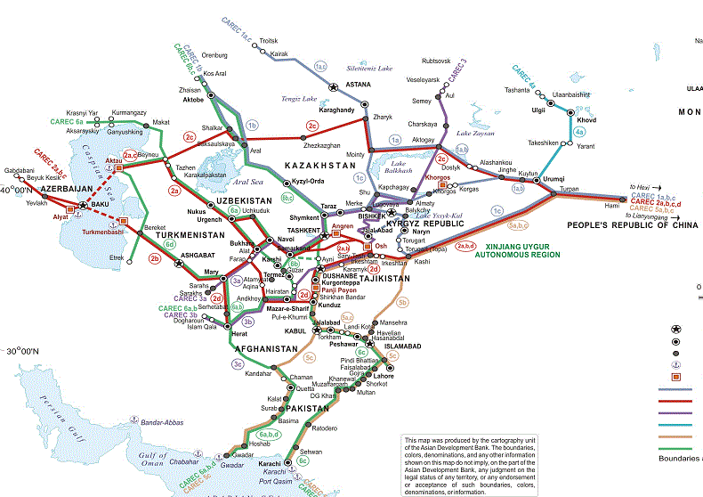
CAREC Corridors

Slide 8
IDB Intervention in Transport
Total IDB financing in Transport infrastructure in Central Asia is around USD 1.5 billion
Development Objectives:
  Reduce transportation cost to improve competitiveness
  Facilitate movement of goods & people to induce economic growth
  Provide sustainable, safe and environmentally friendly transport and trade networks
  Support complimentary investments (logistic centers, border crossing improvements and road maintenance)
  Provide access to health and education services

Slide 9
IDB Intervention in Transport
Major projects financed by IDB:
Tajikistan:
Taraz-Talas Road / Shagon-Zigar Road
Afghanistan:
Doshi to Pol-e-Khumri Road
Azerbaijan:
Yevlakh to Ganja Road (M2)
Kazakhstan:
Western Europe - Western China Corridor (Oblast-Taraz Section)
Kyrgyz Republic:
Taraz-Talas, Road / Bishkek-Torugart Road
Turkmenistan:
Turkmenistan-Iran Border Railway (North –South Corridor)
Uzbekistan:
Upgrading of M39 Tashkent-Termez Road, Uzbekistan
Western Europe-Western China International Road Corridor
  CAREC Transport Corridor 6b

Slide 10
Energy Strategic Objectives in Central Asia
Natural resources (oil, gas and hydro)
Electricity export potential
Improve Energy Efficiency
    Combined Cycle Power Plants
    Reduce Transmission Losses - Rehabilitations
    Reduce Commercial Losses – Smart Metering
    Reduce Demand Side – Energy Efficiency Lights
Renewable Energy (Solar, Wind, MiniHydro and Waste to Energy)

Slide 11
IDB Intervention in Energy
Total IDB financing in Energy infrastructure in Central Asia is around USD 1.0 billion
Tajikistan:
Regional Power Interconnection Tajikistan-Afghanistan
Mini-Hydro power Stations
Azerbaijan:
Janub Combined Cycle Power Plant
Baku Waste to Energy
Kyrgyz Republic:
220kV / 110kV Transmission Lines, Improvement of Electricity in Bishkek and Batken
Uzbekistan:
Improvement of Street Lights Tashkent
Modernization of Hydropower Stations
Advanced Electricity Metering System

Slide 12
THANK
YOU
معا ً نبني مستقبلا ً أفضل
TOGETHER WE BUILD A BETTER FUTURE
ENSEMBLE NOUS CONSTRUISONS UN AVENIR MEILLEUR

