Slide 1
Minister of transport
of the Republic of Tajikistan
Khayrullo Asozoda
27/10/2014

Slide 2
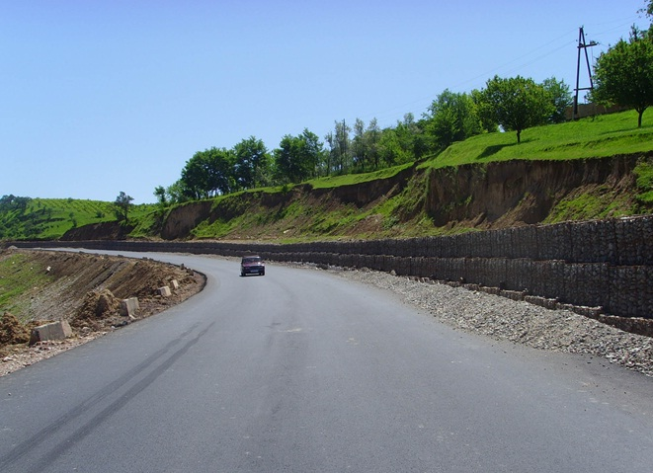
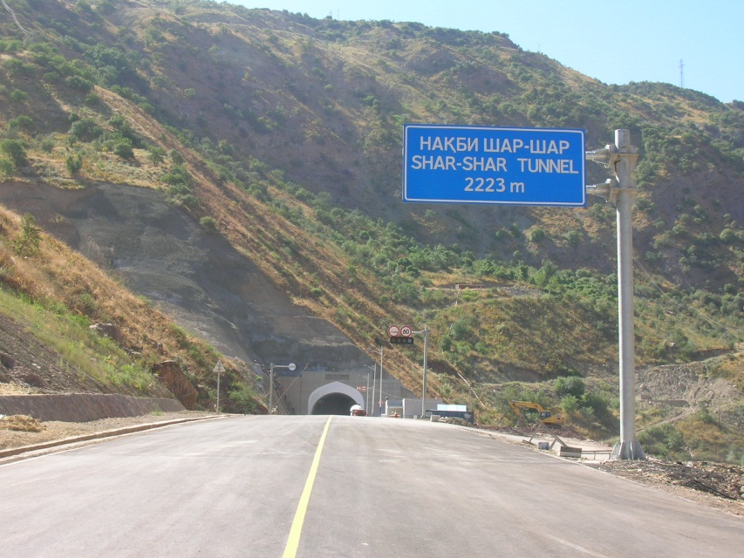
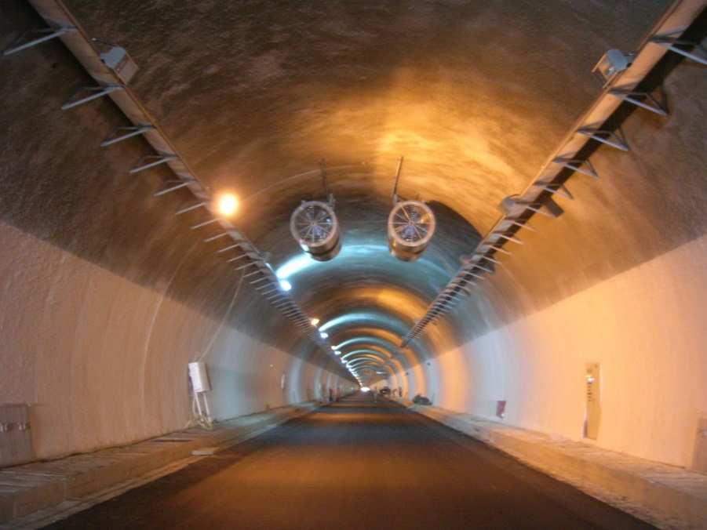
28 realized projects by total amount of 1.37 billion US dollars

Slide 3
Participation of Tajik citizens in realization of projects

Slide 4
Investment chart in USD
1 037,6 млн
536,0 млн

Slide 5
Works done under the projects:
1700 km of international roads
Hundred bridges
31 km of tunnel and avalanche galleries

Slide 6
Investments for projects (16 projects)

Slide 7
Outcome of 16 ongoing projects :
400 km roads
More than 50 bridges
will be operated

Slide 8
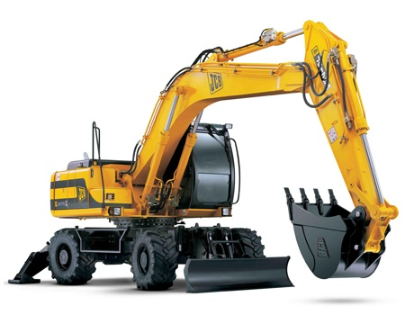
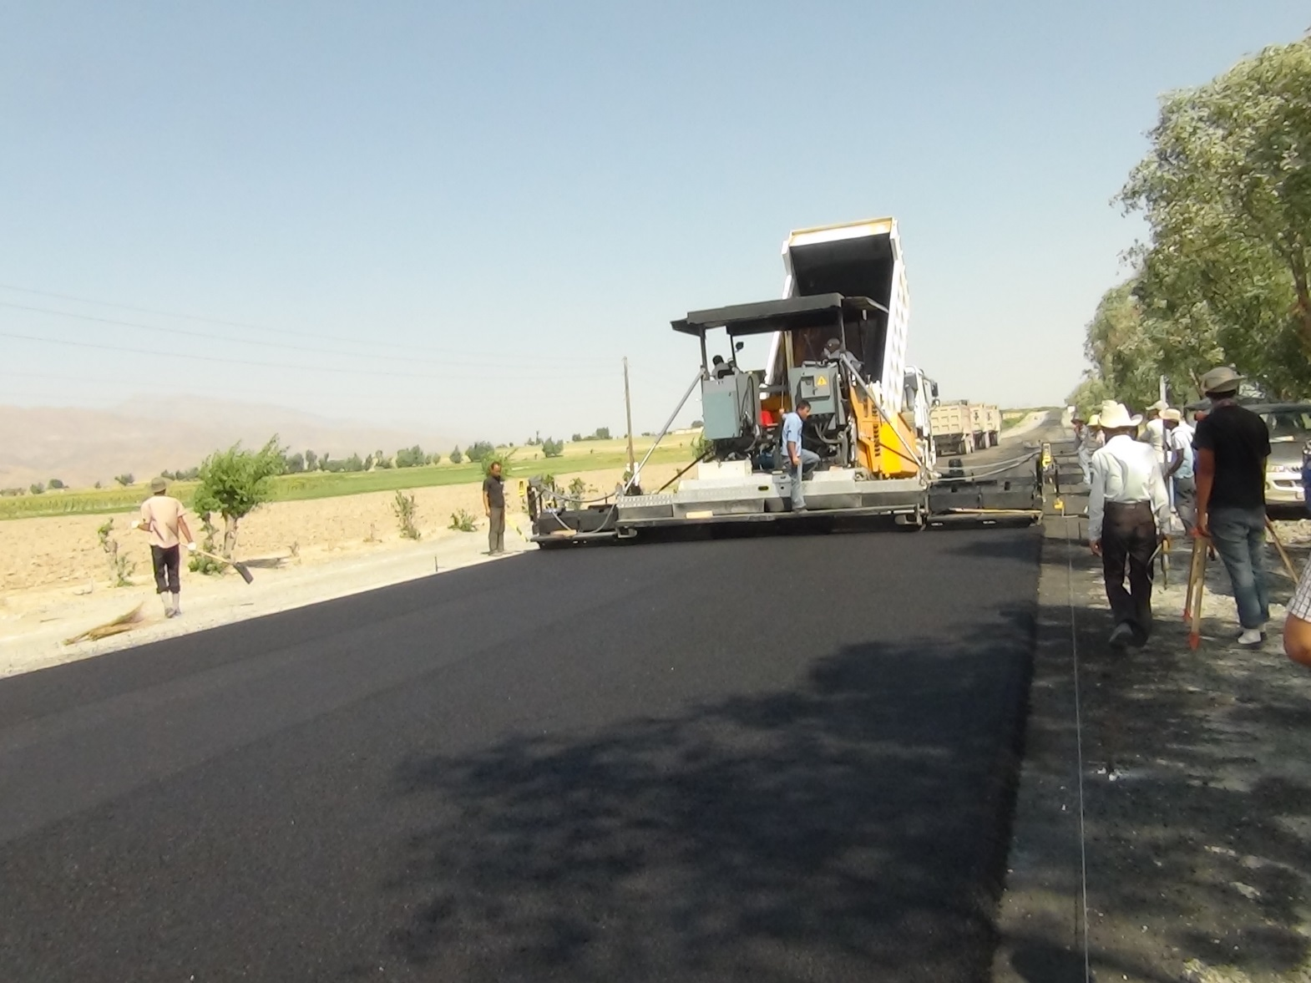
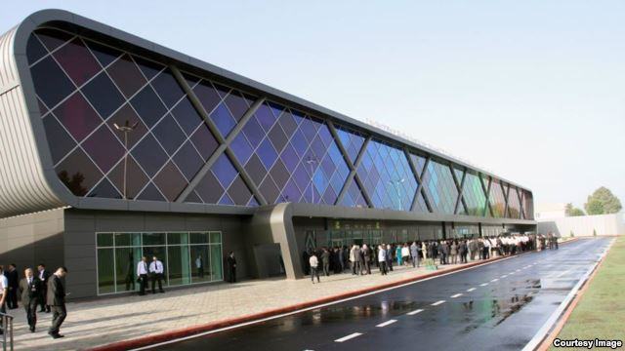
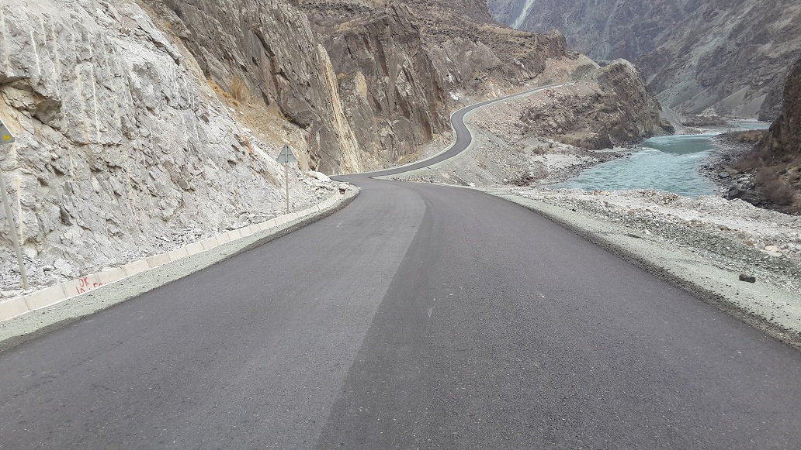
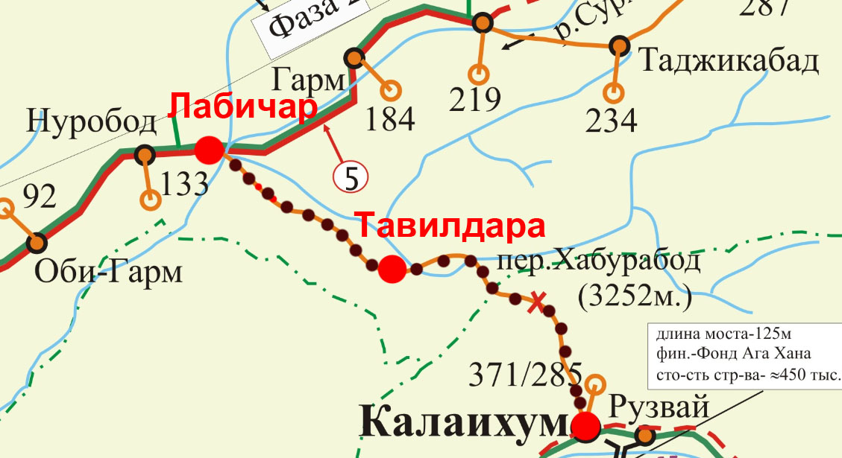
Projects to be realized by the end of 2014
4. Feasibility study of Labi Jar-Tavildara road
2. Construction of new passenger terminal at Dushanbe international airport
3. Road maintenance equipment and machinery supply
1. Shagon-Zighar road construction Phase 3
5. Rehabilitation of Dusahnbe –Dangara Phase 3, Dangara-Kangurt

Slide 9
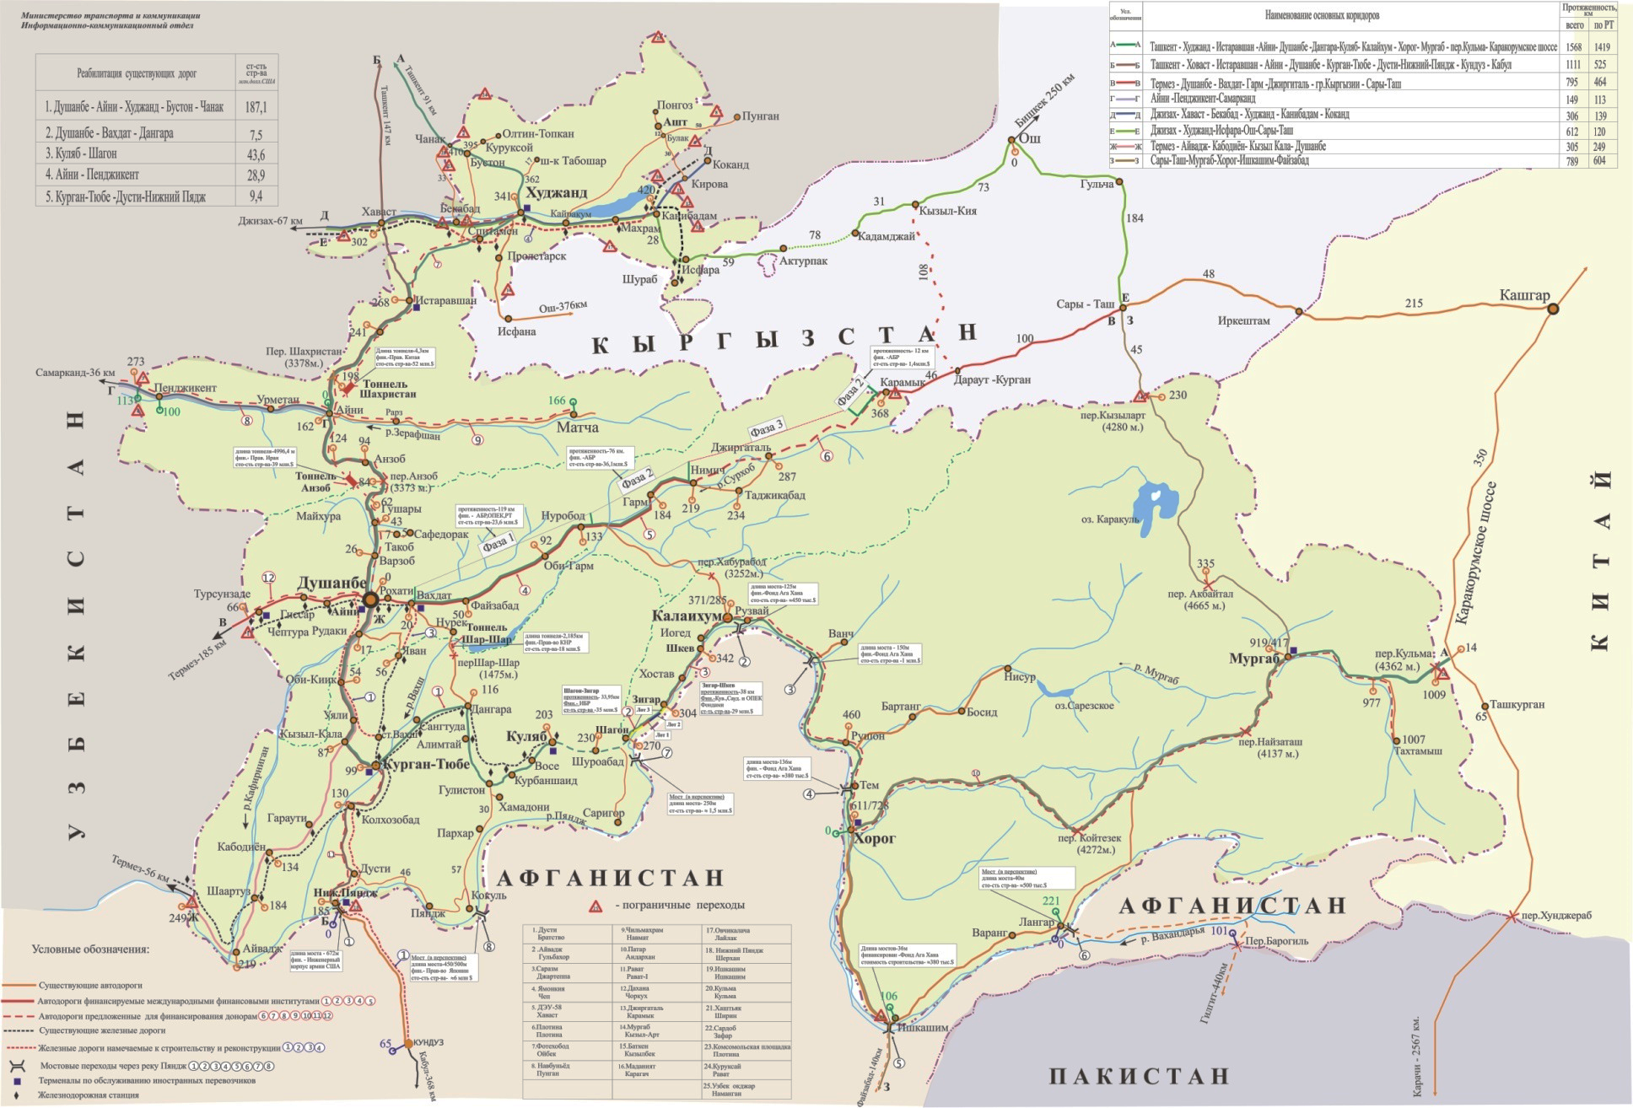
International roads
Khujand
Khavast
Kyrgyz border
Rasht
Tursunzoda
Murghab
Kulma
Panji Poyon

Slide 10
Donor countries cooperation
Japan
France
Iran
China
USA

Slide 11
Cooperation with Financial Institutionas
Abu Dhabi Fund
Saudi Development Fund
Aga Khan Foundation
Asian Development Bank
Islamic Development Bank
Kuwait Fund of Arab Economic Development
European Bank of reconstruction and Development

Slide 12
Investment funds of Islamic Banks (million USD)

Slide 13
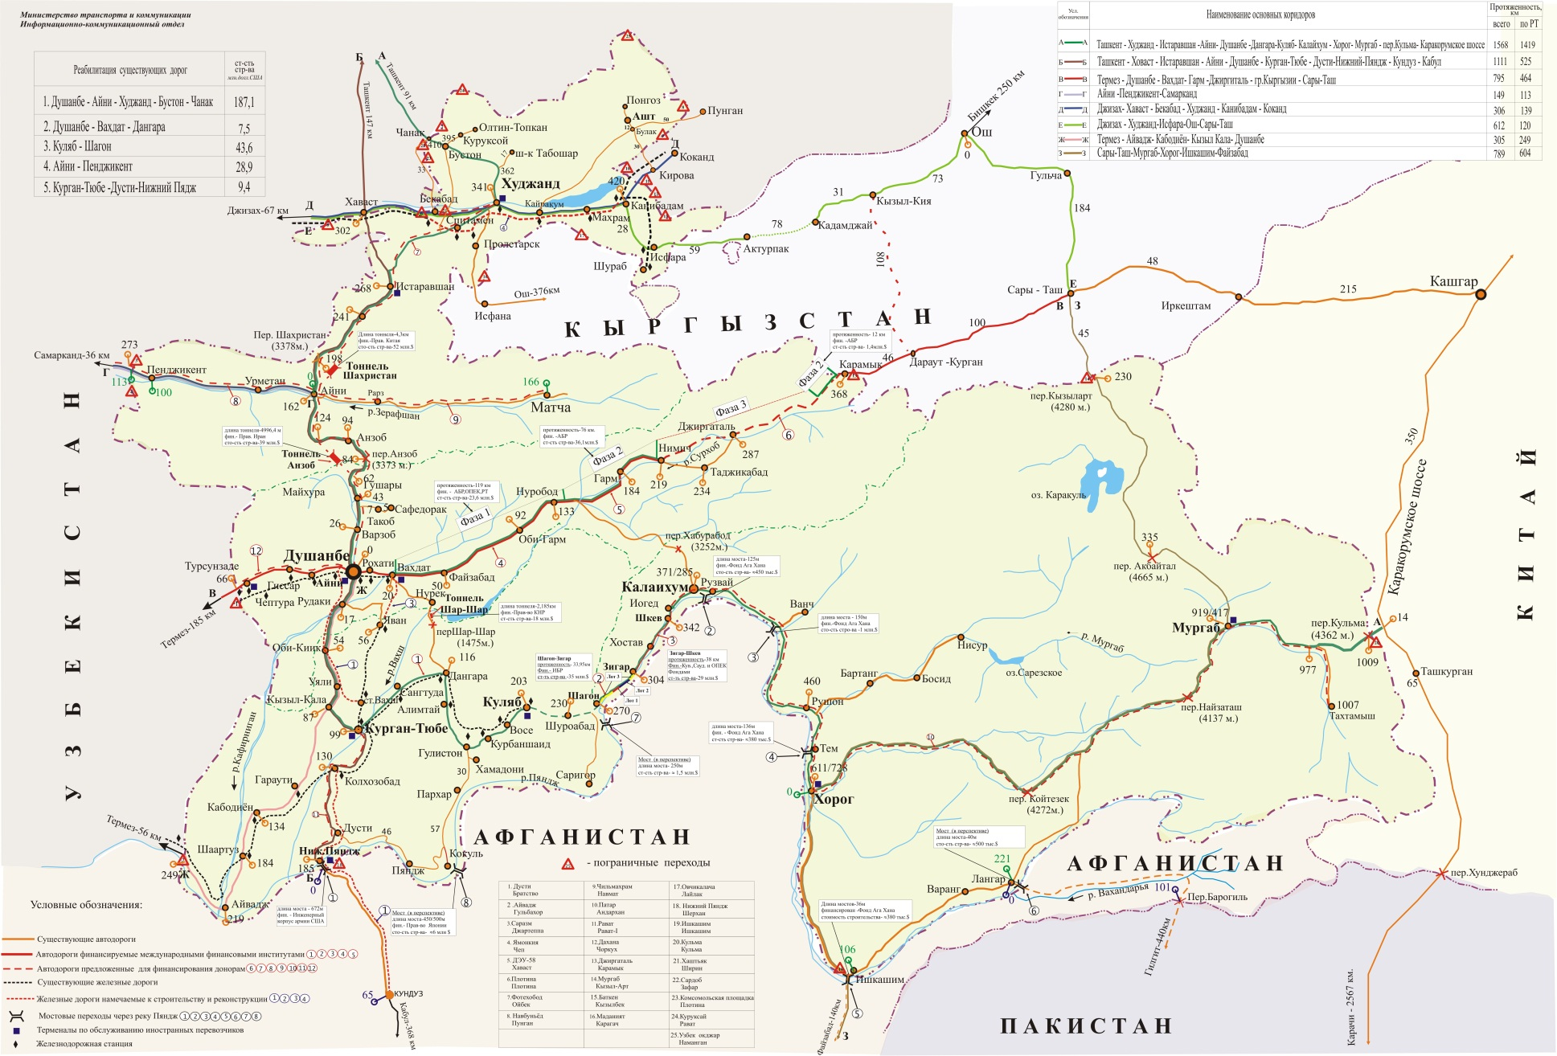
Asian highway (AH)
Khujand
Khavast
Kyrgyz border
Rasht
Tursunzade
Murgab
Kulma
Panji Poyon

Slide 14
Khujand
Khavast
Kyrgyz border
Рашт
Tursunzoda
Murgab
Kulma
Panji Poyon

Slide 16
International transport

Slide 17
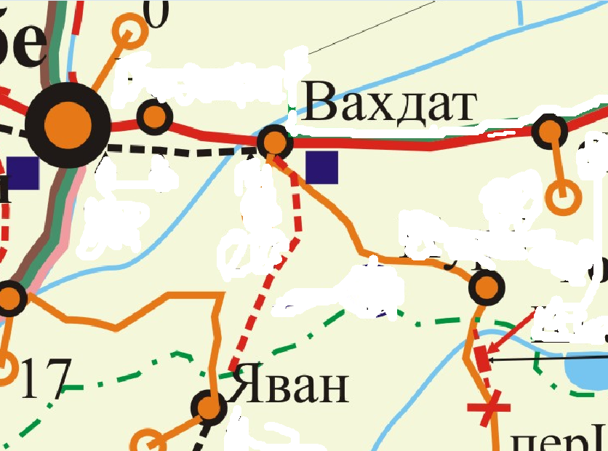
Роҳи оҳани Ваҳдат-Ёвон

Slide 18
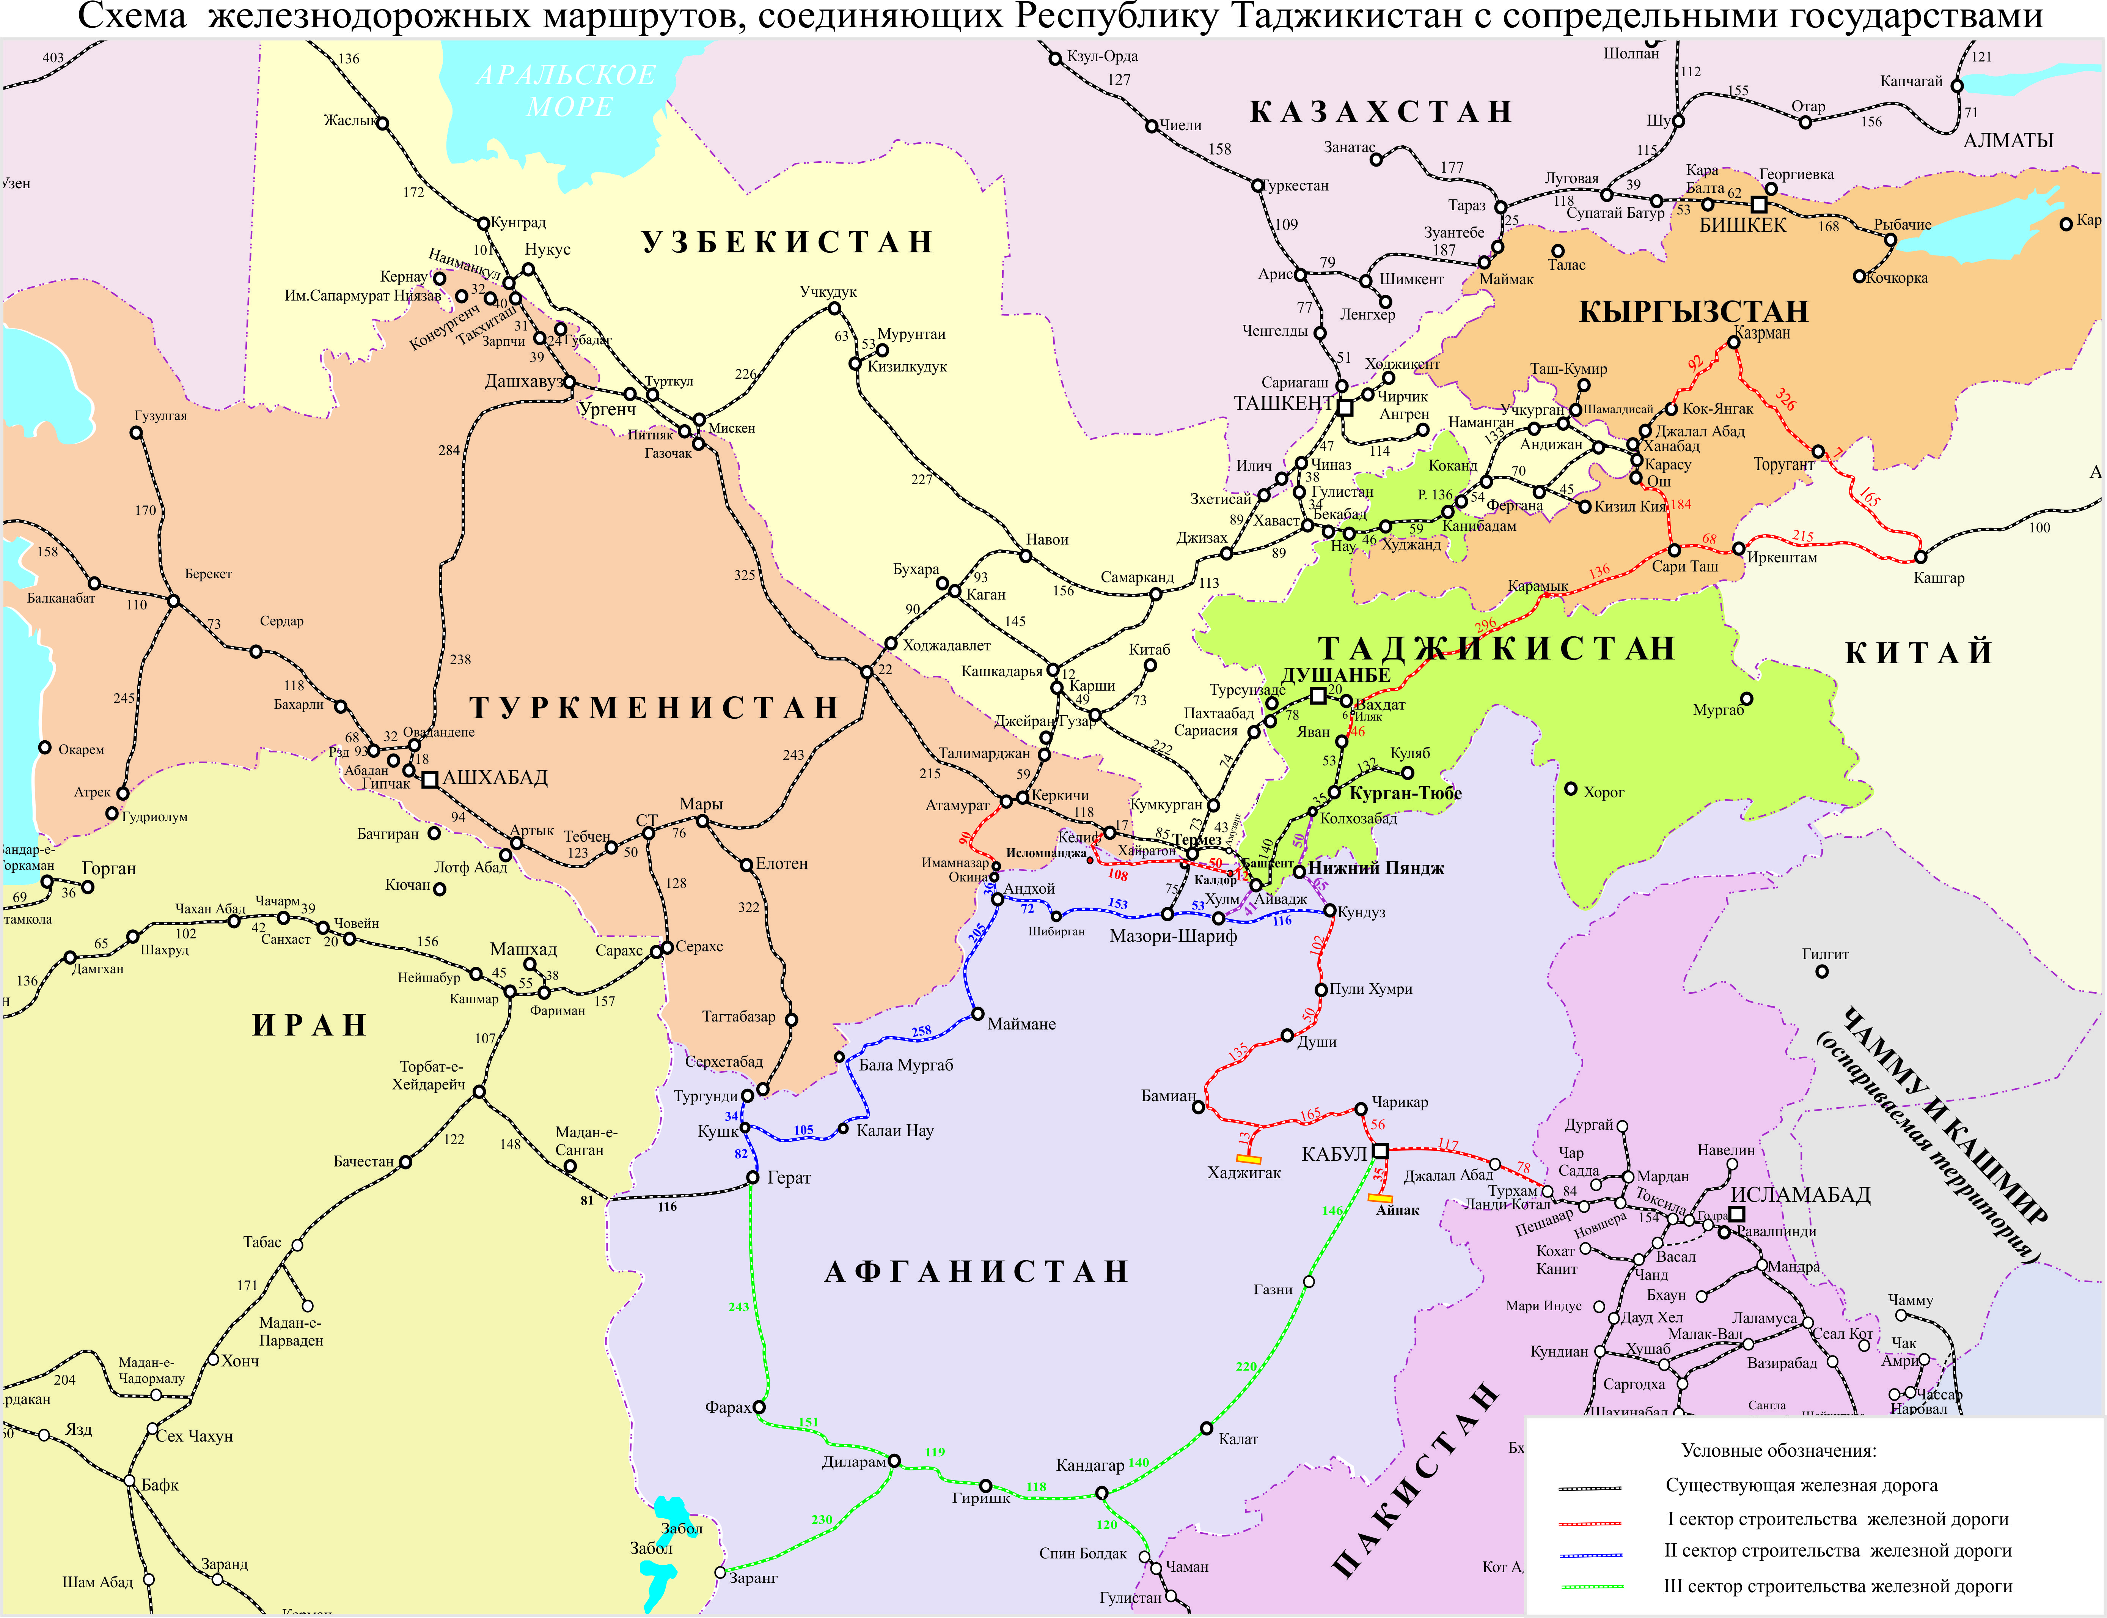
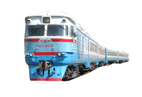
TAJIKISTAN
TURKMENISTAN
AFGHANISTAN

Slide 19
CIVIL AVIATION SECTOR
Хуҷанд- Красноярск
Хуҷанд- Сургут
Хуҷанд- Нижневартовск
Хуҷанд- Санкт-Петербург
Хуҷанд- Москва
Хуҷанд- Урумчи
Хуҷанд- Оренбург
Хуҷанд- Екатеринбург
Хуҷанд- Новосибирск
Хуҷанд- САМАРА
Хуҷанд- Иркутск
Хуҷанд- Тюмень
Душанбе- Дели
Душанбе- Сургут
Душанбе- Машҳад
Душанбе- Оренбург
Душанбе- Шарҷа
Душанбе- Санкт-Петербург
Душанбе- Тюмень
Душанбе- Киев
Душанбе- Новосибирск
Душанбе- Иркутск
Душанбе- Нижневартовск
Душанбе- Иркутск
Душанбе- Екатеринбург
Душанбе- Москва
Душанбе- Истамбул
Душанбе- Бишкек
Душанбе- Дубай
Душанбе- Урумчи
Душанбе- САМАРА
Душанбе- Истамбул
Душанбе- Алматы
Душанбе- Франкфурт
Душанбе- Красноярск
Душанбе- Сочи
Кӯлоб-Москва
Кӯлоб-Санкт-Петербург
Қурғонтеппа-Москва

Slide 20
Disbursement of funds for road maintenance and capital construction
Parameter | 9month of 2013, million TJS | 9-months of 2014, million TJS | Difference (+,-)
Capital construction | 7,8 | 10,0 | +2,2
State budget allocation for maintenance and repair | 45,3 | 51,7 | +6,4
Local budget allocations | 4,2 | 5,6 | +1,4
Private sector investments | 3,2 | 27,3 | +24,1

Slide 21
State budget investment
(million TJS)
57,3
34,0
18,1

Slide 22
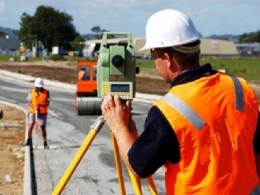
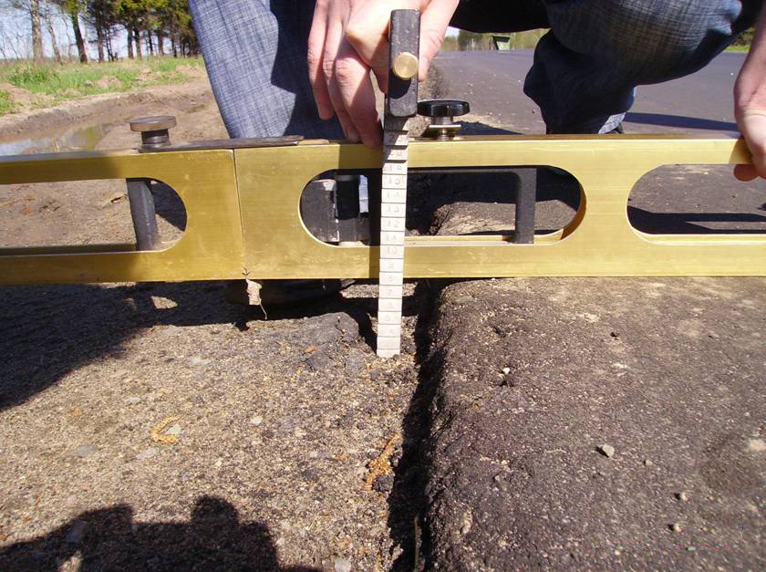
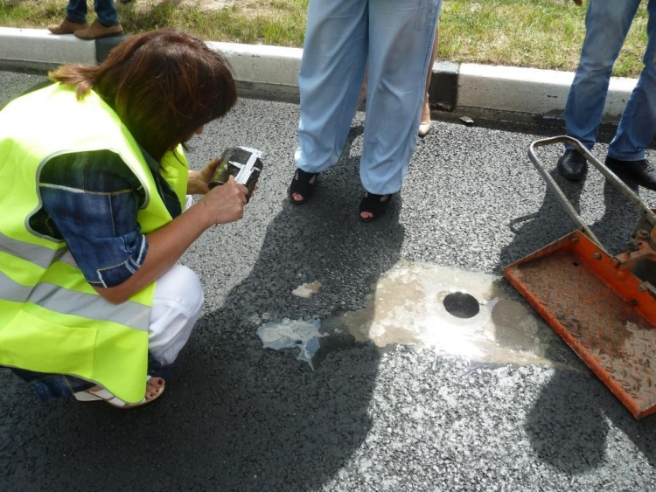
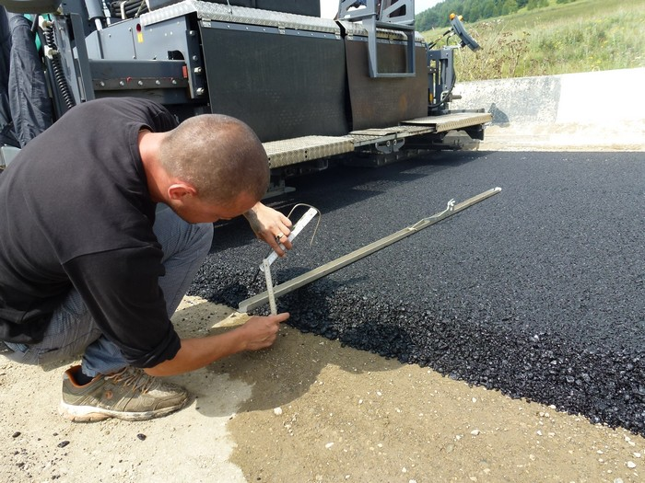
Work acceptance according to quality parametres

Slide 23
Priority projects
Rehabilitation of Bekobod-Khujand-Konibodom-Isfara-Kyrgyz border
Tajikistan-Afghanistan-Turkmenistan railway construction
Rumi (Kolkhozabad)-Panji Poyon-Qunduz railway construction
Construction of Kulyab-Kalaikhum, road Kulyab –Shurabad section
Construction of Kulyab-Kalaikhum road, Shkev-Kalaikhum section
Rehabilitation and reconstruction of Rumi (Kalkhazabad) – Qabodiyon – Shahritus – Ayvaj- Mazori Sharif
Rehabilitaion pf Guliston-Farkhor-Panj-Dusti road

Slide 24
THANK YOU

