Slide 1

ICD support for the SMEs of EE& Central Asia
By Samir Taghiyev, Senior Regional Manager, CIS and Europe countries
Business Development and Partnerships, Islamic Corporation for the Development of the Private Sector (ICD), IDB Group
OIC Investment Forum
October 28,2014 – Dushanbe, Tajikistan

Slide 2
TABLE OF CONTENTS
ABOUT ICD
ICD’S INITIATIVES IN ADVANCING ISLAMIC FINANCE IN EE&CENTRAL ASIA
CASE STUDY
KEY CONTACTS

Slide 3
…WITH A FOCUS ON THE PRIVATE SECTOR
Overview
Key Financial Indicators
Established in 1999 and headquartered in Jeddah, the Kingdom of Saudi Arabia
Multilateral organization affiliated with and 44.7% owned by Islamic Development Bank (“IsDB”)
Complements the role played IsDB through the development and promotion of the private sector as vehicle for economic growth and prosperity
Invests in and finances private sector projects, in addition to providing advisory services to public and private sector actors in member countries
Purpose: To promote growth and development in member countries through the provision of Sharia compliant financing to feasible and viable private sector projects
  Currently 52 member countries from the Middle East, Africa, the Asia Pacific Region, South Asia, Europe and South America
  Regional representatives in IsDB offices in Kazakhstan, Malaysia and Senegal
  All financial transactions are in compliance with Islamic law (Sharia)
Close cooperation with international financial institutions such as IFC, AfDB, Arab Fund and OFID amongst others
As at November 2013 (US$ million)
Total Assets | 1,217
Authorized capital | 2,000
Paid-up capital | 799
Gross revenues | 87
Net Income | 24
Employees | 110
Member countries | 52 representing 1.5bn people
Ownership
Notes:
* Iran Foreign Investment Co.
** Public Investment Fund
ICD’s financial year is the lunar Hijrah year (11 days shorter than the solar Gregorian year)

Slide 4




















































…WITHIN ITS 52 MEMBER COUNTRIES
WEST & EAST AFRICA
EE& CENTRAL ASIA
Benin
Burkina Faso
Cameroun
Chad
Comoros Isles
Cote d’Ivoire
Djibouti
Gabon
Gambia
Guinea
Guinea Bissau
Mali
Mozambique
Niger
Nigeria
Senegal
Sierra Leone
Sudan
Uganda
Albania
Azerbaijan
Kazakhstan
Kyrgyzstan
Tajikistan
Turkey
Turkmenistan
Uzbekistan
EAST ASIA
Bangladesh
Brunei
Indonesia
Malaysia
Maldives
Pakistan
South America
MENA REGION
Suriname
Algeria
Bahrain
Egypt
Iran
Iraq
Jordan
Kuwait
Lebanon
Libya
Mauritania
Morocco
Palestine
Qatar
Saudi Arabia
Syria
Tunisia
U.A.E
Yemen
52 Member Countries, representing 1.5 billion people

Slide 5
ICD Offers Complete Bouquet of Islamic Finance and Investment Products…
OVERVIEW
NATURE
PRODUCTS
ICD provides growth capital in the form of Debt and Equity to clients for projects in industries other than financial sector
Equity Financing
Medium Term Debt Financing
Short Term Debt Financing
Mudaraba | Istisna
Murabaha | Ijara
Wakalah | Bai’ Muajjal
Bai Salam
Direct Investment & Financing
ICD extends its own reach by setting up, investing, financing and providing expert advice to other Islamic Banks in its Member Countries
Direct investment in Islamic Banks
Setting up Islamic Financial Institutions
Provide Lines of Financing
Direct Equity
Murabaha
Wakala
Ijara
Financial Institutions Development
ICD provides wide range of advisory solutions to its clients and establishes, develops and manages funds that support the growth of targeted sectors in its Member Countries
Infrastructure Advisory
IFI Advisory
SEZ Advisory
Sukuk Advisory
Private Equity Funds
SME and Income Funds
Project Development & Finance Advisory
Islamic Window & Bank Conversion Advisory
SEZ Setup Advisory | Sector Based Funds
Short /Long Term Sukkuk Advisory | Income Funds
Advisory & Asset Management

Slide 6
…Expanding Geographic Footprint AND ITS Sectorial Distribution
Investment Approvals since inception by sectors (%)
Focus on Growth of Financial Institutions
Contribute to expanding the range and improving the efficiency of supply of financial services to private enterprises, SMEs and individuals which results in multiplier effect in economic growth
Regional Focus, approvals by sectors (%)
Inception - 2010
Inception - 2013
Focus shifting away from pure MENA region investments
EE& Central Asian and Sub Saharan Countries offering high growth opportunities
Increased focus on developing and acquisition of regional expertise in Asia, EECA and SSA region
Sources: ICD Annual Report

Slide 7
TABLE OF CONTENTS
ABOUT ICD
ICD’S INITIATIVES IN ADVANCING ISLAMIC FINANCE IN EE&CENTRAL ASIA
CASE STUDY
KEY CONTACTS

Slide 8
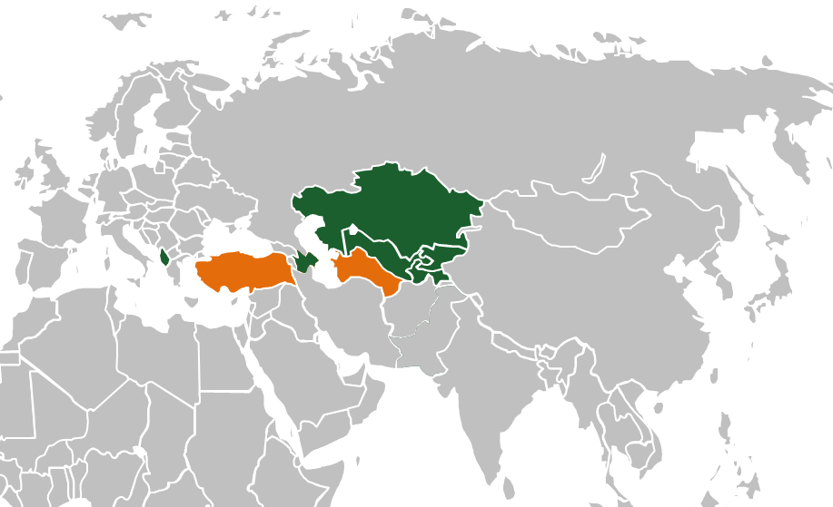

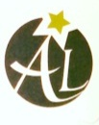




ICD’S OPERATIONS ARE SHIFTING TO EE & CENTRAL ASIA….
Summary of Activities – to date
Islamic Channels
Since inception, ICD approved 62 investments for a total capital commitment of US$ 642 million in East Europe and Central Asia.
ICD thus far has disbursed US$ 249 million for the whole of Easter Europe and Central Asia region
Eastern Europe and Central Asia region represents 19% of approvals among member countries since inception of ICD
ICD provided US$ 41.5 million as equity in Islamic leasing and investment companies in Central Asia only
Sectorial Breakdown – to date

Slide 9









ICD IS PLAYING KEY ROLE IN THE GROWTH OF ISLAMIC FINANCIAL INSTITUTIONS IN EE & CENTRAL ASIA…
To date, ICD has committed up to US$ 41.5 million in establishing Islamic Financial Institutions in Eastern Europe and Central Asia
6
1
Islamic Commercial Bank
Leasing
Companies
ASR LEASING
TAJIKISTAN
KYRGYZSTAN LEASING
ALBANIA LEASING
TURKEY LEASING
TURKMENISTAN LEASING
3
Pipeline
Sector
USD 80-100 Mn
Renewable Energy Fund
Specific Funds
Turkey Capital Markets Fund
Turkey Money Market Fund

Slide 10









…AND IN PROVIDING SHARIAH COMPLIANT CAPITAL TO SMEs THROUGH LOCAL FINANCIAL INSTITUTION
ACCUMULATED APPROVALS OF LINE OF FINANCE US$431 Mn SINCE INCEPTION | HIGHEST APPROVALS OF 36% TO EE & CA REGION SINCE INCEPTION | DISBURSALS EXTENDED TO 8 COUNTRIES SINCE INCEPTION
Being deployed

Slide 11



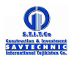

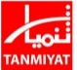





AS WELL AS TARGETING DIRECT FINANCING OPPORTUNITIES TO CORPORATES IN EE & CENTRAL ASIA REGION
To date, ICD has approved up to US$183 million on 23 projects using Shariah Financing in Eastern Europe and Central Asia countries
2
Corporate Equity deals
14
Term Finance
Approved
Equity in Kazakhstan
Equity in Azerbaijan
7
Corporate
Pipeline
Finance
Transactions

Slide 12
TABLE OF CONTENTS
ABOUT ICD
ICD’S INITIATIVES IN ADVANCING ISLAMIC FINANCE IN EE&CENTRAL ASIA
CASE STUDY
KEY CONTACTS

Slide 13
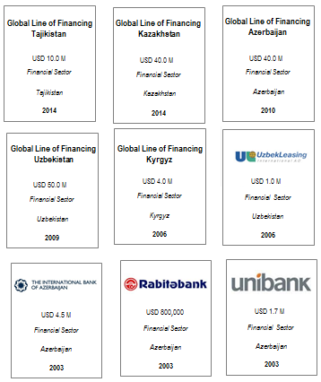
CASE STUDY-1: ICD SUPPORT FOR THE SMEs of EE& Central Asia
Capacity building
Line of Finance to provide Sharia compliant Funding
ICD is exploring establishment of SME Funds in EE & Central Asia countries
ICD is providing a technical assistance for capacity building in Islamic Finance
ICD is currently exploring establishment of Islamic Windows in local banks of EE & Central Asia countries
Line of Finance
ICD disbursed US$146 million as LoF to local banks in EE & Central Asia countries
Board of Directors of ICD approved LoF operations for a total amount of US$ 431 million
US$ 20 million to Azerbaijan, US$ 50 million to Uzbekistan, US$ 40 million to Kazakhstan and US$ 10 million to Tajikistan

Slide 14
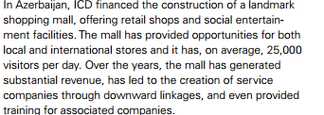
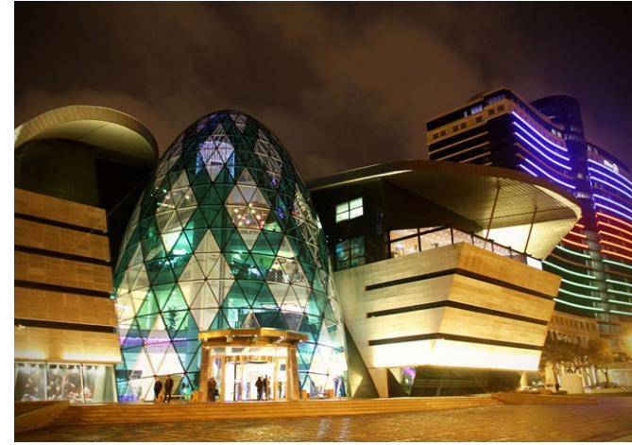
CASE STUDY-2: DIRECT FINANCING FOR PRIVATE SECTOR
DIRECT FINANCING
ICD is offering corporates in EE & Central Asia countries a direct financing opportunities
ICD team is helping corporates on structuring Islamic Finance deals
ICD is exploring corporates which needs technical assistance on issuance of Sukuk

Slide 15
TABLE OF CONTENTS
ABOUT ICD
ICD’S INITIATIVES IN ADVANCING ISLAMIC FINANCE IN EE&CENTRAL ASIA
CASE STUDY
KEY CONTACTS

Slide 16


KEY CONTACTS
Samir Taghiyev
Senior Regional Manager – Business Development & Partnerships
CIS and Europe Countries
Islamic Corporation for the Development of the Private Sector
Tel : +77058404204
E-mail: staghiyev@isdb.org
Enabling Enterprise - Building Prosperity

Slide 17
Enabling Enterprise - Building Prosperity
Disclaimer
© 2013-2014 ICD., a Multilateral Islamic Organization, based in Jeddah, Kingdom of Saudi Arabia, member of Islamic Development Bank Group. All rights reserved. The IDBG names & logos are registered trademarks. The information provided herein is confidential & for the sole use of intended recipient with discretion. Any other use, disclosures or reproduction of any information contained herein is strictly prohibited. This package & any additional information provided must be returned to ICD upon the request of ICD.

