Slide 1
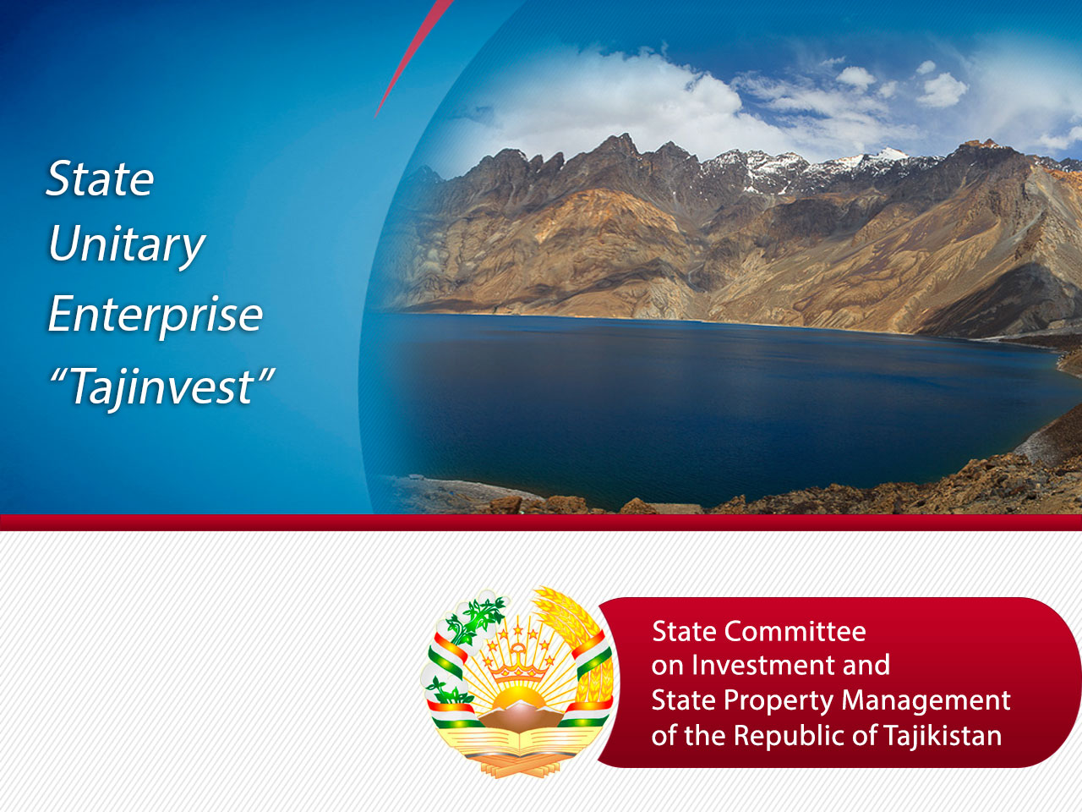
Zabirov Nekroy
General Director

Slide 2
SUE “TAJINVEST”
under the State Committee
on Investments and
the State Property Management
of the Republic of Tajikistan
is engaged in attraction
of foreign investments and promotion
in realization of investment projects
within the country
2

Slide 3
Coordination of Investment activity
Searching for projects, partners and contacts:
  Searching for the investment projects and/or partners on specified criteria;
  Studying of projects and/or partners and the feasibility of its inclusion to the database of investment projects and partners;
  Assistance in establishing contacts for the promotion of projects and business development, organization of meetings and talks.
Fundraising:
  Searching and organizing funding through international and domestic financial institutions;
  Management of financial instruments.

Slide 4
Assist in the management and promotion of investment projects:
  Representing clients interests for the project;
  Preparation of surveys and market research;
  Assist in strategic analysis and planning, preparation of documents for submission of projects (feasibility study, business plan, project summaries);
  Presentation of projects, organization of presentations, training seminars and business conferences.

Slide 5
International Cooperation
Searching for potential investors and attraction of foreign direct investments;
Consulting, lobbying and protection of the rights of foreign investors in the Republic of Tajikistan;
Organization and conducting of conferences, business forums, seminars and exhibitions with different subjects on the territory of the Republic of Tajikistan and overseas;
Organization and holding of annual meetings and forums;
Coordination of Bilateral Business Councils;
Permanent contact with foreign partners, coordinating the activities of Business Councils and sharing information on prospective projects in order to study their feasibility.

Slide 6
Information and promotion activities
Preparation and publication of promotional and information materials for presentation of investment opportunities in Tajikistan;
Creation of “Investor folders” on an annual basis;
Association with local and foreign media to promote the investment image of the Republic of Tajikistan;
Information support about carried out activities on investment theme in Tajikistan and abroad;
Creation of investment projects database.

Slide 7
Legal and consulting services
Providing with legal security tool for investment attraction and realization of investment projects in the Republic of Tajikistan;
Providing consulting services to support entrepreneurship in the Republic of Tajikistan;
Providing consulting services for signing contracts and receiving investment preferences;
Assistance in obtaining a license to employ foreign labor and employment permits for foreign workers;
Making visas;
Representation and protection of the interests of investors in government
Providing consulting services on business conducting to the representatives of private sector.

Slide 8
THE MAIN SERVICES
Practical attraction of investments;
Project development and its lobbying;
Partnerships with the private sector;
Cooperation with foreign companies;
Holding forums and conferences in the country and abroad;
Conducting marketing activities to promote investment opportunities in the country.
3

Slide 9
Today "Tajinvest“
in the framework of its
activities to offer investment
projects in all sectors
4

Slide 10

Agriculture

Slide 11
Investment Project №1
The open company of “Asht-Mohi” — organizations of livestock cattle farms for cultivation of sheep and their realization in the republic markets
The name of the project
Territory of project realization
Sughd region, Asht district, Republic of Tajikistan
Purpose of the project
Breeding sheep and goats and the realization of meat products
Initial production capacity per year - 300 small ruminants
Manufacturers of sausage products and meat semifinished products
Local catering (cafes and restaurants)
Local markets
Target consumers
The Total project cost
300 000 USD
Amount of own funds
and credit needs
The volume of equity - 50 000 USD
The required amount of credits - 250 000 USD
The estimated payback period of the project
3 years
Notes
Number of working places – 20 people;
The initial volume of production per year is 300 heads of small cattle
6

Slide 12
Investment Project №2
The name of the project
PRODUCTION COOPERATIVE "FAIZI DYER” —
development of cattle-breeding (sheep breeding).
Territory of project realization
Matcha district of the Sughd region of Tajikistan (North)
Purpose of the project
increasing the number and improving the productivity of livestock
farming, meat and milk processing
Target consumers
Population Sughd region of Tajikistan
The Total project cost
388 053 USD
Amount of own funds
and credit needs
The volume of equity – 14 500 USD
The required amount of credits – 373 553 USD
The estimated payback period of the project
5 years
Notes
Number of working places – 25 people;
7

Slide 13
Investment Project №3
The name of the project
FARM ENTERPRISE “CHINOR” —
development of beekeeping and livestock
Territory of project realization
Khatlon region, Yavan district, Republic of Tajikistan
Purpose of the project
production of high-quality honey
the increase in livestock
Target consumers
Population of the Republic of Tajikistan
The Total project cost
511 000 USD
Amount of own funds
and credit needs
The volume of equity – 403 614 USD
The required amount of credits – 107 386 USD
The estimated payback period of the project
3 years
Notes
Number of working places – 11 people
10

Slide 14
Investment Project №4
Non-GOVERNMENTAL PUBLIC ASSOCIATION "COUNCIL of RUSSIAN COMPATRIOTS, KULOB — Fish farming in the area of 10 hectares, and the establishment of poultry farms on cultivation of chickens and turkeys
The name of the project
Territory of project realization
Khatlon region, Kulob, Republic of Tajikistan
Purpose of the project
Creating a bird factory for growing chickens and turkeys
Organization of fish farm
Target consumers
Products are sold in the markets, in Kulob city and the nearest regions
The Total project cost
4 000 000 Euro
Amount of own funds
and credit needs
The volume of equity – 150 000 Euro
The required amount of credits – 3 850 000 Euro
The estimated payback period of the project
5 years
Notes
Number of working places – 50 people
41

Slide 15
Investment Project №5
The name of the project
FARM ENTERPRISE “KHUSRAVI KHUDOIBERDI” — the production and development of fish-breeding; the opening of the canning shop
Territory of project realization
Khatlon region, Vakhsh district, Republic of Tajikistan
Purpose of the project
production of canned vegetables and juices
the production and development of fish-breeding
Target consumers
Population of the Republic of Tajikistan, as well as exports to CIS countries
The Total project cost
44 000 USD
Amount of own funds
and credit needs
The volume of equity – 10 000 USD
The required amount of credits – 34 000 USD
The estimated payback period of the project
3 years
Notes
Number of working places – 12 people;
Annual income 40 000 USD
14

Slide 16
Investment Project №6
The name of the project
AGRICULTURAL PRODUCTION COOPERATIVE "DEHQON” — processing of all kinds of seeds and seed Treater PS-5 "Farmer" for seed treatment
Territory of project realization
Sughd region, Zafarobod district, Republic of Tajikistan
Purpose of the project
Processing of all kinds of seeds and seed treater PS -5 "Farmer" for seed treatment
Target consumers
in 45 cities and districts of the 68 existing agricultural producers in the Republic of Tajikistan
The Total project cost
32 700 000 USD
Amount of own funds
and credit needs
The volume of equity – 600 000 USD
The required amount of credits – 32 100 000 USD
The estimated payback period of the project
5 years
Notes
Number of working places – 650 people
43

Slide 17
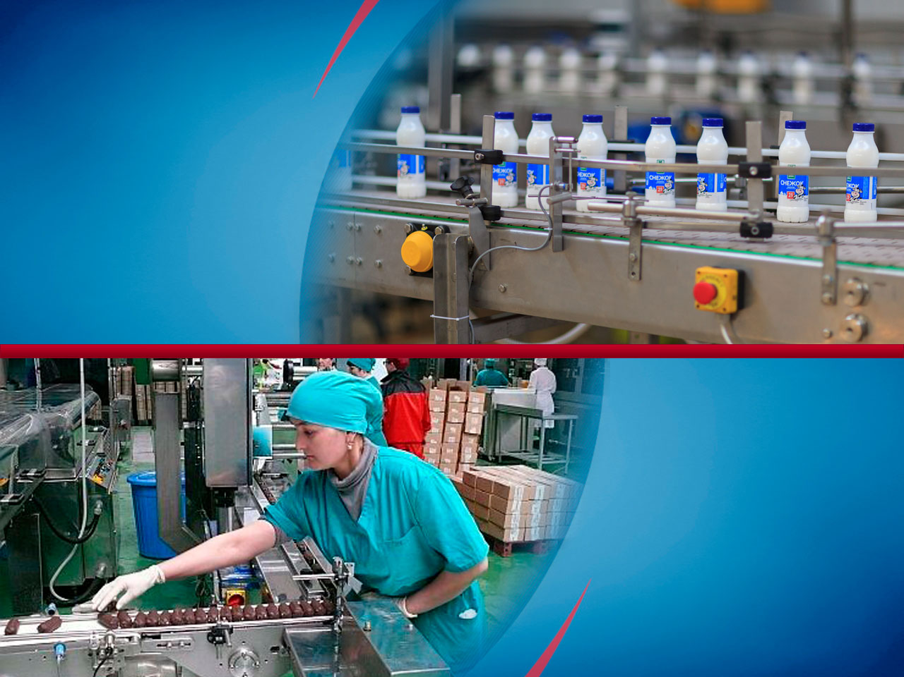
Production
Industry

Slide 18
Investment Project №7
The name of the project
PROCESSING of RAW COTTON, COTTON FIBER AND WOOL — construction of a mini plant for processing the raw cotton and fiber
Territory of project realization
Republic of Tajikistan
Purpose of the project
the production of four exclusive designs innovative achievements for farmers and other users in industries Farmers and industry
Target consumers
Population of the Republic of Tajikistan
The Total project cost
200 000 USD
Amount of own funds
and credit needs
The volume of equity – 20 000 USD
The required amount of credits – 180 000 USD
The estimated payback period of the project
3 years
Notes
Number of working places – 15-20 people
18

Slide 19
Investment Project №8
The name of the project
LLC “KHATLON” — sugar production, based on the cultivation of sugar beet in the region
Territory of project realization
Khatlon region, Bokhtar district, Republic of Tajikistan
Purpose of the project
Is planned the construction of mini-plant on the territory of Bokhtar district of Khatlon region
Target consumers
Population of Khatlon province of Tajikistan
The Total project cost
1 000 000 USD
Amount of own funds
and credit needs
The volume of equity – 80 000 USD
The required amount of credits – 920 000 USD
The estimated payback period of the project
3 years
Notes
Number of working places – 20 people;
20

Slide 20
Investment Project №9
FREE ECONOMIC ZONE “FAIZI ISTIQLOL”
— construction of plant for drying and canning of fruits and vegetables
The name of the project
Territory of project realization
Khatlon region, Dangara district , Republic of Tajikistan
Purpose of the project
Construction of the plant for processing of dried fruits and dried
Target consumers
Product sales in the CIS
The Total project cost
300 000 USD
Amount of own funds
and credit needs
The volume of equity – 30 000 USD
The required amount of credits – 270 000 USD
The estimated payback period of the project
3 years
Notes
Number of working places – 15 people
21

Slide 21
Investment Project №10
The name and purpose of the project
LOCAL STATE EXECUTIVE POWER —
processing of industrial and household waste
Territory of project realization
GBAO, Khorog, Republic of Tajikistan
Purpose of the project
processing of industrial and household waste accumulated in the city of
Khorog and its surroundings.
Target consumers
Population of GBAO
The Total project cost
474 300 Euro
Amount of own funds
and credit needs
The volume of equity – 50 000 Euro
The required amount of credits – 424 300 Euro
The estimated payback period of the project
3 years
Notes
Number of working places – 20-25 people
29

Slide 22
Investment Project №11
The name of the project
LLC “GOZIYON AND K” —
processing of wool, production of woolen yarn
Territory of project realization
Sughd region, Matcha district, Republic of Tajikistan
Purpose of the project
Purchase of the equipment for processing of wool, production of woolen yarn and purchase of small cattle
Target consumers
Exports outside the Republic of Tajikistan
The Total project cost
250 000 USD
Amount of own funds
and credit needs
The volume of equity – 25 000 USD
The required amount of credits – 225 000 USD
The estimated payback period of the project
3 years
Notes
Number of working places – 10-12 people
30

Slide 23
Investment Project №12
The name of the project
LLC “NURAFKAN” — production of barite concentrate powder barium sulphate(ВаОS4)
Territory of project realization
Gissar district, Republic of Tajikistan
Purchase of special equipment and machinery for the production of concentrate sulfate barium
Target consumers
Target consumers
Exports outside the Republic of Tajikistan
The Total project cost
1 000 000 USD
Amount of own funds
and credit needs
The volume of equity – 50 000 USD
The required amount of credits – 950 000 USD
The estimated payback period of the project
3 years
Notes
Number of working places – 15-20 people
31

Slide 24
Investment Project №13
The name of the project
PROCESSING FIELD, "KIZILSOY” —
extraction and processing of sand-gravel mixture.
Territory of project realization
Khatlon region, Dangara district, Republic of Tajikistan
Purpose of the project
The funds will be used for development of the field "Kizilsoy", mining and processing of sand-gravel mixture.
Target consumers
Population of the Republic of Tajikistan, and construction organizations.
The Total project cost
1 000 000 USD
Amount of own funds
and credit needs
The volume of equity – 50 000 USD
The required amount of credits – 950 000 USD
The estimated payback period of the project
1 year
Notes
Number of working places – 15-20 people
32

Slide 25
Investment Project №14
The name of the project
ENTERPRISE “DANGARA”—
the production of "GACH" gypsum-cardboard
Territory of project realization
Khatlon region, Dangara district, Republic of Tajikistan
Purpose of the project
The production of "GACH" gypsum-cardboard
Target consumers
Population and building organizations of the Republic of Tajikistan, as well as export to the countries of Afghanistan, Uzbekistan and Kyrgyzstan.
The Total project cost
500 000 USD
Amount of own funds
and credit needs
The volume of equity – 50 000 USD
The required amount of credits – 450 000 USD
The estimated payback period of the project
2 years
Notes
Number of working places – 10-12 people
33

Slide 26
Investment Project №15
LLC "SUFIYON” — creation and development of sugar production and construction of mini-plant
The name of the project
Territory of project realization
Dushanbe, Republic of Tajikistan
Purpose of the project
Creation and development of sugar production and construction of
mini-plant
Target consumers
Citizens and organizations of the Republic of Tajikistan
The Total project cost
25 000 000 Euro
Amount of own funds
and credit needs
The volume of equity – 300 000 Euro
The required amount of credits – 24 700 000 Euro
The estimated payback period of the project
10 years
Notes
Number of working places – 20-25 people
44

Slide 27
Investment Project №16
JSC "LAL” — the creation of a modern production line for production of "polished" glass
The name of the project
Territory of project realization
Sughd region, Khujand, Republic of Tajikistan
Purpose of the project
The creation of a modern production line for production of "polished"
glass
Target consumers
Population of the Republic of Tajikistan and export to Kazakhstan,
Afghanistan
The Total project cost
9 000 000 USD
Amount of own funds
and credit needs
The volume of equity – 200 000 USD
The required amount of credits 8 800 000 USD
The estimated payback period of the project
5 years
Notes
Number of working places – 50 people
38

Slide 28
Investment Project №17
STATE UNITARY PRODUCTION ASSOCIATION "TAJIKTEXTILEMASH” — expansion of the production of plastic products for household and industrial purposes.
The name of the project
Territory of project realization
Dushanbe, Republic of Tajikistan
Purpose of the project
Production of plastic products for household and industrial purposes.
Target consumers
Population of the Republic of Tajikistan
The Total project cost
6 800 000 USD
Amount of own funds
and credit needs
The volume of equity – 3 000 000 USD
The required amount of credits – 6 500 000 USD
The estimated payback period of the project
3 years
Notes
Number of working places – 10-15 people
46

Slide 29
Investment Project №18
The name of the project
SCIENTIFIC-INDUSTRIAL COMPANY "ALPAKAT” — production of ecologically clean diesel fuel
Territory of project realization
Dushanbe, Republic of Tajikistan
Purpose of the project
Production of ecologically clean diesel fuel based processing of industrial and household waste
Target consumers
Population of Republic of Tajikistan
The Total project cost
4 500 000 Euro
Amount of own funds
and credit needs
The volume of equity – 400 000 Euro
The required amount of credits – 4 100 000 Euro
The estimated payback period of the project
5 years
Notes
Number of working places – 40-50 people
40

Slide 30
Investment Project №19
The name of the project
FREE ECONOMIC ZONE “DANGARA” — production of MTZ-82 tractors
Territory of project realization
Khatlon region, Dangara district, Republic of Tajikistan
Purpose of the project
Production of MTZ-82 tractors for agricultural workers
Target consumers
Population of the Republic of Tajikistan and the export to the CIS countries and abroad
The Total project cost
7 500 000 USD
Amount of own funds
and credit needs
The volume of equity – 500 000 USD
The required amount of credits – 7 000 000 USD
The estimated payback period of the project
5 years
Notes
Number of working places – 45-50 people
48

Slide 31
Investment Project №20
The name and purpose of the project
LCC “ORIYO” — construction of a factory for the production of spinning and weaving products
Territory of project realization
Khatlon region, J.Rumi district, Republic of Tajikistan
Purpose of the project
The study of prospects for the construction of factories for the production of spinning and weaving production
Target consumers
The population of the Republic of Tajikistan, as well as exports to CIS countries
The Total project cost
59 934 732 USD
Amount of own funds
and credit needs
The volume of equity – 1 000 000 USD
The required amount of credits – 58 934 732 USD
The estimated payback period of the project
10 years
Notes
Number of working places – 45-50 people
42

Slide 32
Investment Project №21
The name of the project
FEZ “DANGHARA” INVESTMENT PROJECT “DOLOMIT” —
construction of the factory “Dolomit”
Territory of project realization
Khatlon region, Dangara district, Republic of Tajikistan
Purpose of the project
Construction of the factory “Dolomit”
Target consumers
Population of the Republic of Tajikistan
The Total project cost
10 000 000 USD
Amount of own funds
and credit needs
The volume of equity – 700 000 USD
The required amount of credits – 9 300 000 USD
The estimated payback period of the project
2 years
Notes
Number of working places – 25-30 people
50

Slide 33
Investment Project №22
The name of the project
JSC "RESANDAI QURGHONTEPPA” — introduction in manufacture of new technological spinning line in the factory, Kurgan-Tyube
Territory of project realization
The Republic of Hungary, Debrecen
Purpose of the project
Introduction in manufacture of new technological spinning line in the factory, Kurgan-Tyube
Target consumers
Exports to the CIS and abroad
The Total project cost
45 980 853 USD
Amount of own funds
and credit needs
The volume of equity – 5 000 000 USD
The required amount of credits – 40 980 853 USD
The estimated payback period of the project
2 years
Notes
Number of working places – 15 people
52

Slide 34
Investment Project №23
The name of the project
MANUFACTURE of HYGIENE PRODUCTS — establishment of production of new hygienic products (diapers)
Territory of project realization
Sughd region, Khujand, Republic of Tajikistan
Purpose of the project
Establishment of production of new hygienic products (diapers), Khujand
Target consumers
Population of the Republic of Tajikistan
The Total project cost
1 000 000 USD
Amount of own funds
and credit needs
The volume of equity – 50 000 USD
The required amount of credits – 950 000 USD
The estimated payback period of the project
3 years
Notes
Number of working places – 20-25 people
53

Slide 35
Investment Project №24
The name of the project
CONSTRUCTION of the CEMENT PLANT
Territory of project realization
Khatlon region, Dangara district, Republic of Tajikistan
Purpose of the project
High-quality cement, will be sold on domestic market
Target consumers
Population of Khatlon, Republic of Tajikistan
The Total project cost
178 000 000 USD
Amount of own funds
and credit needs
The volume of equity – 3 000 000USD
The required amount of credits – 175 000 000 USD
The estimated payback period of the project
4-5 years
Notes
Number of working places – 60-70 people
56

Slide 36
Investment Project №25
The name of the project
THE CONSTRUCTION OF A CEMENT PLANT
Territory of project realization
Republic of Tajikistan, Bobojon Ghafurov district, Sughd region
Purpose of the project
Production of high-quality cement
Target consumers
Population of Khatlon, Republic of Tajikistan
The Total project cost
45 206 853 USD
Amount of own funds
and credit needs
The volume of equity 2 283 890 USD
The required amount of credits – 42 922 963 USD
The estimated payback period of the project
7 years
Notes
Number of working places – 68 people;
600 thousand tones per year
70

Slide 37
Investment Project №26
The name of the project
CONSTRUCTION OF ENTERPRISE FOR MANUFACTURE OF FOOTWEAR
Territory of project realization
Republic of Tajikistan, Khatlon region, Dangara district
Purpose of the project
Manufacture of footwear
Target consumers
Population of Khatlon, Republic of Tajikistan
The Total project cost
1 000 000 USD
Amount of own funds
and credit needs
The volume of equity – 70 000 USD
The required amount of credits – 930 000 USD
The estimated payback period of the project
2 years
Notes
Number of working places – people;
74

Slide 38
Investment Project №27
The name and purpose of the project
"Development of deposits of marble onyx “Patru”
Territory of project realization
Republic of Tajikistan, Khatlon region, Dangara district
Purpose of the project
Development of deposits of marble onyx “Patru
Target consumers
Population of Khatlon, Republic of Tajikistan
The Total project cost
7 400 000 USD
Amount of own funds
and credit needs
The volume of equity – 500 000 USD
The required amount of credits – 6 900 000 USD
The estimated payback period of the project
7 years
Notes
Number of working places – 120 people;
72

Slide 39
Investment Project №28
FREE ECONOMIC ZONE “DANGARA” -
Production of ceramic tile
The name of the project
Territory of project realization
Republic of Tajikistan, Khatlon region, Dangara district
Purpose of the project
Production of ceramic tile
Target consumers
The population of the Republic of Tajikistan and export to CIS countries
The Total project cost
10 000 000 USD
Amount of own funds
and credit needs
The volume of equity – 500 000 USD
The required amount of credits – 9 500 000 USD
The estimated payback period of the project
1 year
Notes
Number of working places – 70 people;
Annual capacity of 3 million sq. m
71

Slide 40
Investment Project №29
The name of the project
ATLAS-SILK – factory on deep mechanical processing of cocoon and raw
Territory of project realization
Republic of Tajikistan, Dushanbe
Purpose of the project
Factory on deep mechanical processing of cocoon and raw
The population of the Republic of Tajikistan and export to CIS countries, Europe
Target consumers
The Total project cost
2 000 000 USD
Amount of own funds
and credit needs
The volume of equity – 200 000 USD
The required amount of credits – 1 800 000 USD
The estimated payback period of the project
5 years
Notes
Number of working places – 90 people
69

Slide 41
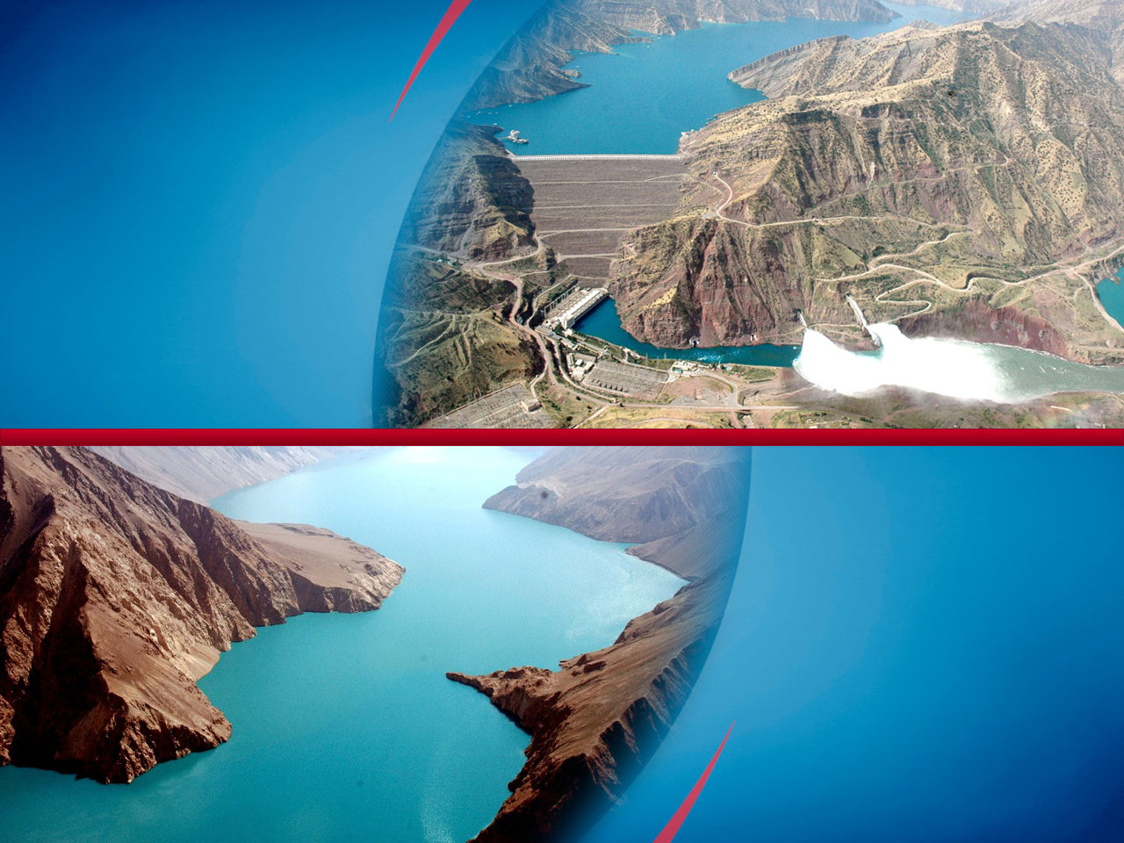
Energy

Slide 42
Investment Project №30
The name of the project
LLC "SOMON ENERGY” - Organization of production of energy efficient led lamps
Territory of project realization
Republic of Tajikistan, Sughd region, Chkalovsk
Purpose of the project
Production of energy efficient led lamps
Target consumers
Population of the Republic of Tajikistan
The Total project cost
2 448 616 USD
Amount of own funds
and credit needs
The volume of equity – 400 000 USD
The required amount of credits – 2 048 616 USD
The estimated payback period of the project
5 years
Notes
Number of working places – 40 people;
73

Slide 43
Investment Project №31
The name of the project
JOINT STOCK COMPANY "R. MIRZOYEV” —
the construction of a small hydropower station in the river "Siyokhob”
Territory of project realization
Khatlon region, Muminabad district, Republic of Tajikistan
Purpose of the project
Construction of a small hydropower station in the river "Siyokhob”
Target consumers
Population Muminabad, Khatlon province of the Republic Tajikistan
The Total project cost
160 070 USD
Amount of own funds
and credit needs
The volume of equity – 10 000 USD
The required amount of credits – 150 700 USD
The estimated payback period of the project
3 years
Number of working places – 11-16 people.
You must purchase the equipment of the hydro unit, pipelines, transformer and other technical equipment.
Notes
35

Slide 44
Investment Project №32
The name of the project
SHPP “DUOB” — The construction of small HPP “DUOB”
Territory of project realization
Khatlon region, Muminabad district, Republic of Tajikistan
Purpose of the project
Provision of electric power of 2 villages consisting of 200 households with a total population of 1450 people
Target consumers
Population Muminabad, Khatlon province of the Republic Tajikistan
The Total project cost
180 000 USD
Amount of own funds
and credit needs
The volume of equity – 20 000 USD
The required amount of credits – 160 000 USD
The estimated payback period of the project
4-5 years
Notes
Number of working places – 5 people
Annual average electricity is 900000 kW/hour.
36

Slide 45
Investment Project №33
The name of the project
LLC “HUNARMAND” — Construction of small hydroelectric power plant “Khrazmoni".
Territory of project realization
Muminabad district, Khatlon region, Republic of Tajikistan
Purpose of the project
Construction of small hydropower "Hrazmoni" capacity of 400 kW.
Target consumers
High school and part of the population Muminabad, Khatlon, Tajikistan
The Total project cost
580 000 USD
Amount of own funds
and credit needs
The volume of equity – 30 000 USD
The required amount of credits – 550 000 USD
The estimated payback period of the project
4 years
Notes
Number of working places – 20 people
54

Slide 46
Investment Project №34
The name of the project
LLC “HUNARMAND” — Construction of small hydroelectric power plant “Margak“.
Territory of project realization
Muminabad district, Khatlon region, Republic of Tajikistan
Purpose of the project
Construction of small hydropower "Margak" capacity 360 kW
Target consumers
High school and part of the population Muminabad, Khatlon, Tajikistan
The Total project cost
510 000 USD
Amount of own funds
and credit needs
The volume of equity – 10 000 USD
The required amount of credits – 500 000 USD
The estimated payback period of the project
4 years
Notes
Number of working places – 15-20 people
55

Slide 47

Construction

Slide 48
Investment Project №35
The name of the project
LLC "NUZAM"— construction of a five-storey residential building for the population
Territory of project realization
Dushanbe, Republic of Tajikistan
Purpose of the project
Construction of a five-storey residential building for the population
Target consumers
Population of Dushanbe, Republic of Tajikistan
The Total project cost
1 220 000 USD
Amount of own funds
and credit needs
The volume of equity – 100 000 USD
The required amount of credits – 1 200 000 USD
The estimated payback period of the project
3 years
Notes
Number of working places – 20-25 people
All five floors of the hotel provides 40 apartments
38

Slide 49
Investment Project №36
The name of the project
NDIVIDUAL ENTREPRENEUR "SAIDZOIROV M.” —
the construction of tourist hotel
Territory of project realization
GBAO, Khorog, Republic of Tajikistan
Purpose of the project
Construction of tourist hotel
Target consumers
Foreign visitors and tourists
The Total project cost
28 438 USD
Amount of own funds
and credit needs
The volume of equity – 5 000 USD
The required amount of credits – 25 438 USD
The estimated payback period of the project
1 year
Notes
Number of working places – 4-5 people
41

Slide 50
Investment Project №37
The name of the project
LLC "BAHRI TOJIK” — to increase the volume of demand
Territory of project realization
Kairakkum, Sughd region, Republic of Tajikistan
Purpose of the project
Developing Fitness Center by improving services and service-range of extra services
Target consumers
Population Sughd region of Tajikistan
The Total project cost
18 727 378 USD
Amount of own funds
and credit needs
The volume of equity – 727 378 USD
The required amount of credits – 18 000 000 USD
The estimated payback period of the project
5 years
Notes
Number of working places – 80-90 people
57

Slide 51
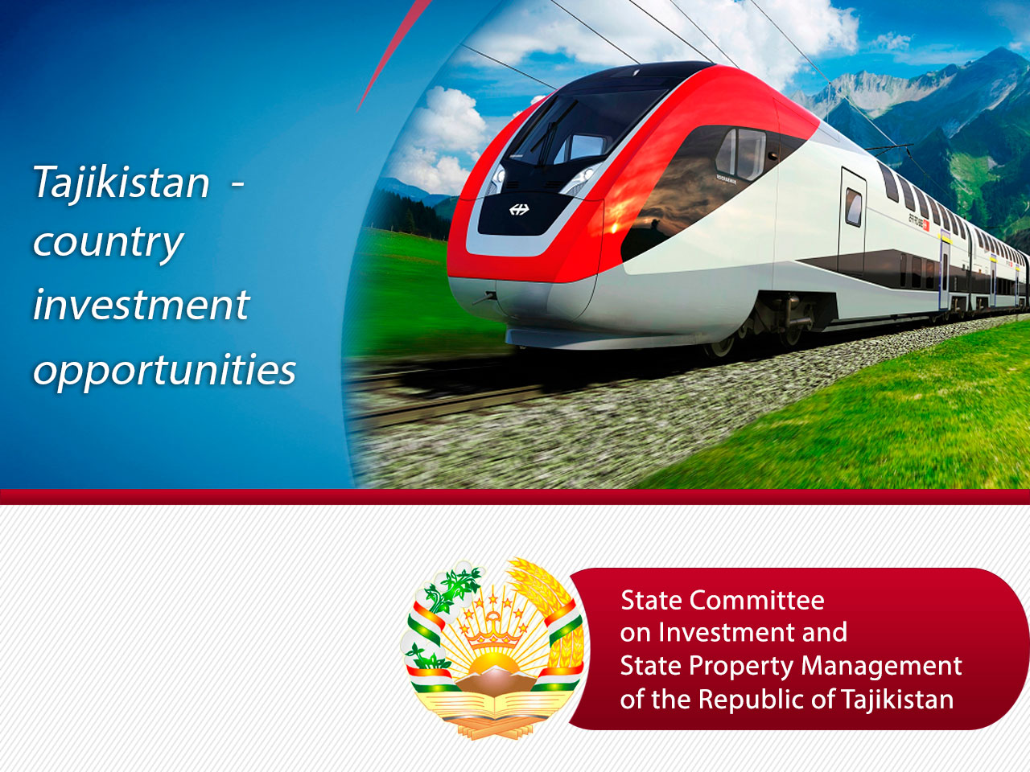

Slide 52
Thank you for your attention!

