Slide 1
Why Kazakhstan is attractive for investors?
Speaker:
Daniyar Zhomartov
Chief expert of the Committee on investments
of the Ministry of investments and development
of Kazakhstan

Slide 2
Stable macroeconomic indicators and high growth
GDP
(bln.USD)
GDP per capita
(ths.USD)
Inflation
(%)
GDP increased by 14 times
GDP per capita increased by 12 times
Inflation decreased by 13%
Birth rate
(per 1000 people)
Unemployment rate
(%)
Average monthly nominal wage
(USD)
Unemployment rate decreased by 8%
Average monthly nominal wage increased by 7.2 times
Gross International Reserves and
Assets of the National Fund of RK
(bln.USD)
Government External Debt to GDP (%)
The total amount of gross FDI from 2005 to 2013 amounted to $184 billion.
Herewith, the average annual growth rate of gross FDI is 17.4%.
Government External Debt decreased by 14%
Exchange rate regime - floating
Free exchange
Source: The National Bank of Kazakhstan
Notes:
Kazakhstan’s macroeconomic data shows continuous improvement for the period from 1999 till current times. GDP is growing steadily, while unemployment rate and inflation indicators are going down. The reserves of the country are increasing and total size of it stands at 95,5 bln USD as of end of 2013. Government external debt has decreased from 17,1% in 2001 till 2,6% in 2013. The average growth rate of gross FDI is 17,4%

Slide 3
Substantial natural resources
Place of Kazakhstan in the world rankings on reserves
Place of Kazakhstan in the world rankings for the extraction
Notes:
Our country has substantial natural resources, which gives it a great support in developing industries, which use it for higher value added production in Kazakhstan. Kazakhstan has sizeable reserves in major metals and minerals, taking leading position in the world ranking.

Slide 4
Political stability and good investment climate.
Protection of foreign investments
Doing Business
Kazakhstan – 50 rank
Belarus – 63
Russia– 92
The Global Competitiveness Index
Kazakhstan– 50 rank
Russia– 64
Belarus – n/a
Top 20 host economies
Russia – 9
Kazakhstan – 19 rank
Belarus– n/a
The attractiveness among the CIS countries
Russia – 1
Kazakhstan – 2 rank
Belarus – 5
Protecting Investors
Kazakhstan – 22 rank
Russia– 29
Belarus– 98
Protecting Investors
Kazakhstan – 10 rank
Russia– 100
Belarus – n/a
Platforms for dialogue between public authorities and investor
Foreign Investors’ Council chaired by the President | on strategic issues
Council for improvement of investment climate chaired by the Prime Minister | on systemic issues
Investment Ombudsman chaired by the Minister on Investments and Development | on current problems of investors
Taxation
Kazakhstan – 18 rank
Russia – 56
Belarus – 133
Trust in political institutions index
Kazakhstan – 35 rank
Russia – 84
Belarus – n/a
Notes:
Kazakhstan is one of the fast developing countries with a high potential for investors. By ease of doing business Kazakhstan ranks 50th place opposed to Russia’s 63d place and Belarus’s 92nd place.
In terms of protecting investors, taxation and political stability Kazakhstan also stands out as a leader in the Customs Union region.
There is an effective platform for dialogue between investors and local authorities, which helps in solving current problems of investors as well as systemic and strategic issues.

Slide 5
TNC in Kazakhstan
1992-2009
2010-2014
2015-2019
In the period from 1992 to 2009, with the participation of foreign investors, 51 projects have been implemented amounting to 7.2 billion USD, which include:
Oil and gas industry;
Uranium industry;
Financial sector;
- Production of food;
Production of construction materials.
In the period from 2010 to 2013, with the participation of foreign investors, 63 projects have been implemented amounting to 12.4 billion USD. For first time the following manufacturing established was organized :
- Assembly of locomotives (diesel and electric) and passenger carriages;
- Car models of "KIA", "Hyundai", "SsangYong", "Peugeot", "Toyota";
- Assembly of helicopters;
- Pharmaceutical products and others.
There are 190 projects that are currently in the process of implementation in collaboration with the leading TNC.
Implementation of projects is expected in the such areas:
- Pharmaceuticals;
- Renewable energy sources;
- MMC (Mining and metallurgical complex);
- ICT;
- Electronics and Engineering:
- Food industry.
Notes:
TNCs are well presented in our country and they operate successfully in different industries.
There is a visible shift of TNCs in Kazakhstan from extracting to manufacturing industries, which, we think, is a result of the government support measures and willingness to differentiate the economy of the country. There are 190 projects that are currently in the process of implementation in pharmaceuticals, renewable energy sources, mining and metallurgy, as well as food industry.

Slide 6
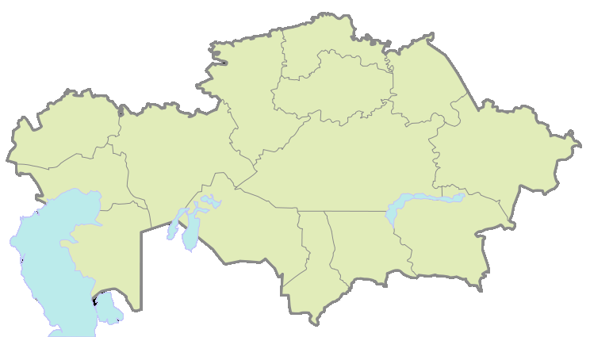
Support for investors
Investment preferences
Special economic zones
Tax benefits
CIT – 0 % 10 years
Land tax – 0% 10 years
Property tax– 0% 8 years
Tax benefits
Customs privileges
CIT – 0%
Land tax– 0%
Property tax– 0%
VAT – 0% (on all goods completely consumed in the production process)
Exemption from customs duties
for goods imported into SEZ territory
Investment reimbursement
Up to 30% of construction and installation works and equipment
SEZ
SEZ
Other privileges
SEZ
Providing the land in the territory of the SEZ for a period of up to
10 years
SEZ
SEZ
SEZ
SEZ
Simplified procedure for recruiting foreign workers
SEZ
SEZ
SEZ
Customs privileges
Customs duties 0% on the import of:
equipment and its components,
spare parts,
raw materials and supplies.
The "one stop shop" principle for the investor and service support for investment
State in-kind grants
Land plots, buildings, machinery and equipment in property.
Assistance in obtaining the required approvals and permits
Provision of services to foreign investors and representatives of Kazakhstan business
Migration benefits
The right to employ foreign labor without quotas and permits
Visa-free travel for citizens of 10 countries
Information, consulting, organizational and other assistance to the investor
Support for investment project till the start of the production
Notes:
The Government approved new measures to stimulate investors in June 2014. Companies that intend to invest in priority industries will benefit from state support measures such as corporate income tax – 0% for 10 years, land-tax – 0% for 10 years, property tax – 0% for 8 years, cash-back of 30% of capital investment and free import of labor force. More benefits and preferences are foreseen in the territories of special economic zones and industrial parks (complete infrastructure, tax exemptions and customs privileges).
“One window approach” will help investors in obtaining all necessary approvals and permits to start the business and will support will be provided on all stages till the start of the production.

Slide 7
Industry niches
MMC - $12,7 bln.
Machinery Industry - $10,3 bln.
Chemical Industry - $1,7 bln.
Import
Domestic production
2,1
Domestic production
3,8
0,6
0,6
8,9
8,2
1,1
Domestic production
Import
Import
Foodstuffs - $3,8 bln.
Construction materials - $1,3 bln.
Import
1,2
Import
0,34
2,6
Domestic production
0,94
Domestic production
Petrochemicals - $0,5 bln.
Petroleum refining - $1,7 bln.
Domestic production
Import
0,05
0,6
1,1
Import
0,4
Domestic production
Notes:
These are industry niches, which were estimated to help investors in evaluating business potential. There is huge potential to substitute import and initiate export to the countries of Customs Union as well as to our neighboring countries.

Slide 8
Market of the macro-region
2
1
1st level
Border regions of Russia
3
5
3d level
Western regions of China
4
2nd level
Russia
Ukraine
Belarus
5th level
Iran
Azerbaijan and other Caucasian countries
4th level
China
Uzbekistan
Tajikistan
Turkmenistan
Kyrgyzstan
Level of integration of the macro-region
High
Low
Notes:
Kazakhstan is located between Europe and Asia, bordering with very important economical states. Launching of a Customs Union of three countries - Kazakhstan, Russia and Belarus from 2010 it creates a common market with the capacity of 170 million consumers with an aggregated GDP of 2 trillion USD. Customs procedures and selective customs controls are abolished inside the union. Customs Union certainly opens big prospects for trade and economic cooperation for different businesses.
We also see China, Iran, Azerbaijan and other Central Asian countries as a great export potential of goods produced in Kazakhstan. All together we call this as a macroregion market.

Slide 9
Thank you for your attention

