Slide 1
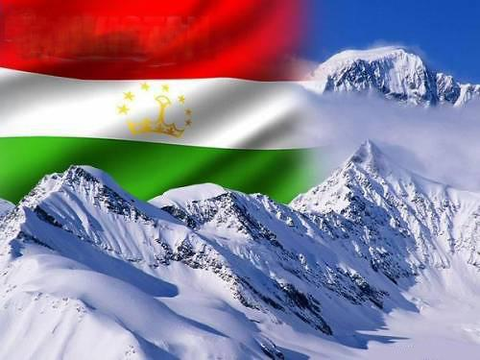
Trade and Investment in the Central Asian OIC Member States
27 - 28 october 2014 Dushanbe
Ministry of Economic Development and Trade of the Republic of Tajikistan

Slide 2
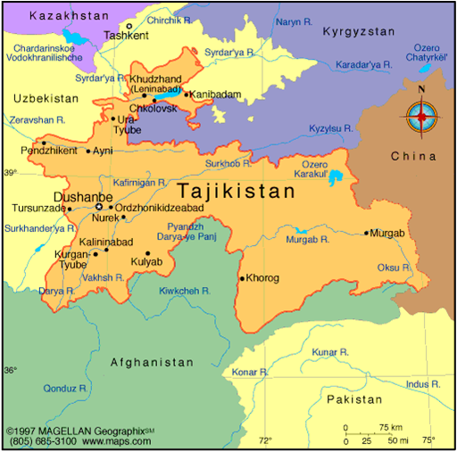
General Information about
Republic of Tajikistan
Area: 142,6 square km
Population: 8,2 million (2013)
GDP: 8,5 Bln.$. in 2013 year
Currency: Somoni
President: Emomali Rahmon
Large Cities : Khujand,
Kurgan-Teppa, Khorugh, Kulob
Religion: Islam - 98,9 %
Internet Domen: .tj

Slide 3
Main macroeconomic indicators
GDP in Market Prices for 2009-2013 (in US $ mln.)
GDP growth in 2009-2013 (in %)

Slide 4
Main macroeconomic indicators
Income growth (in %)
Inflation rate (in %)

Slide 5
Membership of the Republic of Tajikistan
to International Organizations
UN
CIS
EAEC
OIC
SCO
IDB
WTO
IMF
ECO

Slide 6
Main macroeconomic indicators
Foreign Trade Turnover (in US $ mln.)
Foreign Investment (in US $ mln.)

Slide 7
Share of trade turnover of the Central Asian countries, Afghanistan and Azerbaijan in total trade turnover of the OIC member countries (in %)
http://www.oic-oci.org/

Slide 8
Indicators of Doing Business
(OIC member countries in Central Asia, Afghanistan and Azerbaijan)
COUNTRIES | Rate
Afganistan | 164
Azerbaijan | 70
Kazakhstan | 50
Kyrgyzstan | 68
Tajikistan | 143
Uzbekistan | 146
2014
“Doing Business”
2010-2011 Tajikistan in the list of top ten reformers

Slide 9
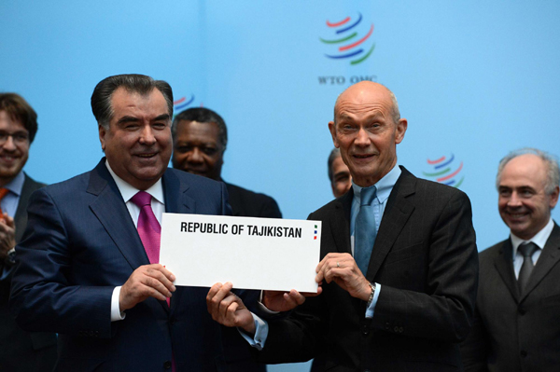
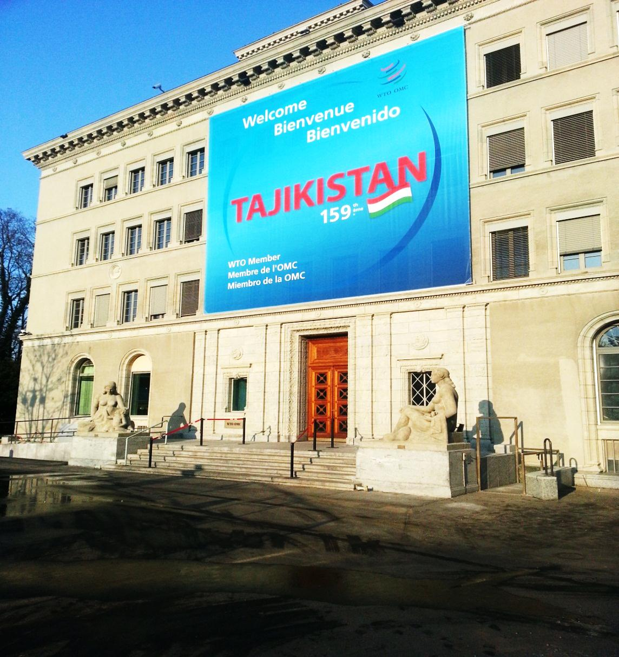
Tajikistan: 159th WTO member
Geneva,
December 10, 2012

Slide 10
Economic Development and Trade difficulties of
the Central Asian OIC members countries
Weak diversification of production and export;
Weak infrastructure development;
Tariff and non-tariff barriers to trade;
Over cost of doing business;
Complicated process of documentations;
Complicated cross border inspection of goods and transport

Slide 11
Single Window
for import and export
Exporters/
Importers
BROKERS
Banks
SINGLE WINDOW
CUSTOMS
Insurance
companies
Agency on
certification, labaratory
State Agencies

Slide 12
Working system of
«Single Window»
Participant of FIA,
Broker
Operator of
Single Window
Ministry of
health
Ministry of
agriculture
SINGLE WINDOW
Chamber of
commerce and industry
Ministry of
transport
Single Automated
Information Systems

Slide 13
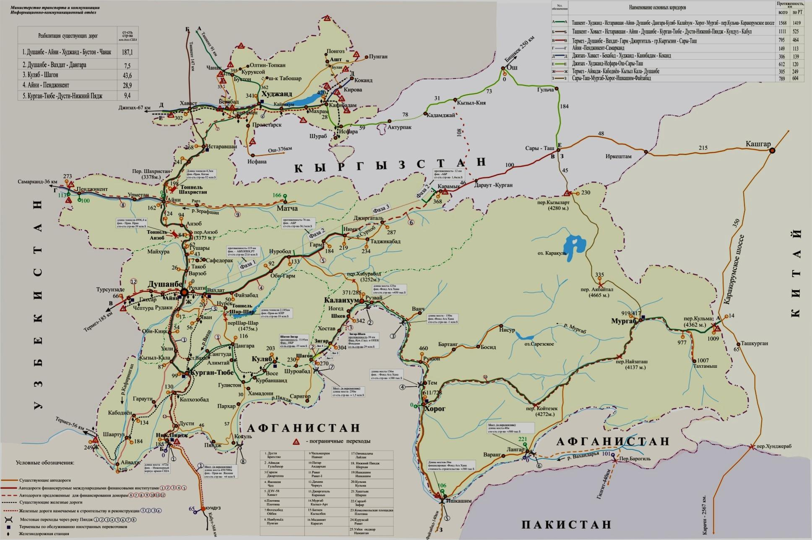
Roads infrastructure development in the Republic of Tajikistan
Chanak
Khujand
Border with Kyrgyzstan
Irkeshtam
Rasht
Tursunzade
Dushanbe
Murgab
Kulma
Kurgan-tube
Dusti
Khorog
Ishkoshim
Pandzhi Poyon

Slide 14
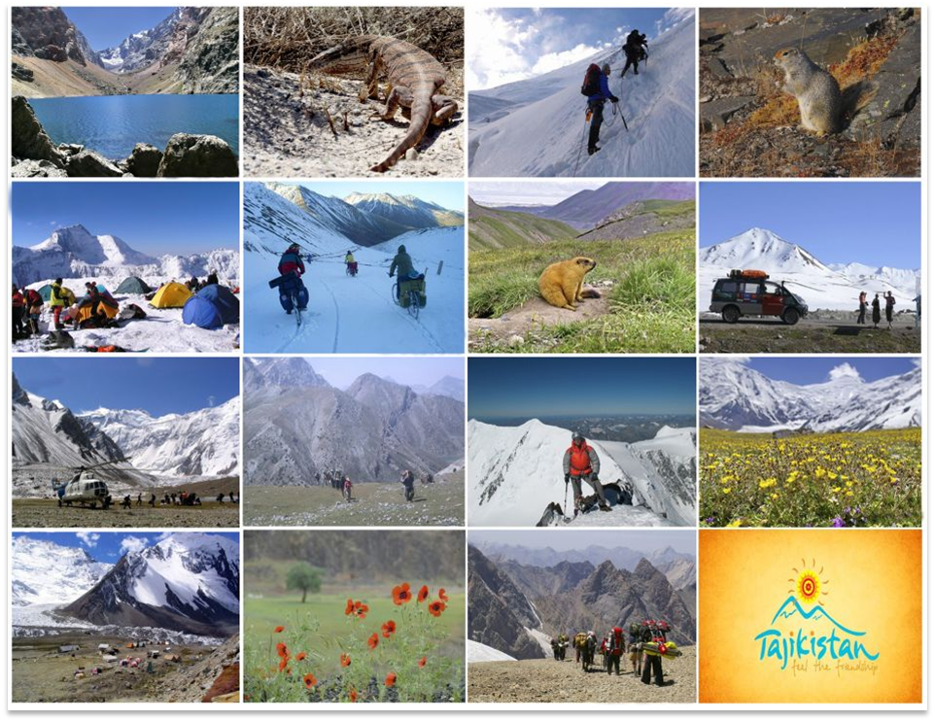
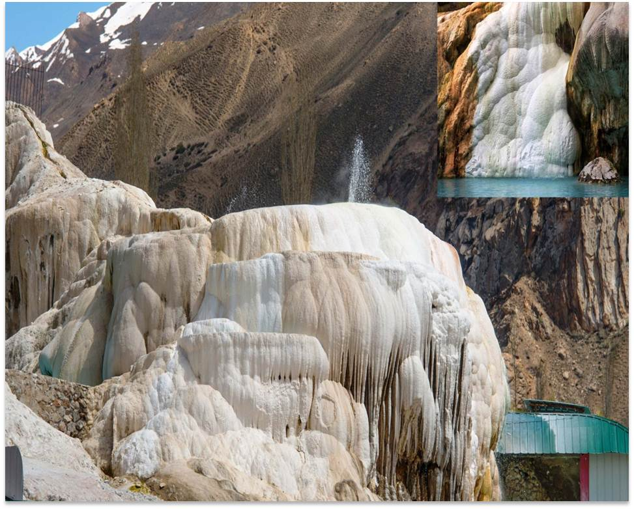
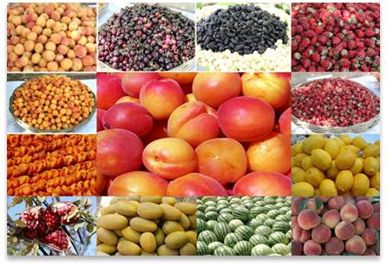
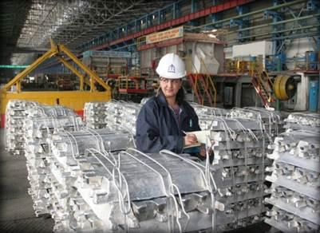
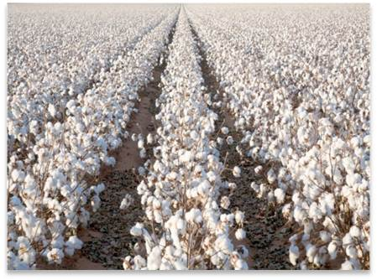
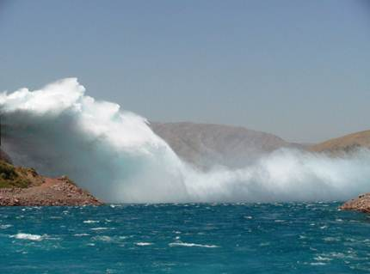
The most attractive spheres
for investment
Hydropower
Mining Industry
Processing of agricultural products
Banking and insurance
Turism and Services
Infrastructure and Communication

Slide 15
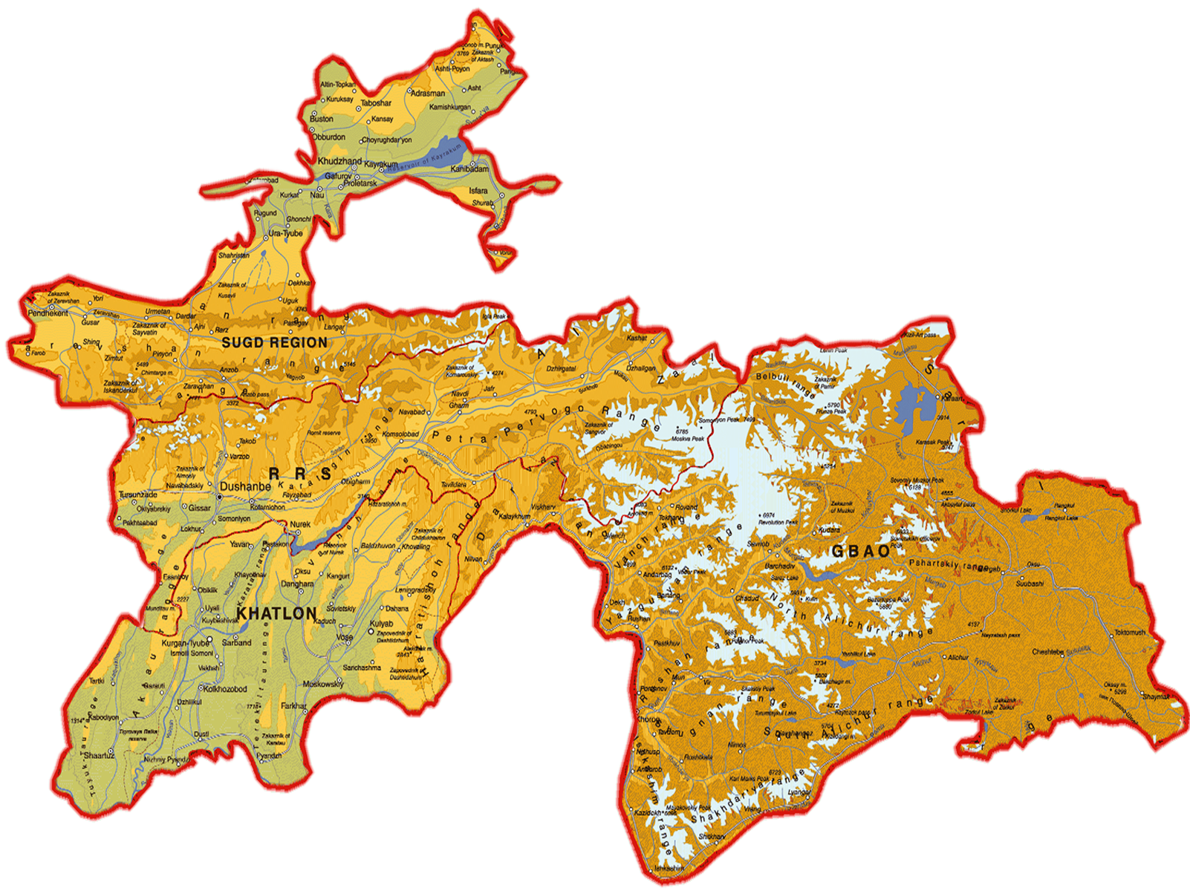
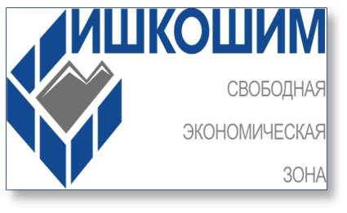
Free Economic Zones in the Republic of Tajikistan
FEZ «Sughd»
320 hectare
FEZ«Danghara»
521,3 hectare
FEZ «Pandj»
401 hectare
FEZ «Ishkoshim»
200 hectare

Slide 16
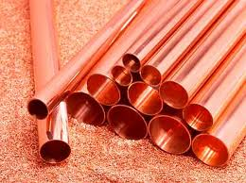
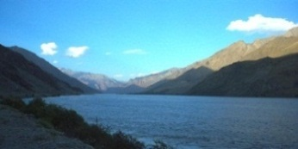
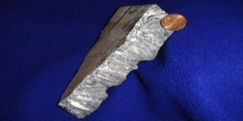
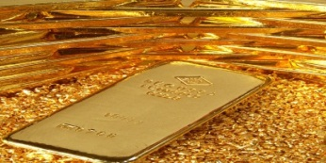
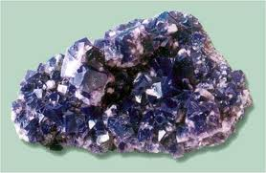
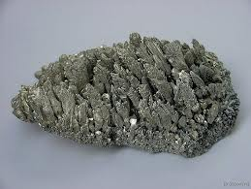
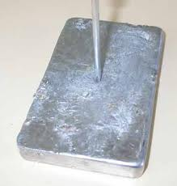
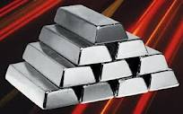
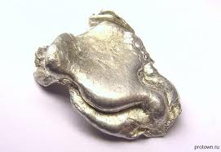
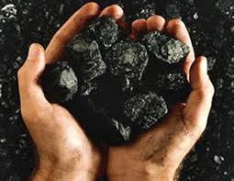
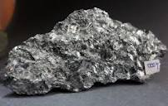
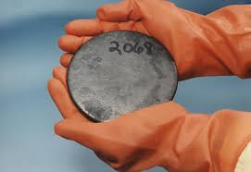
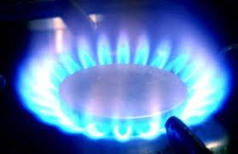
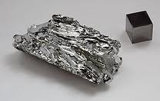
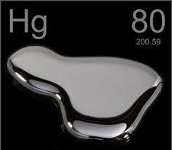
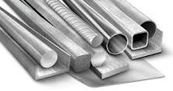
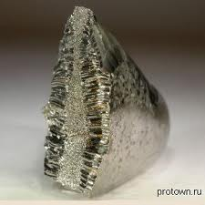
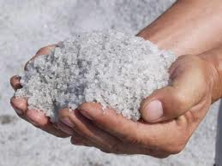
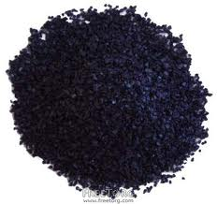
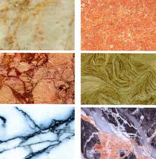
Natural Resourses of Tajikistan
Copper
Water
Zink
Gold
Fluorspar
Magnesium
Lead
Silver
Tin
Coal
Bismuth
Antimony
Uranium
Gaz
Molybdenum
Mercury
Gland
Oil
Tungsten
Common salt
Merganser
Marble

Slide 17
Organisation of Islamic Coorperetion
Republic of Tajikistan

Slide 18
THANKS FOR YOUR ATTENTION!!!

