Slide 1
First Investment Forum on OIC Plan of Action for Cooperation with Central Asia
– SMIIC General Secretariat
27-28 October 2014
Dushanbe, Republic of Tajikistan

Slide 2
SMIIC, OIC/SMIIC HALAL STANDARDS and increase of intra-OIC trade.

Slide 3
OUTLINE
OIC
SMIIC
STANDARDIZATION
ACCREDITATION
SMIIC AND HALAL
CONCLUSION

Slide 4
OIC

Slide 5
Organization of Islamic Cooperation (OIC)
The second largest inter-governmental organization after the United Nations.
Established in September 1969.
57 Member States spread over four continents.
Collective voice of the Muslim world and ensuring to safeguard and protect the interests of the Muslim world.
OIC

Slide 6
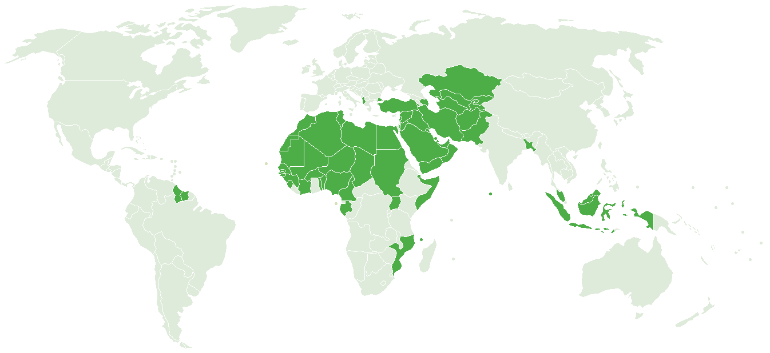
OIC Member States
OIC

Slide 7
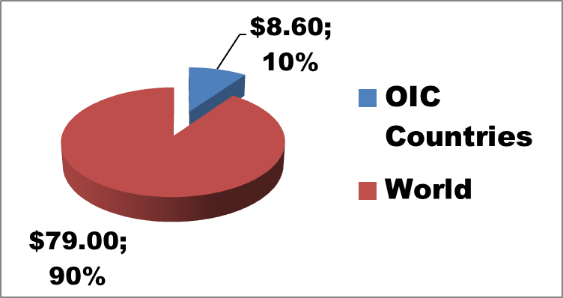
Share of the OIC Countries (1)
US$ 79 trillion, 2011 World GDP(total)
US$ 8.6 trillion, 2011 OIC Countries GDP
Source: SESRIC 2012 Annual Economic Report
OIC

Slide 8
Share of the OIC Countries (2)
World population approx. 7 billion
OIC Countries population approx. 1.8 billion
World OIC Countries
OIC

Slide 9
Share of the OIC Countries (3)
This picture is not fair
A quarter(25%) population with %10 share of world economy
OIC Countries do not deserve this.
So;
SOLUTION / ACTION: Trade should be increased
By removing the technical barriers to trade
OIC

Slide 10
SMIIC

Slide 11
What is SMIIC?
SMIIC is an affiliated organ to the OIC (The Organisation of Islamic Cooperation).
Has its own budget.
Established in August 2010.
Headquarters located in Istanbul, Turkey.
SMIIC

Slide 12
Main Objectives OF SMIIC
1) To develop harmonized standards
2) To prepare OIC/SMIIC standards
3) To achieve uniformity in metrology, laboratory testing and standardization
4) To provide technical assistance to the Member States who do not possess such standard bodies.
5) To establish an Accreditation Scheme
SMIIC

Slide 13
SMIIC MEMBERS
- All OIC Member States through their National Standardization, Metrology and Accreditation Bodies can be a member.
- SMIIC has 29 Member States to date.
http://www.smiic.org/smiic-members

Slide 14
STANDARDIZATION

Slide 15
WHAT IS A STANDARD?
A document established by CONSENSUS,
Approved by a recognized body,
Contributed by its stakeholders,
For common and repeated use,
Voluntary.
A DOCUMENT WHICH DEFINES THE MUSTS OF A PRODUCT OR SERVICE OR A PROCESS
STANDARDIZATION

Slide 16
STANDARDIZATION IS:
The activity of establishing standards
The necessary process for ensuring effectiveness in any product/service
STANDARDIZATION

Slide 17
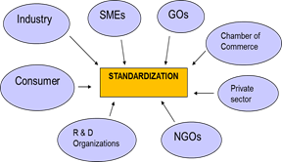
CONSENSUS IN STANDARDIZATION
CONSENSUS ON STANDARDIZATION IS BEST ACHIEVED BY THE CONTRIBUTION OF ALL STAKEHOLDERS
STANDARDIZATION

Slide 18
TECHNICAL COMMITTEES
Standards are not developed by the standardization organization itself.
Standardization is handled by various TECHNICAL COMMITTEES (TCs).

Slide 19
TECHNICAL COMITTEES are:
key bodies that drive the standardization process
comprise of experts from the member organizations
a completely voluntary effort
TCs ARE THE KEY BODIES IN THE STANDARDIZATION PROCESS
Technical Committees

Slide 20
SMIIC TCs
TC 1: Halal Food Issues
TC 2: Halal Cosmetic Issues
TC 3: Service Site Issues
TC 4: Renewable Energy
TC 5: Tourism and Related Services
TC 6: Agriculture Processes
TC 7: Transportation

Slide 21
Accreditation
Accreditation is the internationally accepted procedure that recognizes the competence of testing and calibration laboratories, product certification bodies, quality system certification bodies and inspection bodies.

Slide 22
Accreditation (1)
Accreditation schemes minimize the duplication of re-testing and re-certification, reduces cost and eliminates non-tariff barriers to trade and market access delays.

Slide 23
SMIIC Accreditation Committee
It is the unit assigned the task of;
Coordination of OIC Member States accreditation organizations to implement the OIC/SMIIC 3:2011 “Guidelines for the Halal Accreditation Body accrediting Halal Certification Bodies” standard.
All national accreditation organizations of OIC Member States are eligible to be a member of it.

Slide 24
SMIIC Metrology Committee
SMIIC Metrology Committee (MC) is SMIIC’s operational structure for cooperation between metrology institutes from Islamic Countries.
26 Members States.
facilitate and harmonize the activities of metrology services in Member Countries

Slide 25
HALAL AND SMIIC

Slide 26
The need of a Global Halal Food Std.
Differing Halal standards not only between countries but also within each country, cause confusion, extra costs and technical barriers.

Slide 27
In fact, all sectors recognize the need for one global Halal standard that is recognized by all importing countries.
Different Halal authorities follow different Islamic rulings regarding issues such as gelatine, some additives, slaughtering type and stunning of animals.

Slide 28
Solution ?
There must be a common platform where all the parties come together to define the minimum requirements of a Halal Standard
This platform is nothing but SMIIC which is the technically competent body on Halal Issues.

Slide 29
OIC/SMIIC Standards on Halal Food
OIC/SMIIC 1:2011, General Guidelines on Halal Food
OIC/SMIIC 2:2011, Guidelines for Bodies Providing Halal Certification
OIC/SMIIC 3:2011, Guidelines for the Halal Accreditation Body Accrediting Halal Certification Bodies

Slide 30
Certification and Accreditation Mechanism in Brief
Production in compliance with OIC/SMIIC 1
Certification of producers according to OIC/SMIIC 1 by the certifiers in compliance with OIC/SMIIC 2.
Accreditation of certifiers according to OIC/SMIIC 2 by the accreditation body in compliance with OIC/SMIIC 3.

Slide 31
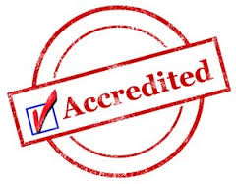
Briefly the mechanism is,
Control of the competency of Halal Certification Bodies that implement OIC/SMIIC standard, through a common Accreditation Scheme established by the SMIIC Accreditation Committee amongst Members.

Slide 32
The Result,
Increase of consumer trust on Halal,
Tracebility,
Mutual Recognition of certificates through accreditation
Diminishing technical barriers to trade with mutual recogniton

Slide 33
Central Asian Countries
Membership of Central Asian countries to SMIIC would have many beneficial effects for the member state:
1) Harmonization of standards and the achievement of uniformity in metrology, laboratory testing and standardization will aid in the decrease technical barriers to trade thorught the OIC.
2) technical barriers intra-OIC trade.
3) Use of the technical assistance provided to the Member States who do not possess such standard bodies

Slide 34
Membership of SMIIC, would give the possibility to voice and represent the needs of the National Standards, Metrology and/or Accreditation body and country.
Membership of SMIIC allows for members to come together in a platform(SMIIC Technical Committees) where standards are being harmonized and a common standard is being developed for the purpose and use of all SMIIC Members.

Slide 35
Coming together in SMIIC meetings or any other congresses, forums, allows for SMIIC Members to network, have one-on-one meetings, work collaboratively to aid in the further development of infrastructure of members.
National Metrology bodies can become members of the SMIIC Metrology Committee.
National Accreditation Bodies can become members of the SMIIC Accreditation Committee and be involved with its activities, developments and network.

Slide 36
CONCLUSION

Slide 37
1. OIC/SMIIC Halal Standards are the result of a common study of OIC Members and Institutions through Technical Committees.
COMMON Platform to make Common Standards: SMIIC

Slide 38
2. Adoption and Implementation of Halal Standards by the related parties is of vital importance
OIC/SMIIC 1 for production and certification
OIC/SMIIC 2 for certification and accreditation
OIC/SMIIC 3 for Accreditation

Slide 39
- One standard,
- One test,
- One mark (wherever possible).

Slide 40
THANKS

