Slide 1
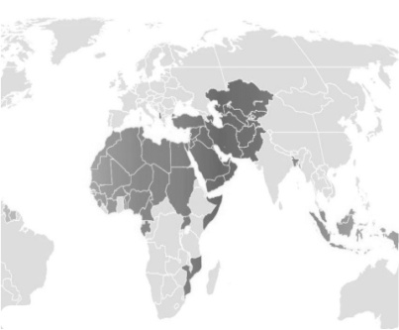
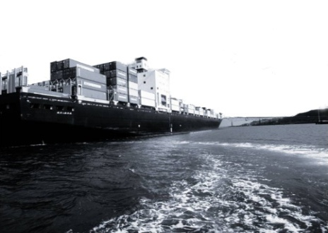
First Investment Forum on OIC Plan of Action for Cooperation with Central Asia
27-28 October 2014, Dushanbe, Republic of Tajikistan
ITFC/IDB GROUP’S AID FOR TRADE INITIATIVES :
ENHANCING INTRA-OIC TRADE AND TRADE COOPERATION AMONG OIC MCs
Ayhan Karaca, ITFC
Islamic Development Bank

Slide 2
Outline
1
Brief Info About ITFC
2
ITFC’s Trade Related Technical Assistance Program
3
ITFC’s Effort Towards Preparation of Aid for Trade Initiative for Central Asian MCs

Slide 3
Summary of IDBG Mandates in Trade
Develop Key Economic Infrastructure to facilitate Trade
Enhance regional integration and economic cooperation
Foster trade promotion and cooperation
Extend competitive trade financing solutions
Mainstream trade as a driver of development
Build capacity in member countries
Support Private Sector Investments
Enhance trade transactions through export credit

Slide 4
PIONEER in SUPPORTING TRADE LED ECONOMIC GROWTH
TRADE IS THE ENGINE OF ECONOMIC DEVELOPMENT
More than US$ 40 billion group trade financing since inception (≥ 50% of total financing)
Half of the trade finance approval extended for intra-OIC TRADE
Over US$ 20 billion development financing of trade-related infrastructure: roads, ports, border posts, construction of dams, etc.
Over US$ 18 billion business covered through export credit and reinsurance of trade operations and private sector investments by ICIEC
Trade related technical assistance (TRTA) for institutional capacity development

Slide 5
About ITFC
Became operational in January, 2008
Authorized Capital of US$3 billion;
Subscribed Capital of US$750 million;
Paid-Up Capital of US$700 million.
ITFC is to be a recognized provider of trade solutions for OIC member countries’ needs
Member of
Islamic Development Bank Group

Slide 6
Trade Approvals
Since inception in 2008, ITFC’s cumulative funded financing reached to US$ 24.8 billion.
ITFC total approvals for last two years is around US$ 10 billion
(US$ billion)
ITFC TRADE FINANCE APPROVALS FOR CENTRAL ASIA REACHED TO US$767 million
Member of Islamic Development
Bank Group

Slide 7
TCCP’s Event Driven Business Model
Business
Lines
Tools & Measures
Outcomes & Impact
Beneficiaries
International Exhibition
B 2 B Meeting
Seminars, workshops,
experts meetings on
trade related areas
Knowledge Sharing
Familiarization program
- Trade Exchange increased
- New business partnership
established
- Market access improved
Custom clearance time
shortened
Trade cooperation among MCs enhanced
Quality of TPOs advisory
services improved
- Skills and knowledge of SMEs, TPOs enhanced
- Collaboration among TPOs, chambers
strengthened
Trade
Promotion
Government Entities
Trade Facilitation
Trade Support Institutions
Capacity Building
Training courses for
trainers, private sector
- Capacity development
program for TPOs
Establishment of foreign
trade training center
Research studies on
commodities & commodity
development Programs
Development of Strategic Commodities
Business Community
Trade Main Streaming
Notes:
This is self explanatory slide demonstrating TCPP’s old modus operandi. Slide #6 explain that ITFC was not able to properly address the needs of MCs with this approach. In the slide #7, we give the detail information why TCPP was not able to response properly to the needs of MCs.

Slide 8
96 Different Activities, Projects were supported/undertaken by ITFC in 5 year
FRAGMANTED APPROACH IN PROVIDING TRTA
Examples for Four Focus Areas
Overseas Study Tours for Kazakhstan’s Entrepreneurs
In-trade Malaysia 2009
14th OIC EXPO 2013 &15th Private Sector Meeting
Exhibition on Textile and Cotton Industry in Burkina Faso
Seminar on OIC Free Trade (Agadir Agreement)
Conference on Trade Development
Workshops/Experts Groups Meeting on the Impacts of Transportation Network on Trade &Tourism
Training Course on Export Strategies & Int’l Marketing
OIC Chamber Academy Programs
Familiarization and Knowledge Sharing Programs on Commodity Exchanges
Needs Assessment Study for Groundnut sector in selected Sub-Saharan MCs
Notes:
Total of 96 different activities, projects, initiatives were undertaken by ITFC/TCPP, which were integrated into the Executive Program

Slide 9
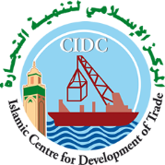
Paradigm Change in Providing TRTA
Stop fragmented approach in providing TRTA
Institutionalize Partnership
Focus on Regional/Thematic Program
Consolidate resources and efforts for jointly developed Programs
Export Promotion Agency of Afghanistan - EPAA
Organization of Islamic Cooperation (OIC)
Notes:
Bismillah, Salat & Salam on Rasul SAV and His Ehli-Beyt and his close friends;
Actually, this first slight is giving the main message of the presentation;
i) There is a paradigm change in TCPP’s modus operandi, where developing partnership is the way taken to meet the trade development needs of MCs

Slide 10
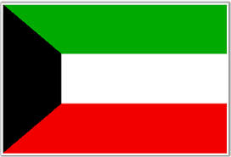
WHAT IS AID FOR TRADE INITIATIVE FOR ARAB STATES
Aiming to foster Arab trade BY IMPROVING COMPETITIVENESS, PROMOTING TRADE AND TRADE COOPERATION FOR ECONOMIC INTEGRATION AND NEW JOBS FOR YOUTH
Multi-Donor, Multi-Country and Multi-Agency Regional Trade Development & Integration Program
under the theme of Aid for Trade

Slide 11
OBJECTIVES
Enhance regional competitiveness through trade reforms | Strengthen trade supply side and value chain integration | Strengthen regional and sub-regional organizations’ capacity to foster trade integration
Output #1: Trade support institutions in the Arab states are more efficient in promoting regional trade environment and integration | Output #4: Bankable Project to support production and trading capacity of SMES in priority export sectors | Output #7: Intra-Arab trade development strategy developed and endorsed
Output #2: Regional Quality Infrastructure Strategy is adopted and implementation is carried away | Output #5: Bankable Project to support SMES’s integration to regional value chains | Output #8: Strengthened capacities of LAS, GCC, Agadir Agreement and Arab Maghreb Union to implement regional integration processes and the PAFTA
Output #3: Bankable Project to support regional business environment improvement through reduction of regional barriers to trade and regulatory reform support | Output #6: Skills Development strategies integrated into sectoral policies to support growth and expand opportunities for the creation of decent employment in priority export sectors

Slide 12
FAST TRACK PROGRAM (2014)
Studies and regional workshops on NTMs
Studies and projects on joint border gate management, multi-modal transport infrastructure and trade logistics
Skill Development Programs and trainings for Trade and Economic Diversification
Technical and institutional support to LAS for formulating trade policy recommendation
Technical support to selected MCs for WTO Accession process
PROJECT PIPELINE (Indicative )
Export Diversification Programme through improved SME Competitiveness and value-chain integration
Programme for Promoting Export of Services in Arab States
Sectoral Export Development Programmes
Development of IT Business support services for SMEs

Slide 13
EFFORTS TOWARDS PREPARATION AID FOR TRADE INITIATIVE FOR CENTRAL ASIA
DEVELOPING REGIONAL VALUE CHAIN INTEGRATION

Slide 14
PRIORITY AREAS
Support the creation of supply side capacities in agro-food and tourism industries
Enhance institutional capacities of trade support institutions
Improve Business environment through regulatory reforms, improved market access
Support accession efforts to multilateral trading system

Slide 15
Phase I :
Preparation of Project Concept Note and Work Program
Phase II:
Resource Mobilization Efforts
Time Frame :
2015-2016
Partners :
UNDP, UNECE, ITFC/IDBG and Donor Community
Outputs:
Implementation of Pilot Projects in Selected Sectors

Slide 16
Thank you
Questions, Comments?
Ayhan Karaca
akaraca@isdb.org

