Slide 1
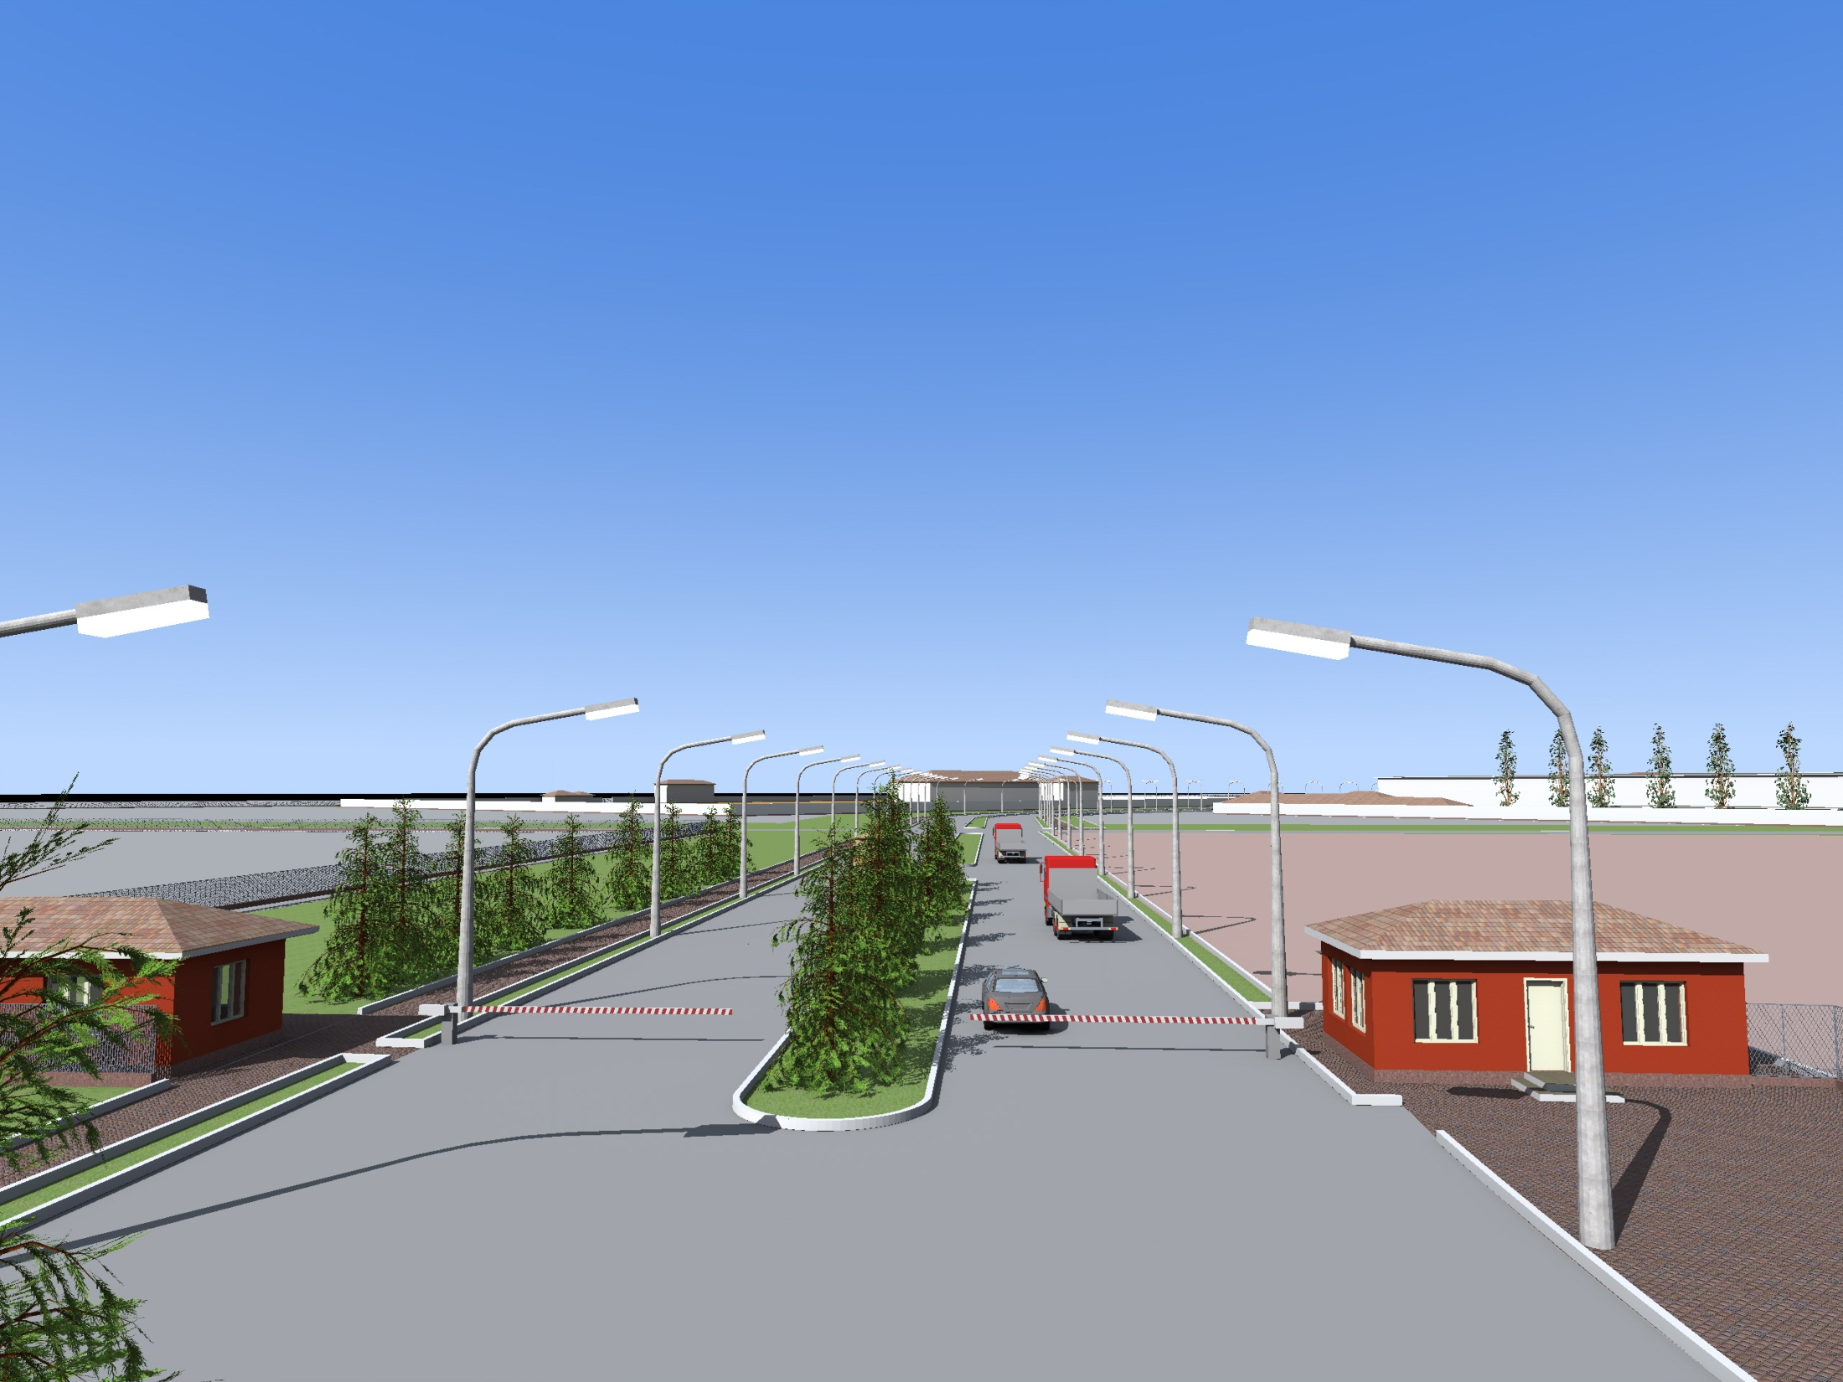
SUGHD FREE ECONOMIC ZONE
INDUSTRIAL AND INNOVATIVE TYPE

Slide 2
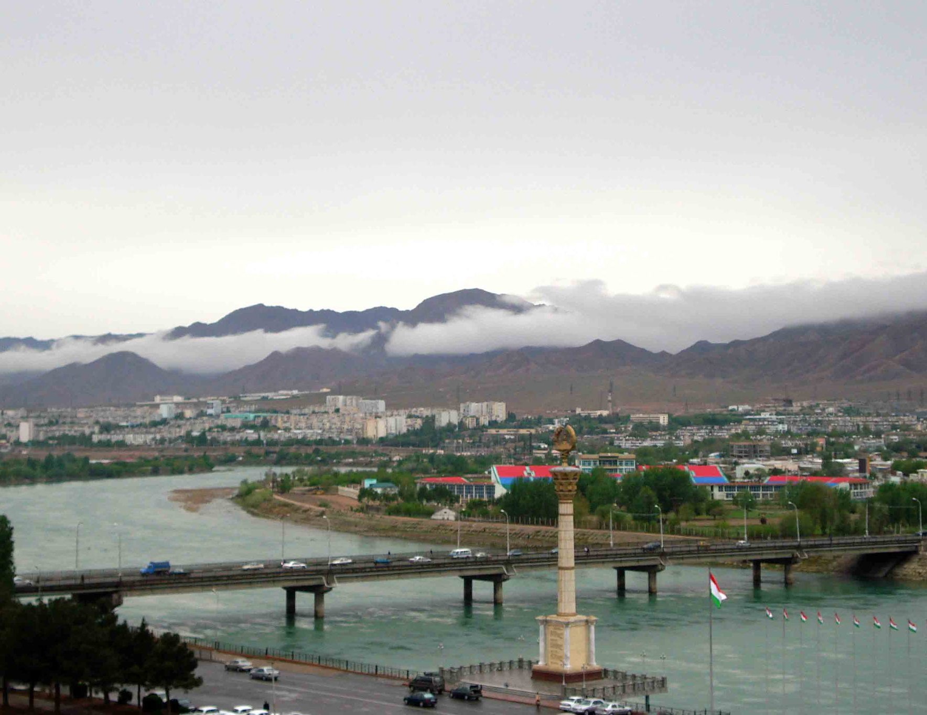
KHUJAND CITY IS ONE OF THE MOST ECONOMICALLY DEVELOPED CITIES IN TAJIKISTAN
AREA:
40 square km
POPULATION:
160 ths people
(In the radius of 30 km the population is over 700 ths)

Slide 3
HUMAN RESOURCES OF SUGHD REGION
Human resource capacity:
218,000 people are economically active
The region has:
7 universities
17 colleges
More than 60% of students study in the fields of economics and industry
Annual output of 8,800 specialists that:
More than 6,000 of them have higher education
2,800 have secondary vocational education

Slide 4
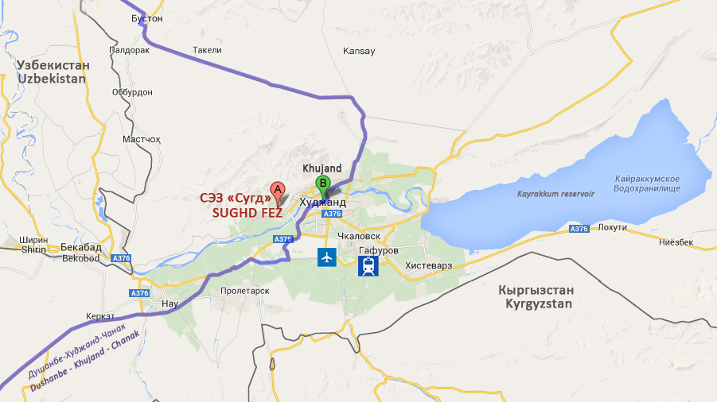
SUGHD INDUSTRIAL AND INNOVATIVE FREE ECONOMIC ZONE
8 km – CENTER FROM KHUJAND
20.3 km – FROM AIRPORT “KHUJAND”
15 km – FROM RAILWAY STATION “SPITAMEN”
INTERANTIONAL HIGHWAY
DUSHANBE-KHUJAND-CHANAK
THE GATE OF FERGHANA VALLEY
(BETWEEN KYRGYZSTAN AND UZBEKISTAN)

Slide 5
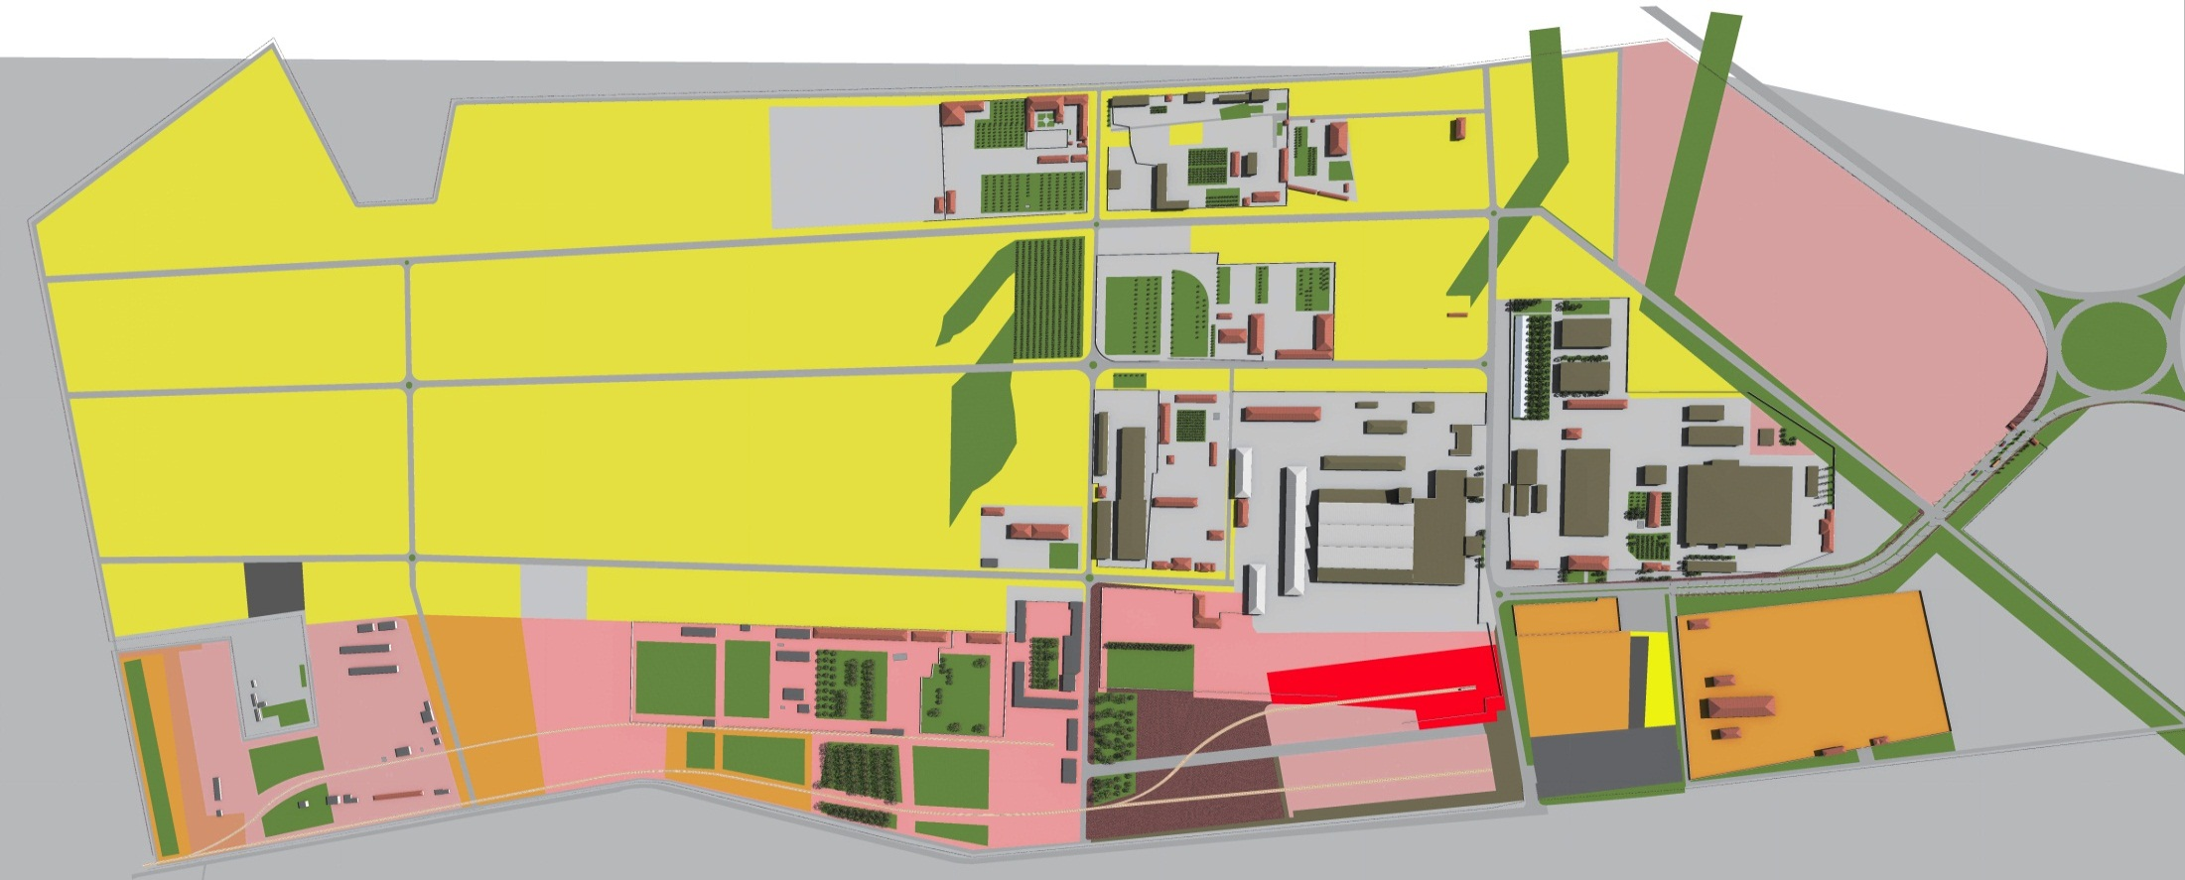
TERRITORY
320 ha
FEZ area
READY-FOR-USE BUILDINGS
FREE AREA
LONG TERM LODGING AND STORAGE OF RAW
MATERIALS AND PRODUCTS

Slide 6
EXISTING INDUSTRIAL INFRASTRUCTURE
POWER
ROADS
SEWERAGE
UP TO 40%
of savings for investors for
capital construction
WATER SUPPLY
HIGH-SPEED INTERNET
CABLE TELEPHONE

Slide 7
FREE ECONOMIC ZONE TREATMENT
EQUIPMENT
GOODS
RAW MATERIALS
0%
0%
CUSTOMS DUTIES
CUSTOMS DUTIES
0%
0%
TAXES
TAXES
SUGHD FEZ
FOREIGN COUNTRIES
REPUBLIC OF TAJIKISTAN

Slide 8
MODE OF FREE ECONOMIC ZONE
EQUIPMENT
GOODS
RAW MATERIALS
0%
0%
CUSTOMS DUTIES
0%
ТАМОЖЕННЫХ
ПОШЛИН
CUSTOMS DUTIES
0%
TAXES
VALUE ADDED TAX IS PAID
SUGHD FEZ
REPUBLIC OF TAJIKISTAN
OUTSIDE OF TAJIKISTAN

Slide 9
TAX PREFERENCES
COMMON MODE
SUGHD FEZ
INCOME TAX
PROFIT TAX
VALUE ADDED TAX
EXCISE TAX
SOCIAL SECURITY TAX
NATURAL RESOURCES TAX
ROAD USERS TAX
SALES TAX ON COTTON AND PRIMARY ALUMINIUM
VEHICLES TAX
PROPERTY TAX
INCOME TAX *
SOCIAL SECURITY TAX * *
* Income tax is withheld from the employee's salary
** Social security tax is paid from payroll

Slide 10
TAX PREFERENCES
INCOME TAX
VALUE ADDED TAX
5% & 18%
0%
15% & 25%
0%
ROAD USERS TAX
SALES TAX ON COTTON AND PRIMARY ALUMINIUM
0,5% & 2%
0%
10% & 3%
0%
From 10 taxes that are stipulated by the Tax Code of the Republic of Tajikistan, the subjects of FEZ pay only 2 of them:
Social security tax (25% of payroll)
Income tax (8 to 13% of the employees' salaries)
Territory of Tajikistan
Territory of Sughd FEZ

Slide 11
GUARANTIES
LEGAL PROTECTION
OF INVESTMENTS
COPYRIGHT PROTECTION OF SUBJECTS
EQUAL TREATMENT OF FOREIGN AND DOMESTIC INVESTMENT
NON-DISCRIMINATION OF ORGANIZATIONS WITH FOREIGN INVESTMENTS

Slide 12
PARTHNERSHIP AND COOPERATION
NGOs, INTERNATIONAL
AND PUBLIC ORGANIZATIONS
INTERNATIONAL BANKS
FREE ECONOMIC ZONES

Slide 13
SUBJECTS
21 subjects
8 JV
Negotiations for creating JV:
Transport and logistic center
SAKHI KHUJAND
Medical threads and plastic pipes
CHUAN TONG TAJIKISTAN
Assembly of agricultural machinery
Fruit processing
Sanitary facilities
FUCHEN MINGDONG
T
Production and package of dried fruits
TAJPROF

Slide 14
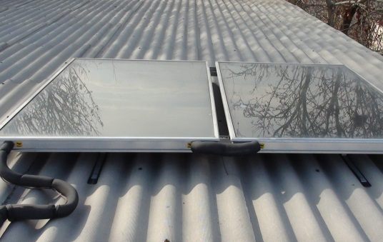
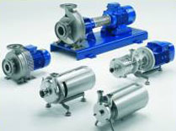
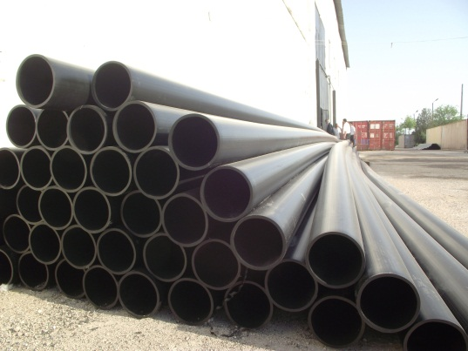
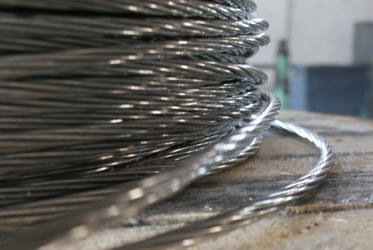
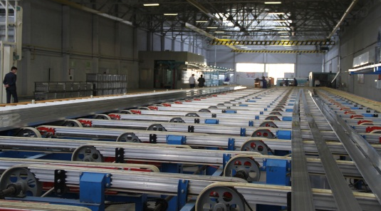
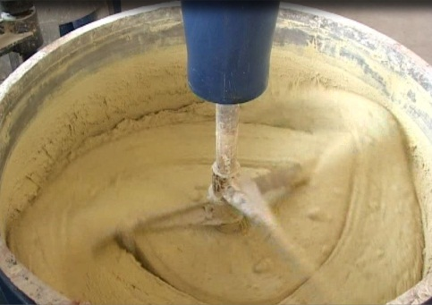
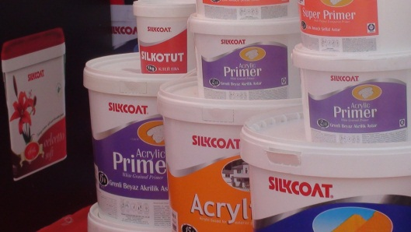
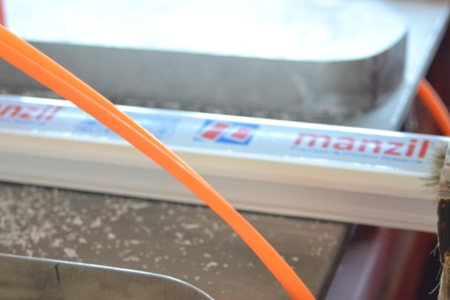
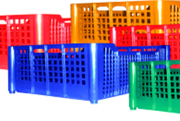
CURRENT PRODUCTION OF FEZ SUGHD
Assembling of solar collectors
Production of deep-well pumps
Production of polyethylene, polypropylene tubes
Production of electric cables
Production of aluminum frames
Production of building materials
Production of paints
Production of PVC
window and door profiles
Production of plastic containers

Slide 15
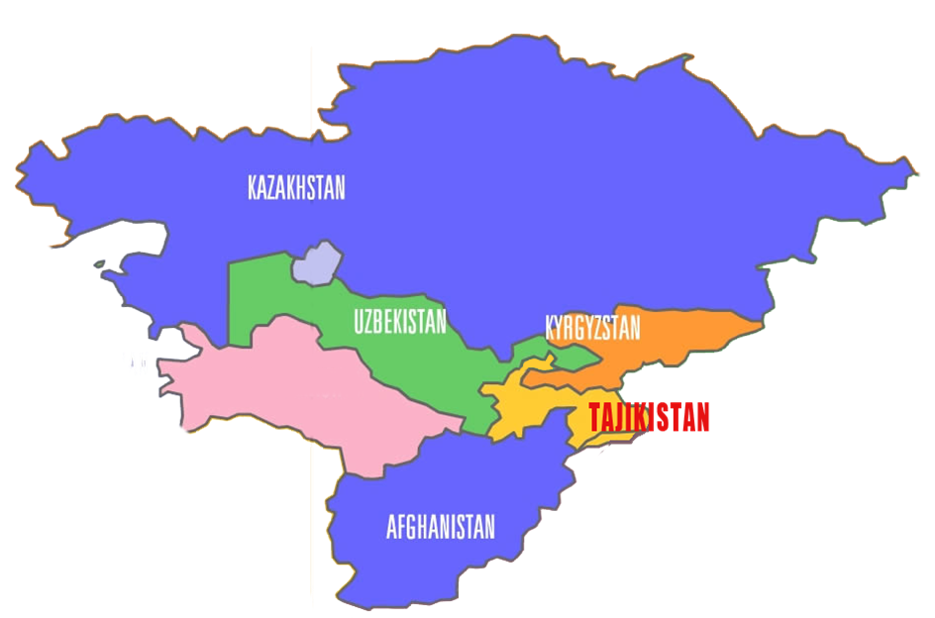
EXPORT
RUSSIA
CHINA

Slide 16
PRODUCTION VOLUME
2014
60 mln somoni
2013
44 mln somoni
2012
22 mln somoni
2011
10.5 mln somoni

Slide 17
PRIORITY FIELDS OF PRODUCTION IN FEZ SUGHD
Sewing threads, knitted fabrics
Machinery
Electrical, electronic and household appliances
Fertilizers and bioadditives for agriculture
Glass and basalt fiber
Modern construction materials
Sanitary goods
Electrical wires
Pharmaceutical products and medicines
Fruit and vegetable processing
Refrigeration equipment for fruit and vegetable storage
Evaluation, credit, insurance, consulting, audit, leasing and certification services
and others...

Slide 18
ОБЪЕМЫ ПРОИЗВОДСТВА
THANKS!
…………………………………………………………………………………………………………………………………………………
Republic of Tajikistan,
Sughd region, Khujand,
Southwest industrial zone
Tel/fax: (+992 44) 630-22-30
e-mail: info@fezsughd.tj
www.fezsughd.tj

