Slide 1







PROMOTING SME’s ROLE in the TOURISM SECTOR
Presented by:
Riyanto Sofyan BSEE., MBA.
Chairman Indonesia Sharia Hotel and Restaurant Association (AHSIN)
Chairman of Halal Food, Hotel and Islamic Tourism, Islamic Economy Society
Chairman PT. Sofyan Hotels Tbk. – SofyanHospitality
Copyright © 2014 SofyanHospitality International| ALL RIGHTS RESERVED

Slide 2

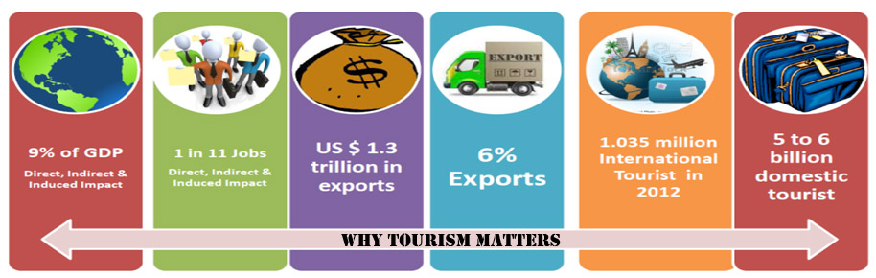
TOURISM INDUSTRY
Source :World Tourism Organization
A remarkable socio-economic phenomena of the past century.
One of the world’s largest industries and categories of international trade.
Have a very significant direct, indirect and induced economy impact, creating 185 supply-side activities according to SICTA-WTO
Copyright © 2014 SofyanHospitality International| ALL RIGHTS RESERVED
Notes:
Tambah tulisan Why Tourism Matters seperti pada slide 28

Slide 3


BOOMING HALAL OR SHARIA COMPLIANT MARKETS
1.6 BILLION POPULATION (23% WORLD POPULATION), Growing 1.5% VS. 0.7% WORLDWIDE. 60`% below 30 Vs. 43% in China.
The total GDP of Islamic Economy in 2012 reached US$ 9.5 trillions VS. China US$ 8.5 Trillion. High Growth in GDP OIC AVG. 6.3% VS. 5.3% WORLDWIDE.
Disposable income est. at $4.8 trillion in 2012
High Growth in Sharia-sensitive Consumers,
Investment, Financing & Trade.
Copyright © 2014 SofyanHospitality International| ALL RIGHTS RESERVED

Slide 4

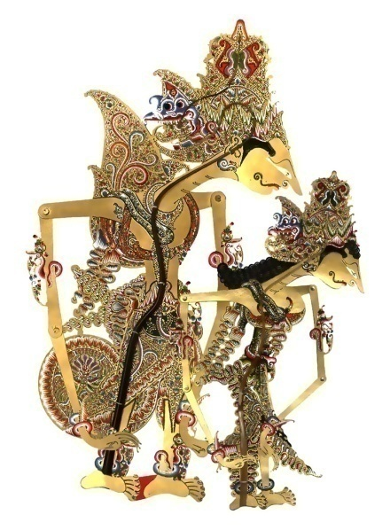
The Predominance Character of Tourism
Its response to particular assets.
Tourism places great value on the assets, such as warm climate, high mountains, rich cultural heritage, inspiring landscapes and abundant biodiversity.
Its accessibility to the SMEs.
Tourism is traditionally made up of small and micro enterprises.
Its connectivity.
Tourism Multiplier Effects → wide range of sectors.
Its linking of consumers to producers. The Tourist visit to the producers (SMEs)
Copyright © 2014 SofyanHospitality International| ALL RIGHTS RESERVED

Slide 5


The Predominance Character of SME
Capability to absorb big size of working force
Great capacity to reduce unemployment and alleviate poverty
Contributing enormous share of the GDP
Minimum investment and low financing structure
Dominant majority numbers of businesses are SMEs
Adaptive and flexible towards market changes
Easiness and timeliness of products innovation and uniqueness
Copyright © 2014 SofyanHospitality International| ALL RIGHTS RESERVED

Slide 6
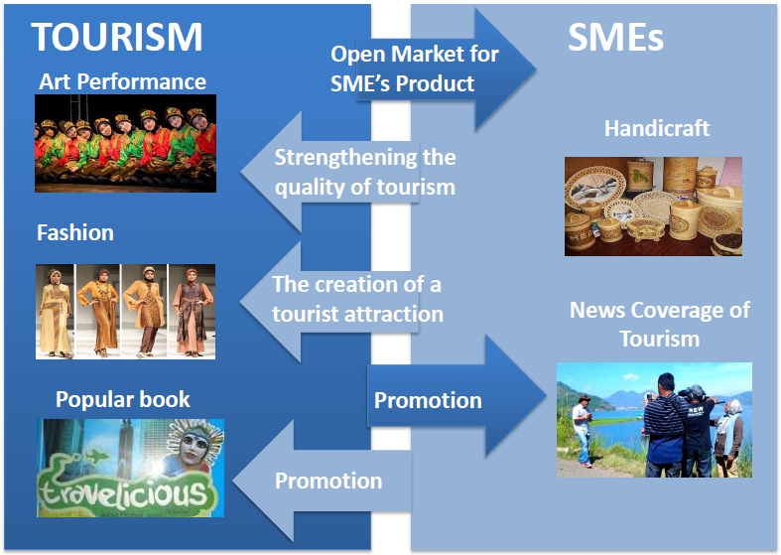
TOURISM & SME’s Inter-RELATION
Copyright © 2014 SofyanHospitality International| ALL RIGHTS RESERVED

Slide 7


FOCUS STRATEGY
IN PROMOTING SME’s ROLE IN TOURISM
To increase the size and performance of the tourism sector as a whole (size of the cake) –
To increase the proportion of spending in the sector that reaches the SMEs (share of the cake)
*Adapted from: Manual on Tourism and Poverty Alleviation, Practical Steps for Destinations. UNWTO and SNV 2010
Copyright © 2014 SofyanHospitality International| ALL RIGHTS RESERVED

Slide 8
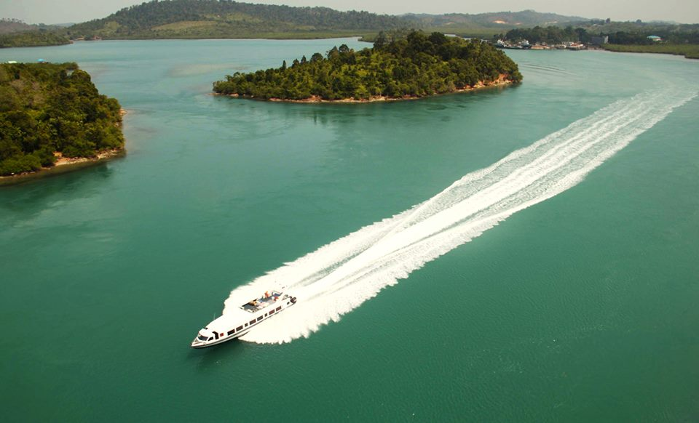
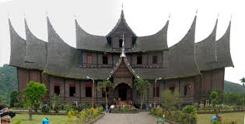
FOCUS STRATEGY 1
To increase the size and performance of the tourism sector as a whole
Copyright © 2014 SofyanHospitality International| ALL RIGHTS RESERVED

Slide 9
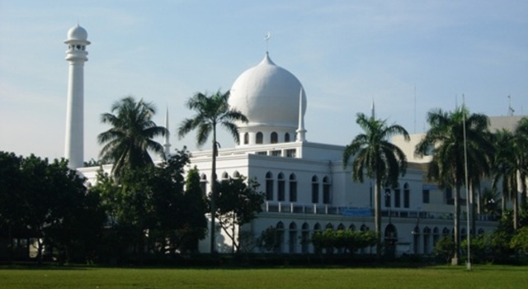
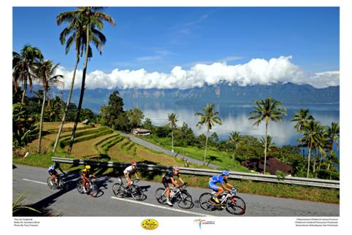

ISLAMIC TOURISM
Booming Halal Sector Market → Has reached US$4.3 Trillions
A new lucrative phenomenon since early 2000
GLOBAL TOURISM MARKET (US$ billions, in 2012), Global Muslim US $137 (12,5% of global Expenditure) – the largest, United States $122, Germany $95, China $89, United Kingdom $65, France $52
Copyright © 2014 SofyanHospitality International| ALL RIGHTS RESERVED

Slide 10
The Potential of Global Tourism Industry (2012)
Description
OIC
Room for Growth
World
Room for Growth
Indonesia
Global Muslim Tourist
Receipts
(ISLAMIC TOURISM)
US$ 30.5 billions
(22%)
US$137 billions
(100%)
US$ 1,66 billions
(1.2%)
International Tourist Receipts
International Tourist Arrivals
US$132.3 billions
(12.3%)
157.3 millions
(15.2%)
US$ 1,075 billions
(100%)
1,035 millions
(100%)
US$ 9.1 Billions
(0.8%)
8.8 millions
(0.8%)
Copyright © 2014 SofyanHospitality International| ALL RIGHTS RESERVED
Notes:
Tambahkan tanda panah “Room for Growth” antara Indonesia dan World, juga antara OIC dan World. Lalu urutannya diganti OIC – World -- Indonesia

Slide 11

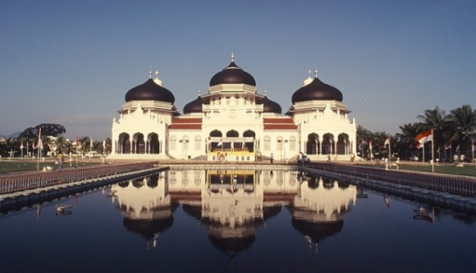

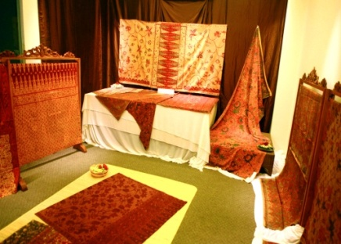
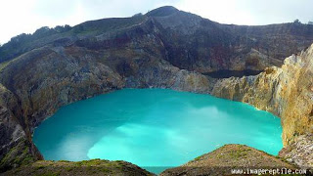




Islamic Tourism
The concept of Islamic tourism is not limited to religious tourism, but it extends to all forms of tourism except those that go against Islamic values.
Need to have
Halal food services
Water usage friendly washrooms and Salaath (Prayer) facilities
All Facilities and Services are Conducive to Islamic Values and Lifestyles
Ramadhan (fasting) services & facilities
Good to have
No non-Halal activities
Sharia Compliant Recreation facilities and services
Nice to have
Copyright © 2014 SofyanHospitality International| ALL RIGHTS RESERVED

Slide 12
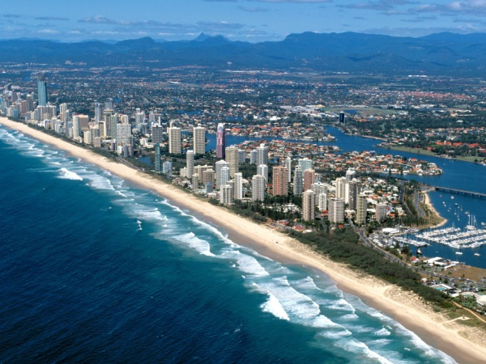
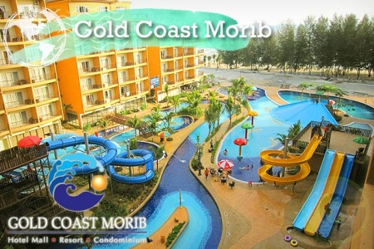
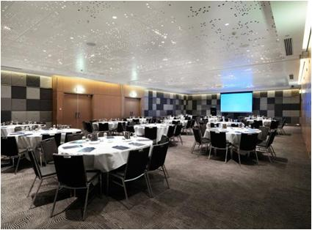
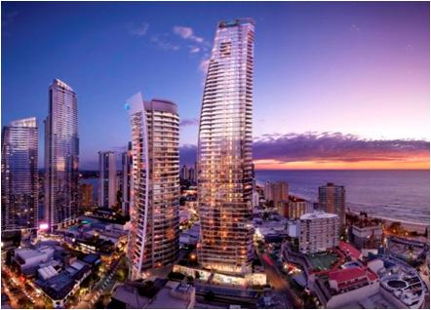


Australia : Gold Coast – Queensland
Prayer rooms in malls & theme parks, halal
food at leading hotels. Qibla and Quran in
rooms..several mosques dotted across Gold Coast*
Government has been jointly organising free Iftar at leading hotels
Five-star Hilton Surfers Paradise - the 15th floor executive lounge turned into Iftar lounge*
Middle East Tourist increased by 38 % *
Average length of stay is 3 weeks and spend per visitor excluding airfare is $7,025 - almost triple the global average*
Hilton Surfers Paradise
*Queensland Tourism Press Release, August 2012
Notes:
Tambahkan gambar Hilton Surfer’s Paradise.

Slide 13

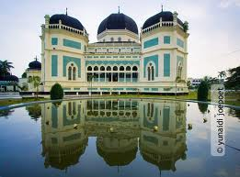

INDONESIA
Indonesia in 2012 launched Islamic Tourism Enhancement Program to boost its Tourism Receipts.
On June 2 and 3, 2014, hosted The First OIC International Forum on Islamic Tourism, in Jakarta, Indonesia. As implementation of Resolutions adopted at the 8th Islamic Cooperation Tourism Ministers Meeting in Gambia 2013.
The Fourth Coordination Committee meeting for the Implementation of the Framework for the Development and Cooperation in the domain of Tourism among OIC Member States, was also held in Jakarta on June 3, 2014 , and designated Indonesia to coordinate relevant actions for development and cooperation on Islamic Tourism among OIC member states
Copyright © 2014 SofyanHospitality International| ALL RIGHTS RESERVED
Notes:
Jadi satu dengan slide 13

Slide 14

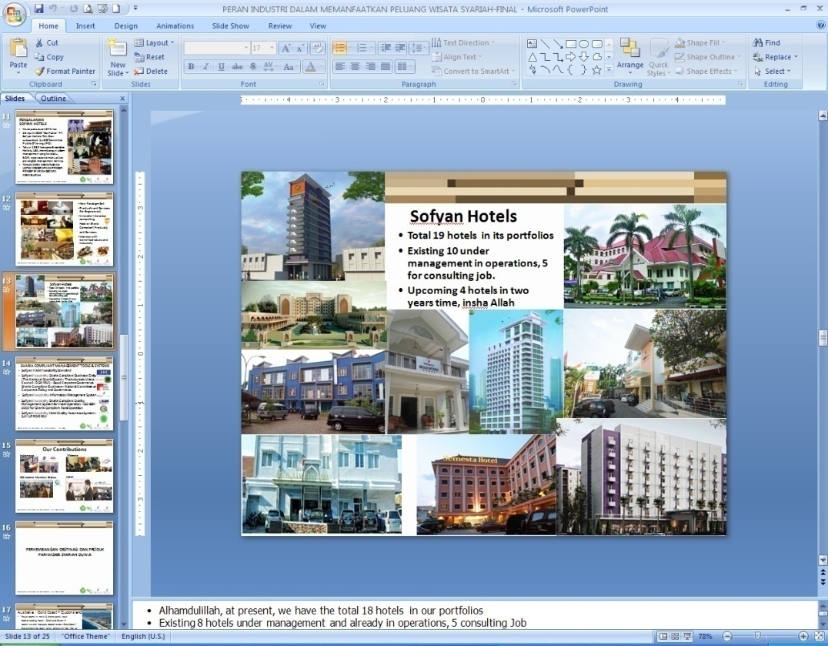
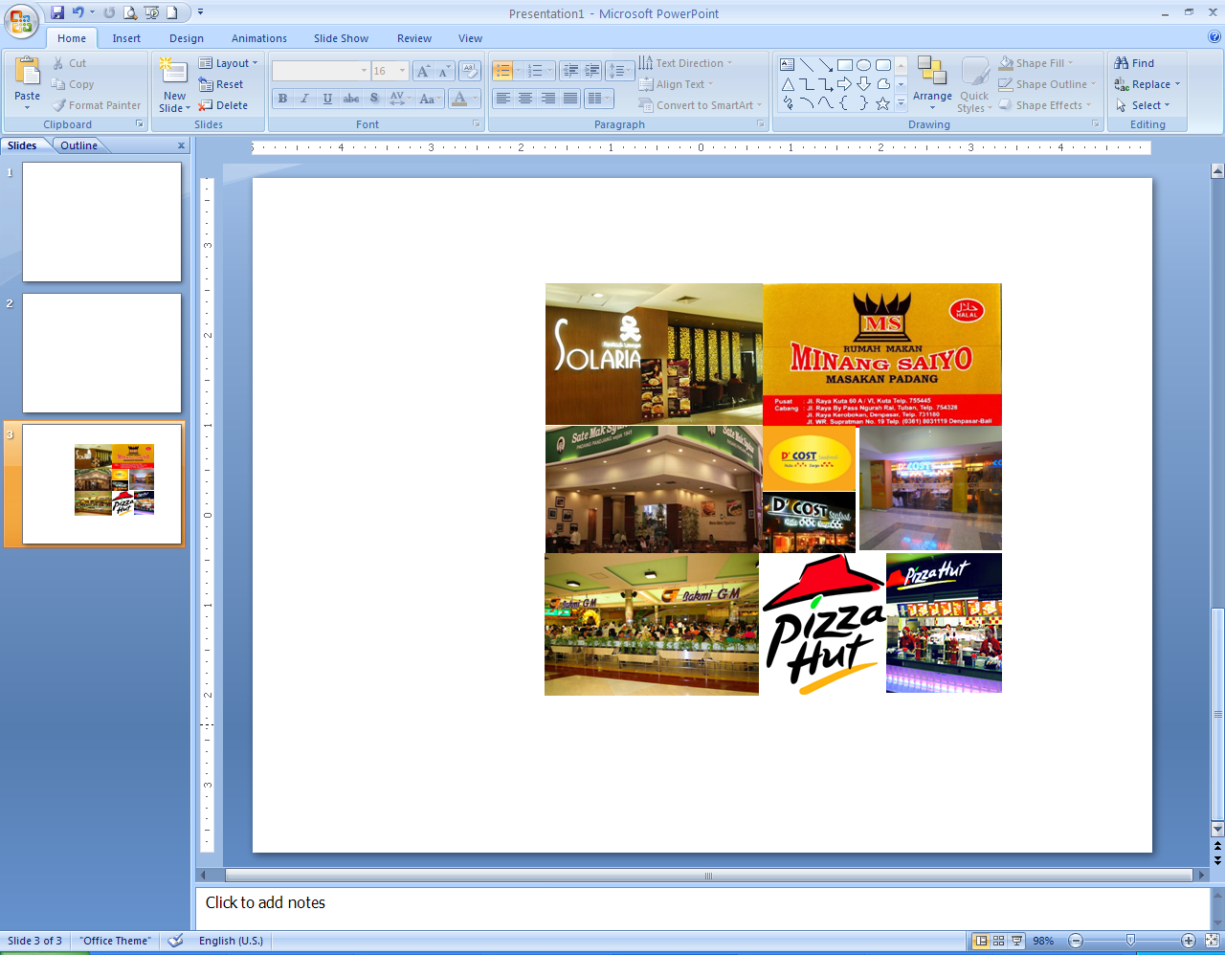
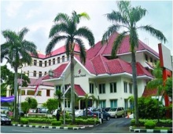
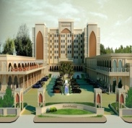
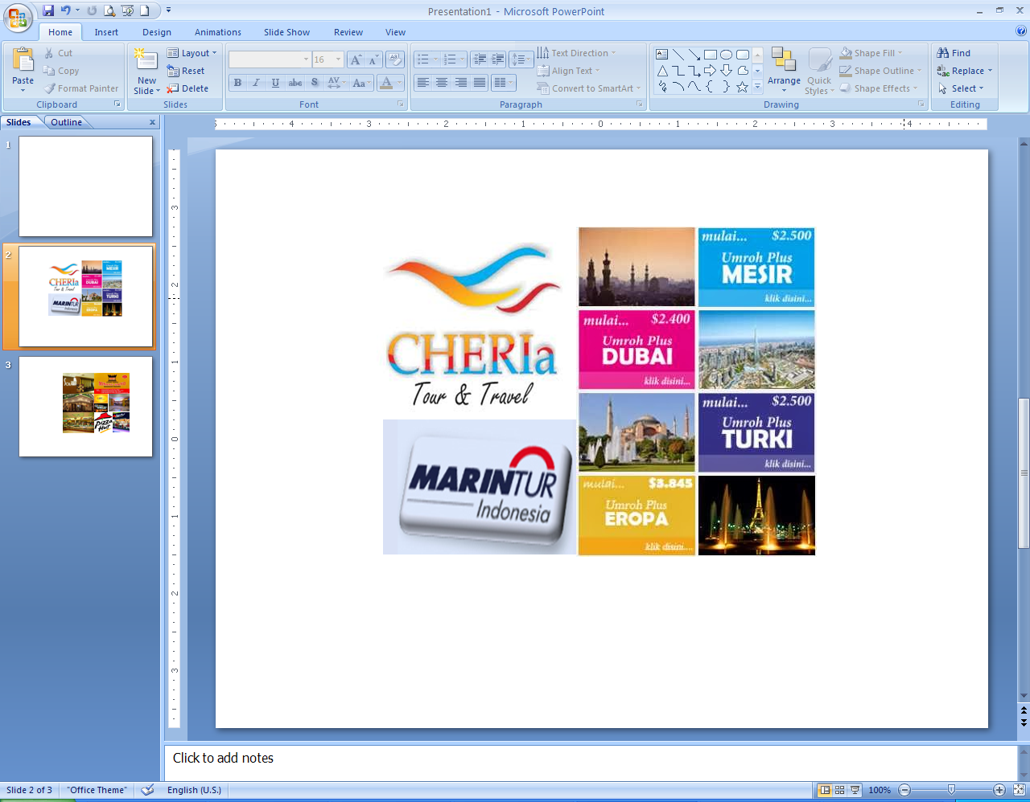
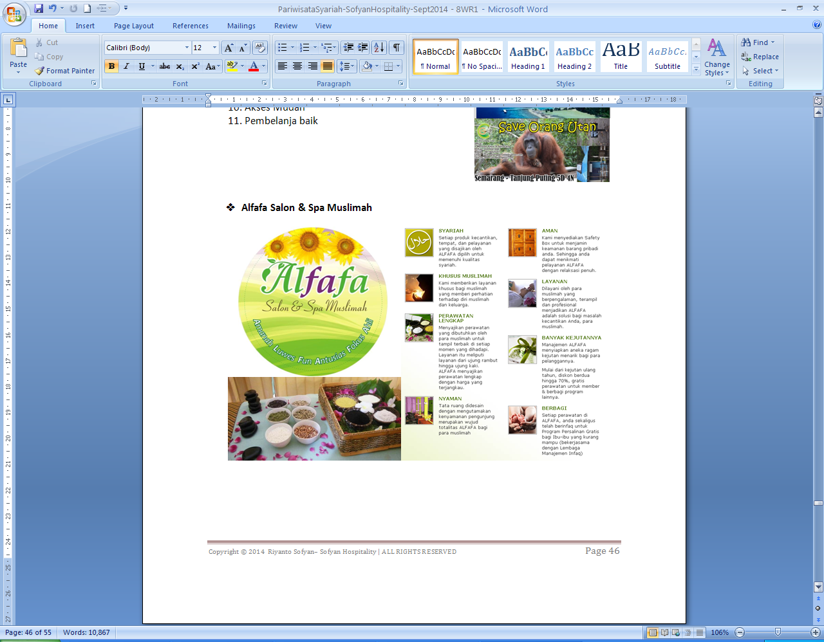
Halal & Sharia Compliant Certified Hospitality Facilities & Services in Indonesia
HOTELS
9.812 HOTELS with 142.275 ROOMS
37 SHARIA COMPLIANT CERTIFIED
ESTIMATED 150 SHARIA COMPLIANT OPERATED
RESTAURANTS
2.916 RESTAURANTS
303 HALAL COMPLIANT CERTIFIED
ESTIMATED 1.800 HALAL COMPLIANT OPERATED
TOUR & TRAVEL
3.698 TOTAL TOUR & TRAVEL
27 SHARIA COMPLIANT CERTIFIED
ESTIMATED 800 SHARIA COMPLIANT OPERATED
SPA
29 TOTAL SHARIA COMPLIANT CERTIFIED
ESTIMATED 100 SHARIA COMPLIANT OPERATED
Copyright © 2014 SofyanHospitality International| ALL RIGHTS RESERVED
Notes:
Tolong dibetulkn, judulnya ditimbulkan, dan gambar- gambar diusahakan lebih besar, benar yang ada ditulisan IAEIpidia, Hotel, Restoran, Tour Traveldan Spa.

Slide 15
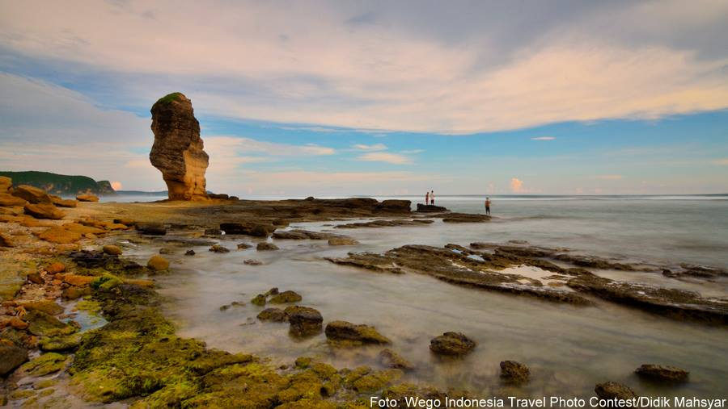
Islamic Tourism Enhancement Program
BUILD A STRATEGIC DEVELOPMENT PLAN
DEVELOPING ISLAMIC TOURISM PRODUCTS STANDARDIZATION AND CERTIFICATION,
DEVELOPING ISLAMIC TOURISM HUMAN RESOURCES COMPETENCY STANDARD, TRAINING PROGRAMS AND CERTIFICATION
BUILDING AWARENESS and CAPACITY BUILDING
POSTIONING, DIFFERENTIATION, BRANDING and PROMOTION
Copyright © 2014 SofyanHospitality International| ALL RIGHTS RESERVED

Slide 16

FOCUS STRATEGY 2
To increase the proportion of spending in the Tourism sector that reaches the SMEs
Copyright © 2014 SofyanHospitality International| ALL RIGHTS RESERVED

Slide 17
INITIATIVES PROGRAMS to PROMOTE SME’s ROLES in TOURISM SECTOR
Government Policy to nurture the development of SME’s enterprises.
  Rules and restrictions of investment and ownership : (PERPRES No. 39 Tahun 2014 & UU No. 10 Tahun 2009).
    100 %of capital share can be owned by foreign investor for large enterprises (eg. 3 to 5 Star Rated Classified Hotel, Golf Course & Driving Range, etc)
    50% of capital share can be owned by Foreign investor for medium enterprises (e.g :Motel & Lodging Service, Spa, Restaurant, Recreational Parks, etc)
    100% of capital share can only be owned local investor for small enterprises (eg. Travel Agent and tourist guide only permitted for domestic
Copyright © 2014 SofyanHospitality International| ALL RIGHTS RESERVED

Slide 18
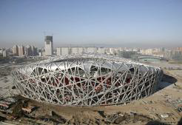

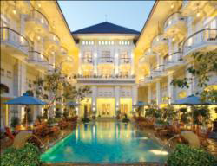
INITIATIVES PROGRAMS to PROMOTE SME’s ROLES in TOURISM SECTOR
Redistribution of proceeds from tax or charge on tourists or tourism enterprises to promote SME’s role through subsidized programs for capacity building, etc.
Encourage support from tourists or tourism enterprises to SMEs developments. (Grant, CSR, etc.)
Encourage Investment in infrastructure stimulated by tourism also benefiting the SME’s enterprise in the locality, directly or through support to other sectors.
Arrangement & facilitation of joint ventures between large enterprises & SMEs
Facilitation of export financing for SMEs
Copyright © 2014 SofyanHospitality International| ALL RIGHTS RESERVED

Slide 19



INITIATIVES PROGRAMS to PROMOTE SME’s ROLES in TOURISM SECTOR
Provide Technical and Financial Assistants for SMEs to acquire business certifications. (Tourism Minister Regulation no. 6 year 2014 article 5)
Conduct trainings and certification of competence for Human Resources in tourism industry to support capacity building.
Copyright © 2014 SofyanHospitality International| ALL RIGHTS RESERVED

Slide 20


INITIATIVES PROGRAMS to PROMOTE SME’s ROLES in TOURISM SECTOR
Zakat, Waqaf, and other charity fund utilization for the empowerment of SME.
Employment of tourism enterprises can be outsourced by SME’s. Eg. Security Staff, Cleaning and House keepings.
Supply of goods and services to tourism sector by the SME’s enterprises.
Expand direct access for SMEs to sell their products and services to tourists.
Support on financing empowerment for micro business actors by micro finance institution.
Copyright © 2014 SofyanHospitality International| ALL RIGHTS RESERVED

Slide 21
CONCLUSIONS
Tourism is one of the strongest drivers of world trade, prosperity and poverty alleviation.
One of the most lucrative opportunity for high growth in tourism receipts is Islamic Tourism.
SMEs represent a principal driving force of economic growth and in nature are closely related to Tourism Industry should be empowered to the fullest capacity in all of Tourist Destinations development strategies and action plans.
Copyright © 2014 SofyanHospitality International| ALL RIGHTS RESERVED

Slide 22

THANK YOU
riyanto.sofyan@sofyanhotel.com
www.sofyanhotel.com
www.arvacorporation.com
For Information Only, Non Binding and Copyrights
The following is intended to outline our general product/services direction. It is intended for information purposes only, and may not be incorporated into any contract. It is not a commitment to deliver any material, code, or functionality, and should not be relied upon in making purchasing or project contract’s decision. The development, release, and timing of any features or functionality described for Sofyan Hospitality products remains at the sole discretion of PT. Sofyan Hotels Tbk – Sofyan Hospitality. All rights reserved. No part of this document may be reproduced or transmitted in any form or by any means, electronic, mechanical, photocopying, recording, or otherwise, without prior written permission of
PT. Sofyan Hotels Tbk – Sofyan Hospitality
Copyright © 2014 SofyanHospitality International| ALL RIGHTS RESERVED

