Slide 1
International Tourism In Oic Member Countries
Prospects and Challenges
Statistical, Economic And Social Research And Training Centre For Islamic Countries (SESRIC)
Organization Of Islamic Cooperation (OIC)
Dr. Cem Tintin
Researcher
First Investment Forum of the OIC Plan of Action for Cooperation with Central Asia,
27-28 October 2014, Dushanbe, Republic of Tajikistan

Slide 2
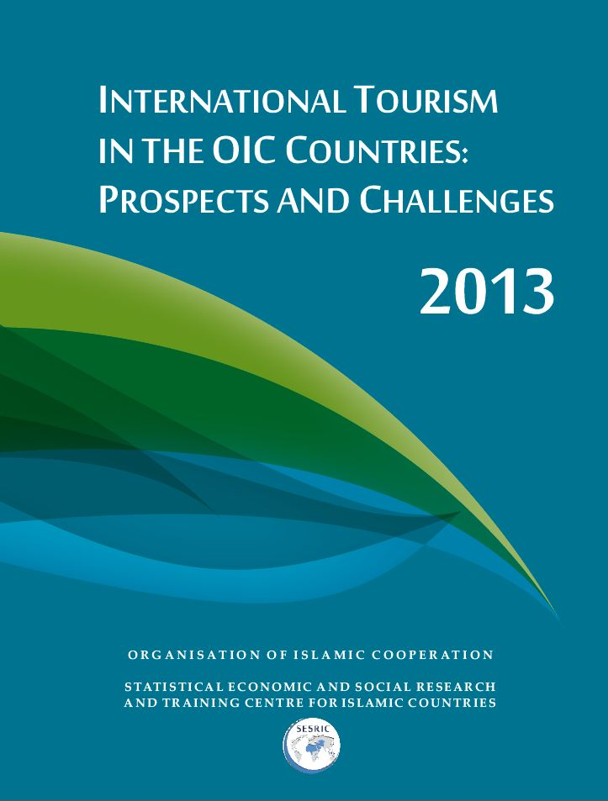
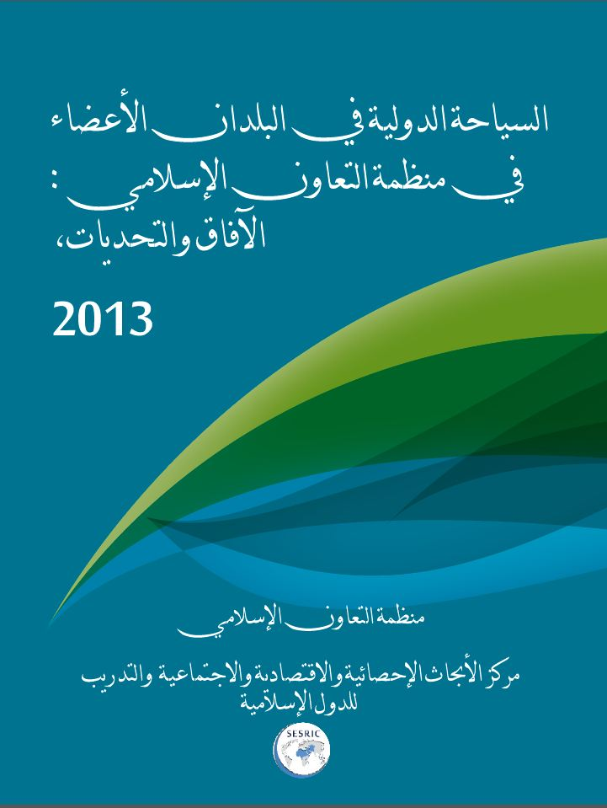
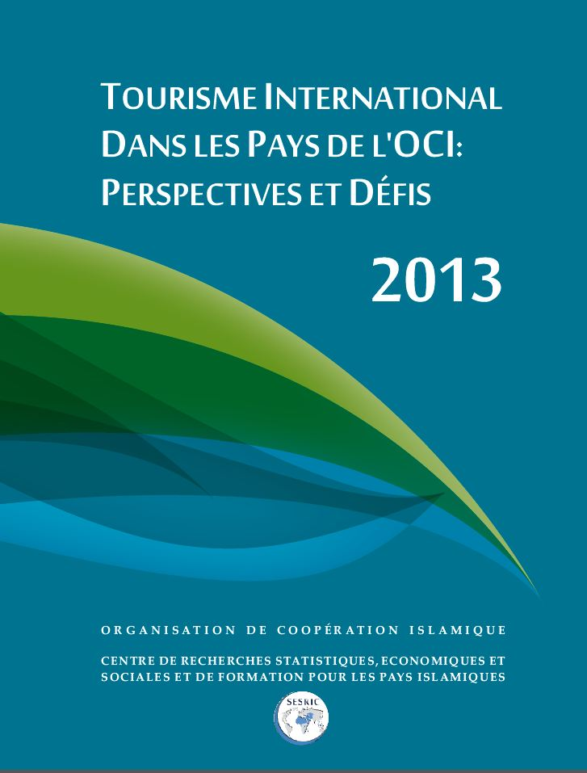

Slide 3
Contents
I. Highlights on International Tourism Worldwide
II. Highlights on International Tourism in OIC Countries
III. The Economic Role of International Tourism in OIC Countries
IV. Intra-OIC Tourism
V. Highlights on SMEs in OIC Countries and the World
VI. Challenges
VII. Recommendations

Slide 4
Highlights on International Tourism Worldwide

Slide 5
Importance of International Tourism
A remarkable socio-economic phenomena of the past century.
One of the world’s largest industries and categories of international trade.
All the activities that are directly/indirectly involved in providing goods and services to tourists (According to SICTA: 185 supply-side activities).
Transportation and communication, hotels and lodging, food and beverages, cultural and entertainment, banking and finance, promotion and publicity services, etc.

Slide 6
Global Tourism Trends: Arrivals and Receipts
Over the last decade, international tourism is growing at substantial and sustainable rates.
From 2007-2013, arrivals are up from 900 to 1087 millions. Similarly, receipts are up from $858 billion to $1159 billion.
During the period under consideration, tourist arrivals increased at an annual average growth of 3.2 per cent whereas annual average growth rate of tourism receipts is around 5.1 per cent.
First Investment Forum of the OIC Plan of Action for Cooperation with Central Asia, 27-28 October 2014, Dushanbe, Republic of Tajikistan

Slide 7
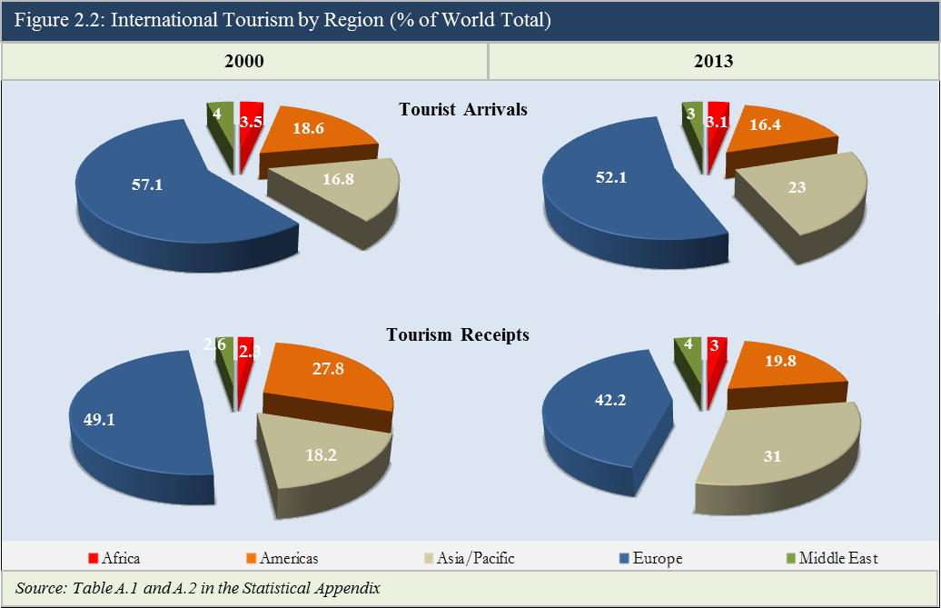
Global Tourism Trends: Regional Performance |2000 vs. 2013|
First Investment Forum of the OIC Plan of Action for Cooperation with Central Asia, 27-28 October 2014, Dushanbe, Republic of Tajikistan

Slide 8
Global Tourism Trends: Regional Performance |Tourism Receipts|
Annual % Change
After 2009, tourism receipts has been continuously on the rise in Africa, Americas and Asia & Pacific.
The average rate of growth of tourism receipts between 2006 and 2012 is as follows:
Africa: 7.0%
Americas: 6.0%
Asia & Pacific: 13.7%
Europe: 4.4%
Middle East: 9.1%
First Investment Forum of the OIC Plan of Action for Cooperation with Central Asia, 27-28 October 2014, Dushanbe, Republic of Tajikistan

Slide 9
Global Tourism Trends: Tourism Receipts per Arrival in 2013 (US$)
The average tourism receipts per arrival is above the world average of $1066 in Asia&Pacific and Americas, whereas, in Middle East, Europe and Africa, it is below the world average.
First Investment Forum of the OIC Plan of Action for Cooperation with Central Asia, 27-28 October 2014, Dushanbe, Republic of Tajikistan

Slide 10
Highlights on International Tourism in OIC Countries

Slide 11
OIC Tourism Trends: Arrivals and Receipts
Figure 3.1: International Tourism in OIC Countries
Tourist Arrivals and Tourism Receipts
Annual % Change
The number of international tourist arrivals in the OIC countries increased from 155.5 million in 2008 to 157.3 million in 2012 corresponding to a 15.2% share in the world. The annual average growth rate is 0.23% between 2008-2012 (impact of recession). However, for the 2000 -2011 period it is 7.2%.
In 2008, these tourists generated $124.1 billion as international tourism receipts in the OIC countries, corresponding to a 14.2% share in the world’s total tourism receipts. In 2012, international tourism receipts amounted to $132.3 billion corresponding to a 12.9% share in world’s total tourism receipts. The annual average growth rate is 1.29%. However, for the 2000 -2011 period it is 10.6%.
First Investment Forum of the OIC Plan of Action for Cooperation with Central Asia, 27-28 October 2014, Dushanbe, Republic of Tajikistan

Slide 12
OIC Tourism Trends: Top Tourist Destinations and Earners, 2012
Top 10 OIC Tourism Destinations
Top-10 countries hosted 124.7 million international tourist , corresponding to a share of 79.2% of the OIC total in 2012.
Top 10 OIC Tourism Earners
Top-10 countries earned $110.6 billion as international tourism receipts in 2012, corresponding to a share of 83.5% of the OIC total.
First Investment Forum of the OIC Plan of Action for Cooperation with Central Asia, 27-28 October 2014, Dushanbe, Republic of Tajikistan

Slide 13
OIC Tourism Trends: International Tourism Receipts per Arrival in OIC Countries in 2012 (US$)
The OIC average tourism receipts per arrival in 2012 amounted to $841.
The highest receipts per tourist arrival were recorded in Lebanon ($4611) followed by Qatar ($2934) and Maldives ($1981).
First Investment Forum of the OIC Plan of Action for Cooperation with Central Asia, 27-28 October 2014, Dushanbe, Republic of Tajikistan

Slide 14
The Economic Role of International Tourism in OIC Countries

Slide 15
OIC Tourism Trends: Balance of International Tourism, Billion US$ 2012
Balance of international tourism is calculated by deducting the international tourism expenditure from the international tourism receipts.
Notably, majority of the countries with highest tourism balance are the main OIC international tourism destinations and earners. Turkey has a surplus of $27.6 billion followed by Malaysia with a surplus of $8.7 billion.
First Investment Forum of the OIC Plan of Action for Cooperation with Central Asia, 27-28 October 2014, Dushanbe, Republic of Tajikistan

Slide 16
Economic Role of Tourism in OIC Countries
81.95
Source: WDI.
First Investment Forum of the OIC Plan of Action for Cooperation with Central Asia, 27-28 October 2014, Dushanbe, Republic of Tajikistan

Slide 17
Intra-OIC Tourism

Slide 18
Intra-OIC Tourism Trends: Arrivals and Receipts
Intra-OIC tourist arrivals decreased from 46.9 million in 2008 to 46.3 million in 2012.
In 2012, intra-OIC tourist arrivals accounted for 30.7 % of the total tourists arrivals in OIC.
Intra-OIC tourism receipts are up from US$ 29.9 billion in 2008 to US$ 30.5 billion in 2012.
As of 2012, Intra-OIC tourism receipts accounted for almost 24.6% of the total international tourism receipts in the OIC.
First Investment Forum of the OIC Plan of Action for Cooperation with Central Asia, 27-28 October 2014, Dushanbe, Republic of Tajikistan

Slide 19
Intra-OIC Tourism Trends: Top Tourist Destinations and Earners, 2012
Arrivals (Millions)
Top-10 countries hosted 41.3 million tourists from the OIC member countries, corresponding to 90.2% of the total intra-OIC tourist arrivals in 2012.
Receipts (Billion US$)
Top-10 countries earned US$ 27.9 billion from intra-OIC tourists corresponding to 91.4% of the total intra-OIC receipts.
First Investment Forum of the OIC Plan of Action for Cooperation with Central Asia, 27-28 October 2014, Dushanbe, Republic of Tajikistan

Slide 20
Highlights on SMEs in OIC Countries and the World

Slide 21
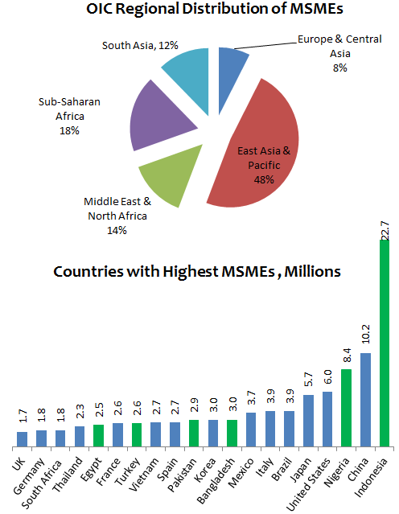
MSMEs in OIC Countries and the World (I)
In 132 countries in the world there are over 125 million formal Micro, Small and Medium Enterprises (MSMEs) …of which 72 per cent are operating in developing countries
In 34 OIC Countries, with data, there are 48 million formal MSMEs ….accounting for 38 per cent of the world and 54 per cent of the developing countries total MSMEs
48 per cent of total MSMEs in OIC operate in three Countries from East Asia and Pacific region namely: Brunei, Indonesia and Malaysia
Six OIC Countries namely: Indonesia, Nigeria, Bangladesh, Pakistan, Turkey and Egypt are ranked among the top-20 countries with highest number of MSMEs operating in the world
Indonesia alone accounts for over 18 per cent of the world total MSMEs
Brunei and Indonesia are ranked First and Second in the world with highest density of MSMEs
Data Source: World Bank International Finance Corporation (IFC), MSME Country Indicators 2010
First Investment Forum of the OIC Plan of Action for Cooperation with Central Asia, 27-28 October 2014, Dushanbe, Republic of Tajikistan

Slide 22
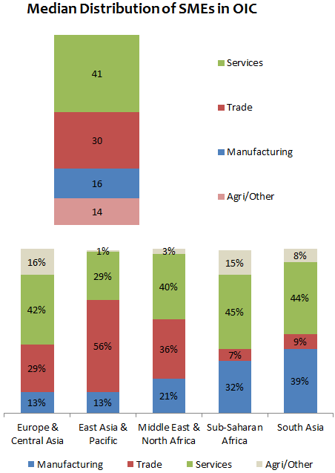
MSMEs in OIC Countries and the World (II)
On average, formal MSMEs employ 34 percent of the workforce in OIC Countries, compared to 39 percent in Non-OIC Developing and 41 percent in the world
MSMEs contribute 47 to 82 percent of total employment in 8 OIC Countries whereas this ratio is 20 to 40 percent for 9 OIC Countries
71 per cent of SMEs in 20 OIC Countries, with data, are operating in Services (41%) and Trade (30%) sectors
Except East Asia & Pacific region, over 40 percent SMEs are operating in Services across the OIC regions
In South Asia and Sub-Saharan Africa Manufacturing accounts for the second highest share of SMEs compared to Trade in other regions
Services sector accounted for over 40 percent of total SMEs operating in 15 OIC Countries.
Data Source: World Bank International Finance Corporation (IFC), MSME Country Indicators 2010
First Investment Forum of the OIC Plan of Action for Cooperation with Central Asia, 27-28 October 2014, Dushanbe, Republic of Tajikistan

Slide 23
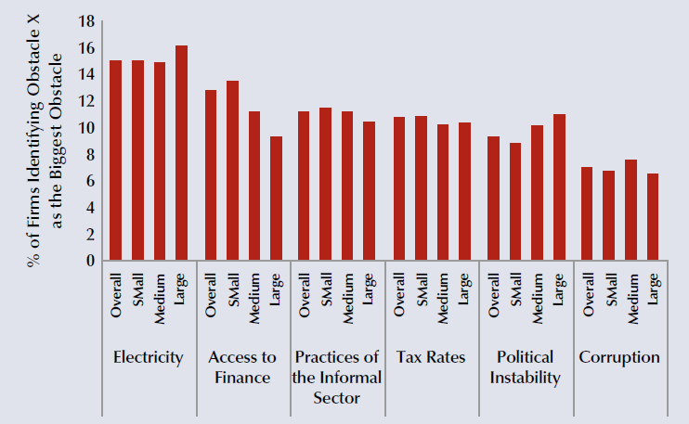
MSMEs in OIC Countries and the World: Challenges
According to the findings of the World Bank Enterprise Surveys Dataset access to electricity and finance are the most cited obstacles for all businesses including SMEs in the developing countries.
Six Most Commonly Cited Obstacles by Firms in Developing Countries
(out of 15 obstacles)
Data Source: World Bank International Finance Corporation (IFC), MSME Country Indicators 2010
First Investment Forum of the OIC Plan of Action for Cooperation with Central Asia, 27-28 October 2014, Dushanbe, Republic of Tajikistan
Notes:
A recent study by International Finance Corporation (IFC) found that around 35 per cent of SMEs in the Middle East and North Africa (MENA) are excluded from the formal banking sector because they seek Sharia-compliant products that are not readily available in the market (i.e.

Slide 24
Challenges
The challenges are diverse as each country has its own tourism features, level of development and national development priorities and policies.
Technical know-how and weak promotional activity
Tourism-related infrastructures
Tourism investments
Consistent tourism strategies and policies
Tourism diversification
Tourism safety
First Investment Forum of the OIC Plan of Action for Cooperation with Central Asia, 27-28 October 2014, Dushanbe, Republic of Tajikistan

Slide 25
Policy Recommendations (I)
At the National Level
Sustainable tourism development strategies and plans
Physical planning of tourism destinations
The quality and efficiency of the basic tourism-related infrastructures and services
Synergies between transport and tourism policies
Private sector involvement including SMEs in tourism development plans and projects
Diversification of tourism products and services
Tourism-oriented education and training programmes
First Investment Forum of the OIC Plan of Action for Cooperation with Central Asia, 27-28 October 2014, Dushanbe, Republic of Tajikistan

Slide 26
Policy Recommendations (II)
At the OIC Cooperation Level
OIC Internet Guide for Tourism
OIC Tourism Alliances, Airline Companies
Agreement on Tourism Visa Arrangements
Promote and Encourage public-private joint investment in Tourism
First Investment Forum of the OIC Plan of Action for Cooperation with Central Asia, 27-28 October 2014, Dushanbe, Republic of Tajikistan

Slide 27
Thank You
Statistical, Economic And Social Research And Training Centre For Islamic Countries (SESRIC)
Organisation of Islamic Cooperation (OIC)
www.sesric.org
First Investment Forum of the OIC Plan of Action for Cooperation with Central Asia, 27-28 October 2014, Dushanbe, Republic of Tajikistan

