Slide 1

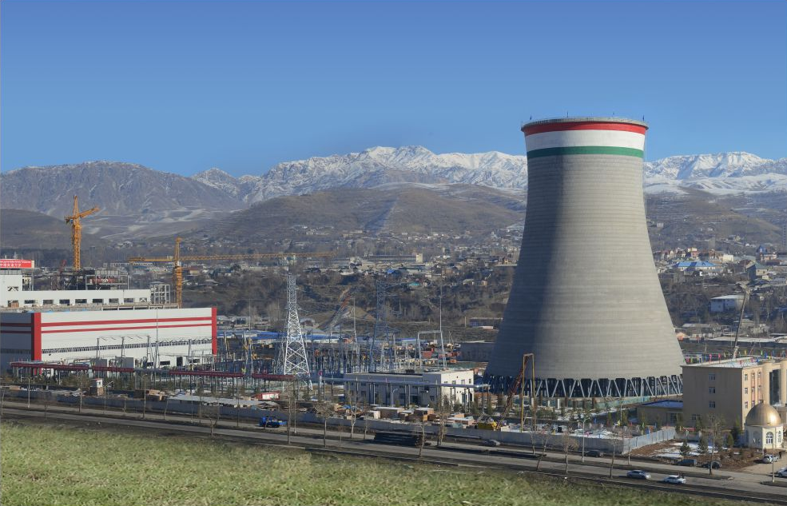
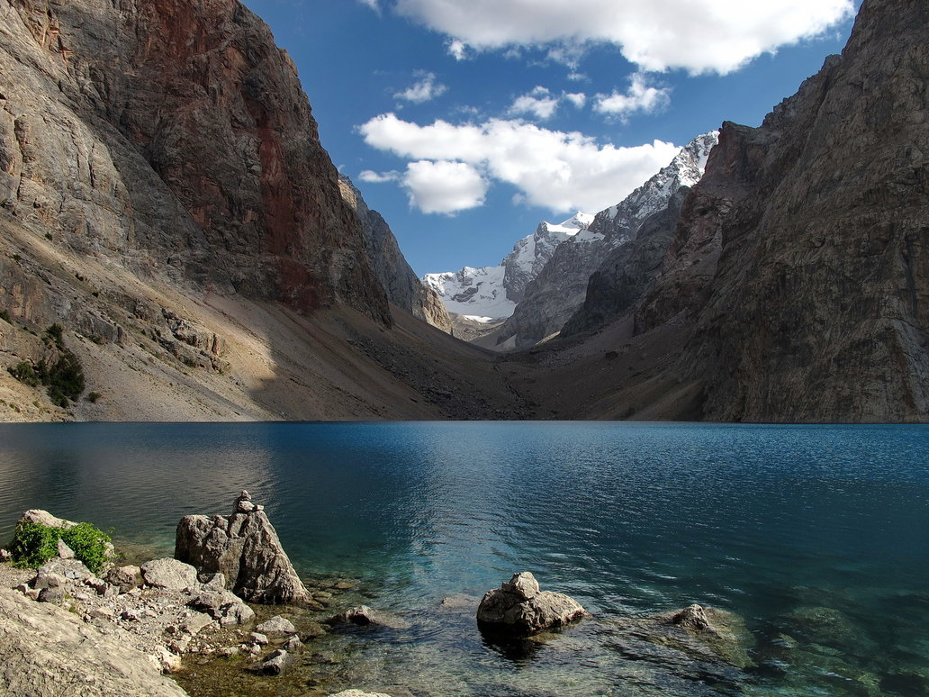

Ministry of Energy and Water Resources of the Republic of Tajikistan
U. Usmonzoda
Minister of Energy and Water Resources
Notes:
We designed this template so that each member of the project team has a set of slides with its own theme. Members, here’s how you add a new slide to just your set:
Mark where you want to add the slide: Select an existing one in the Thumbnails pane, click the New Slide button, then choose a layout. The new slide gets the same theme as the other slides in your set.
Careful! Don’t annoy your fellow presenters by accidentally changing their themes. That can happen if you choose a different theme from the Design tab, which changes all of the slides in the presentation to that look.

Slide 2
NATIONAL DEVELOPMENT STRATEGY
NATIONAL DEVELOPMENT STRATEGY
ENERGY INDEPENDENCE
DEVELOPMENT OF TRANSPORT CORRIDORS
FOOD SECURITY

Slide 3
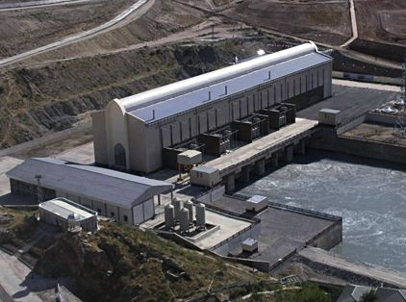
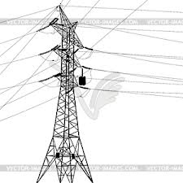



ENERGY INDEPENDENCE
NEW ENERGY CAPACITIES
NEW ENERGY INFRASTRUCTURE
ENERGY EFFICIENCY AND RENEWABLE ENERGY
REDUCTION OF LOSSES
REGIONAL ENERGY MARKET
BILLING SYSTEMS

Slide 4
ENERGY PROFILE
Potential for generate 527 billion. KW. hours per year;
The installed capacity of power plants of 5400 MW;
Of these, 95% hydro and 5% thermal power stations;
The annual generation more than 17 billion. KW. hour;
Excess of hydropower in the summer months (from 3 to 5 billion. KW. hour);
Winter energy shortages more than 2,5 billion. KW. hour;

Slide 5
PROJECTS
Completed Projects
1.7 billion. USD
Ongoing Projects
268 million. USD
Projects
on design and preparation stage
938,3 million. USD

Slide 6

REGIONAL ENERGY MARKET
During the first 9 months of 2014 exported more than 1.2 billion. kWh of energy!
Regional Power Transmission Project CASA - 1000

Slide 7

Projects financed by ADB
ADB
REGIONAL POWER TRANSMISSION PROJECT GRANT 0213-TAJ
ONGOING
GOLOVNAYA 240 MW HPP REHABILITATION PROJECT GRANT
ONGOING
WHOLESALE METERING AND TRANSMISSION REINFORCEMENT PROJECT
GRANT
ON PREPARATION STAGE
REHABILITATION OF ENERGY SECTOR OF THE REPUBLIC OF TAJIKISTAN
LOAN 1817-TAJ
COMPLETED
EMERGENCY BAYPAZA HPP LANDSLIDE STABILIZATION
LOAN 1912-TAJ
COMPLETED
REGIONAL POWER TRANSMISSION INTERCONNECTION PROJECT
LOAN 2303-TAJ
COMPLETED
RECONSTRUCTION OF 500kV SWITCHYARD AT NUREK HPP GRANT 0124-TAJ
ONGOING

Slide 8

Projects financed by IDB
IDB
REGIONAL POWER INTERCONNECTION TRANSMISSION PROJECT Loan 0030-TAD
COMPLETED
REHABILITATION OF RAVSHAN SUBSTATION
0054-TAD
ONGOING
CONSTRUCTION OF MHPP IN RURAL AREAS OF THE REPUBLIC OF TAJIKISTAN Loan 0022-TAD
COMPLETED
REHABILITATION OF ENERGY SECTOR OF THE REPUBLIC OF TAJIKISTAN
Loan 0011,0029 and 0031-TAD
COMPLETED

Slide 9

Projects financed by EXIMBANK
EximBank China
ADDITIONAL WORKS OF CONSTRUCTION 500kV OHL SOUTH-NORTH AND 220kV OHL LOLAZOR-KHATLON
COMPLETED
ESTABLISHMENT OF UNIFIED POWER SYSTEM OF THE NORTH OF TAJIKISTAN
COMPLETED
CONSTRUCTION OF 500kV OHL
SOUTH-NORTH
COMPLETED
CONSTRUCTION OF 220kV OHL
LOLAZOR-KHATLON
COMPLETED
CONSTRUCTION OF
220kV OHL HUJAND-AYNI
COMPLETED

Slide 10
Projects financed by EBRD, WORLD BANK AND SECO
EBRD
REHABILITATION OF KAYRAKUM HPP
ONGOING
ENERGY LOSS REDUCTION PROJECT IN SUGHD REGION
ONGOING
WORLD BANK
EMERGENCY AID FOR POWER SECTOR OF TAJIKISTAN
COMPLETED
ENERGY LOSS REDUCTION PROJECT IN DUSHANBE CITY
ONGOING
SECO
POWER REHABILITATION PROJECT
COMLETED
ENERGY LOSS REDUCTION PROJECT IN DUSHANBE CITY
ONGOING

Slide 11
Projects financed by KFW, KFAED and OPEC
RECONSTRUCTION OF 220kV SWITCHYARD AT NUREK HPP
REHABILITATION OF DUSHANBE CITY ELECTRICITY NETWORKS
REGIONAL POWER TRANSMISSION INTERCONNECTION PROJECT

Slide 12









Our development partners

Slide 13
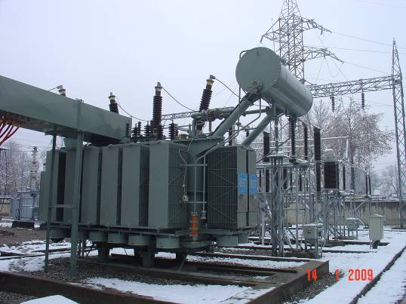
EXAMPLES OF SUCESSFUL PROJECTS
REHABILITATION OF DUSHNBE CITY ELECTRICAL NETWORKS Loan 665
In line with physical and moral depreciation of 0,4/110kV of Dushanbe city electrical networks on June 24, 2003 has been signed Loan Agreement No.665 between the Government of the Republic of Tajikistan and KFAED for allocation the loan for amount of 13,0 mln. USD.
Project components have been successfully completed by the end of 2009. Past two years after completion of project the timeliness of project implementation that allowed to increase reliable power supply for consumers of Dushanbe city has been proved.
Installation of new 110/6kV Power Transformer
at Vakhdat Substation

Slide 14

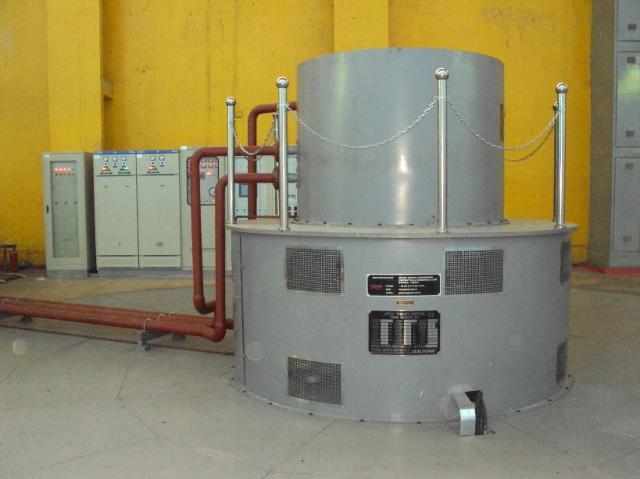
EXAMPLES OF SUCESSFUL PROJECTS
REHABILITATION OF UNIT 4 AT GOLOVNAYA HPP
Project implemented in line with loan agreement TAD-0030 signed between the Government of the Republic of Tajikistan and IDB in October 31, 2007 for amount of 14.06 mln. USD.
Golovnaya HPP was commissioned in 1962-1963, and since that time only 3 units had been rehabilitated in late 1989-1991.
After completion of rehabilitation works the installed capacity of unit No.4 from original 35 MW was increased up to 45 MW.
Unit No.4 at Golovnaya HPP

Slide 15

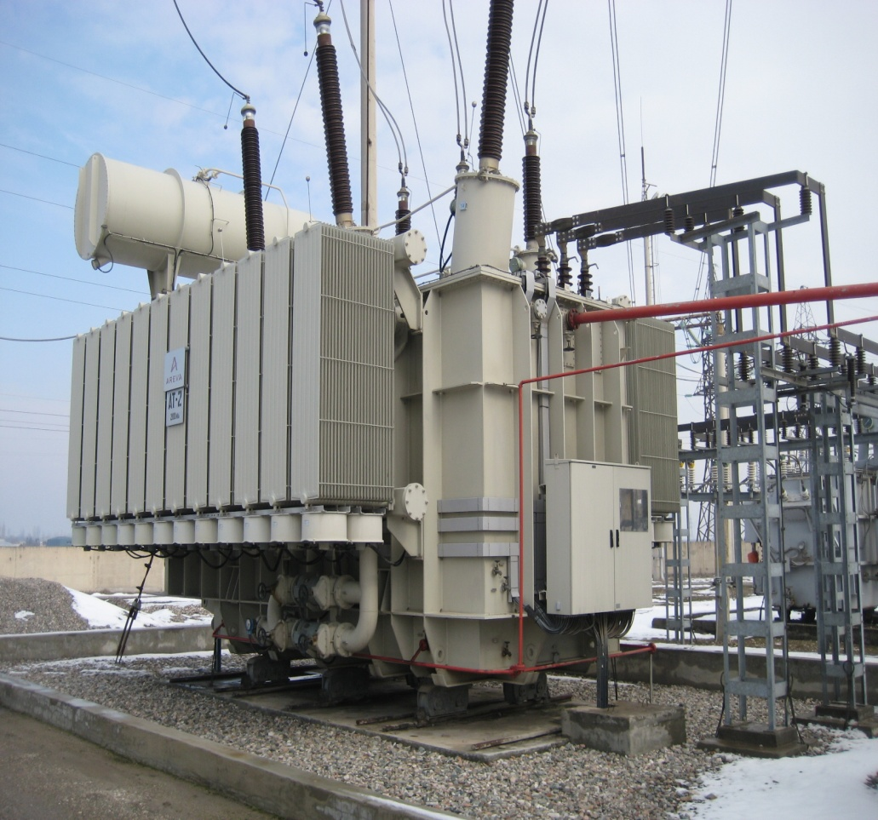
EXAMPLES OF SUCESSFUL PROJECTS
POWER REHABILITATION PROJECT, LOT-6: REHABILITATION OF 220kV NOVAYA
AND JANGAL SUBSTATIONS
The Loan Agreement No.0011-TAD for amount of 7.0 mln. ID under the project concluded on January 29, 2001 between the Government of the Republic of Tajikistan and Islamic Development Bank.
220/110/10kV Novaya and Jangal substations are being the large tie-stations of Tajikistan capital Dushanbe, and has been commissioned in 1965-1977 and second one in 1981. Technical conditions of equipment in both substations were physically and morally worn-out.
The main objective of project is technical modernization of substations equipment, capacity increase of autotransformers and reliable power supply of Dushanbe city and its suburbs.
220kV Jangal Substation
Autotransformer - 1 х200 MWA

Slide 16
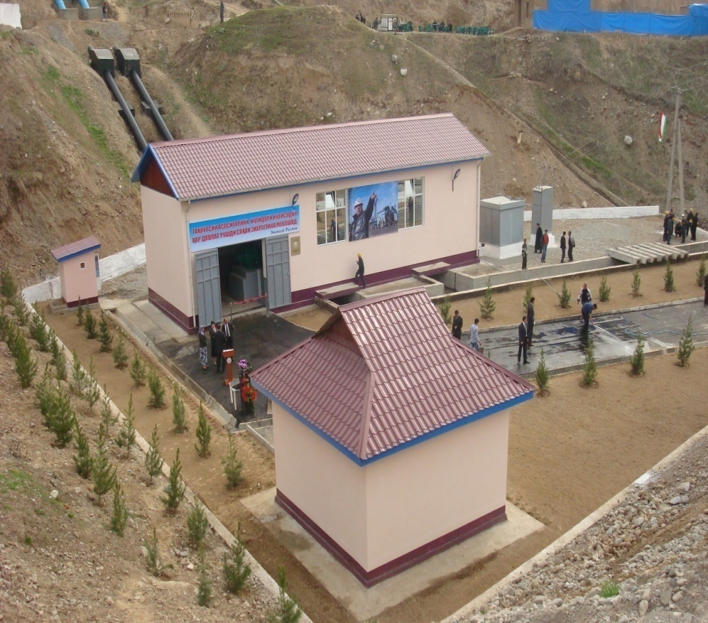
EXAMPLES OF SUCESSFUL PROJECTS
CONSTRUCTION OF MHPP’S IN RURAL AREAS OF TAJIKISTAN LOAN 0022-TAD
During 2010-2011 thanks to financing and support of IDB and OSHPC Barki Tojik, the local contractor companies substantially succeed on fulfillment of their obligations. For the expired period 6 MHPPs have been commissioned: Shashboloi, Fathobod, Shirkent, Horma, Sangikar and Marzich.
At MHPP Pitavkul all construction and setting-up activities had been completed and performed test run for the rated capacity.
At MHPP Toj all construction and installation activities had been completed and at present moment are being conducted the setting-up works.
MHPP Shirkent -576kW
Notes:
Лот 6А дополнительные работы

Slide 17

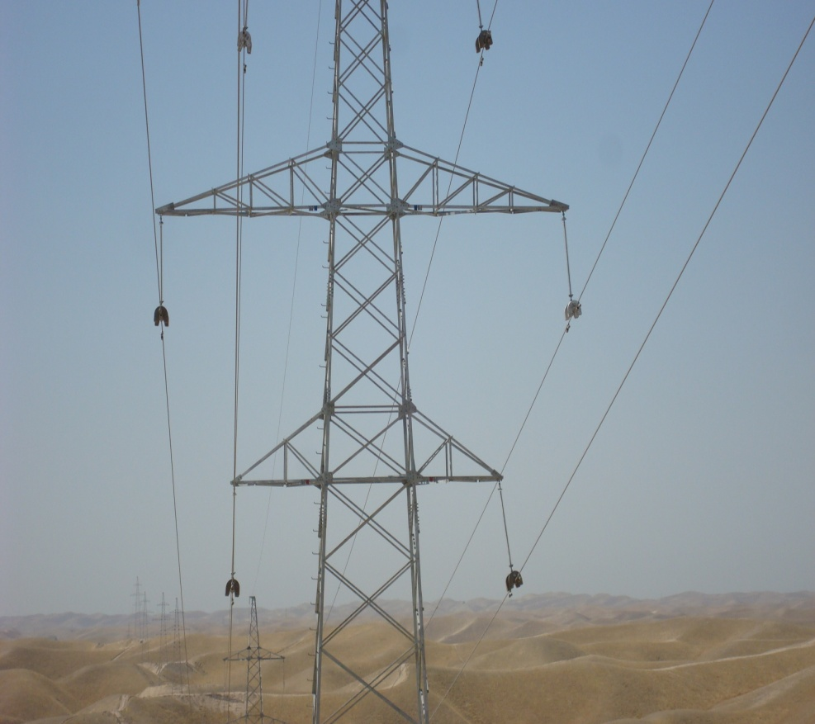
EXAMPLES OF SUCESSFUL PROJECTS
РЕГИОНАЛЬНЫЙ ПРОЕКТ МЕЖСИСТЕМНОЙ ЛИНИИ ЭЛЕКТРОПЕРЕДАЧИ
Loan Agreement No. 2303-TAJ for amount of 21,5 mln. USD dated 22 December 2007.
Loan Agreement No.1141P with OPEC Fund for amount of 8,5 mln. USD dated September, 2007.
The main objective of the project was to increase reliability of electricity transmission system of south region, strengthen regional cooperation through electricity supply of neighboring Afghanistan by less cost power electricity.
ВЛ 220кВ Таджикистан – Афганистан - 116 км

Slide 18
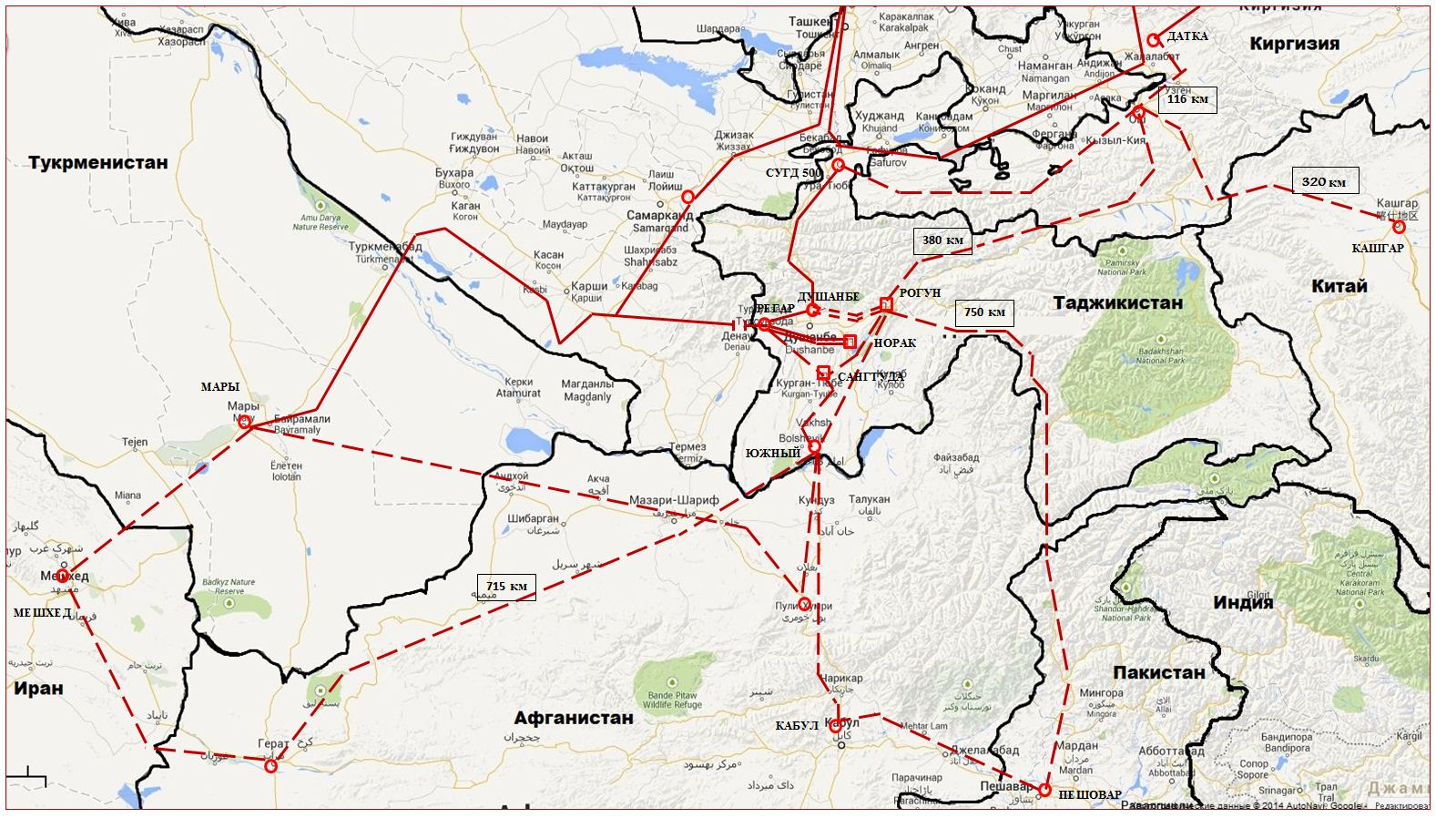
REGIONAL INITIATIVES
Notes:
Лот 6А дополнительные работы

Slide 19
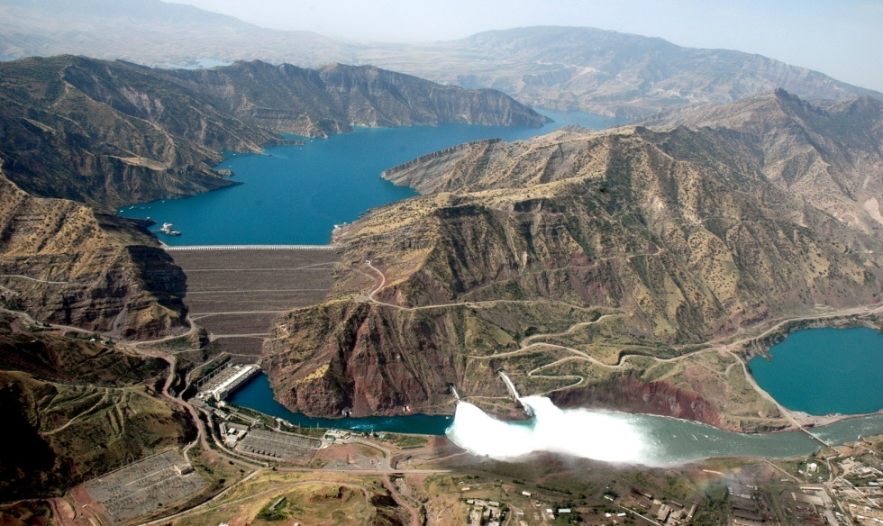
PROSPECTIVE PROJECTS
ROGUN HPP (3600 MW);
SHUROB HPP (900 MW);
NUROBOD HPP– 1 (200 MW);
NUROBOD HPP– 2 (160 MW);
SANGVOR HPP (300-200 MW);
FONDARYO HPP (300 MW);
AYNI HPP (160 MW);
SANOBOD HPP (125 MW);
ZARAFSHON HPP (150 MW)

Slide 20
PROSPECTIVE PROJECTS
DUSHANBE-2 TPP 2х150 MW – SECOND PHASE (300 MW)
SHUROB TPP
(300 MW)
FONYAGNOB (600 MW)

Slide 21

PROSPECTIVE PROJECTS
CASA-1000 PROJECT
TUTAP PROJECT
500kV OHL TAJIKISTAN - PAKISTAN
(through Vakhan corridor)
500kV OHL
TAJIKISTAN-AFGHANISTAN-IRAN

Slide 22
THANK YOU FOR YOUR ATTENTION
Notes:
Лот 6А дополнительные работы

