Slide 1
MODERNIZATION
OF
BORDER GATES
ALİ NEHİR YÜCEL
BUSINESS EXPERT
Notes:
DISTINGUISHED PARTICIPANTS,
LADIES AND GENTLEMAN,
GOOD AFTERNOON

Slide 2
The services given in the BCPs must be effective and rapid.
Modernizing the border gates, which are ineffective and inefficient, becomes one of the most important issues.

Slide 3
Lack of Finance
from the Public Budget
Build – Operate – Transfer Model

Slide 4
TOBB ;
The Union of Chambers and Commodity Exchanges
Umbrella organization for the Turkish Private Sector
1.3 million members

Slide 5
High Sensitivity of Border Gates
TOBB
Organisation with public institution Status

Slide 6
WHO IS GTİ?
Incorporated: 2005
Associated by: TOBB & 137 Chambers
Modernization of Border Gates:
Build – Operate –Transfer (BOT Model)
Notes:
I WOULD LIKE TO START WITH INTRODUCING MY COMPANY “GTI”.
GTI HAS BEEN INCORPORATED IN 2005, BY THE UNION OF CHAMBERS AND COMMODITY EXCHANGES OF TURKEY, WHICH IS KNOWN AS “TOBB”, AND 137 CHAMBERS AROUND TURKEY.
WE MODERNIZE LAND BORDER GATES, WITH THE MODEL, “BUILD – OPERATE – TRANSFER”.
MODERNIZATION OF BORDER GATES WITH THIS MODEL, IS THE FIRST PRACTICE IN THE WORLD.

Slide 7
BUILD
The border gate facility is rebuild.
Financed by GTI
OPERATE
Operation of commercial facilities
TRANSFER
Transfer of facilities to the public free of charge
Operating activities
Notes:
IN THE FIRST STAGE, WHICH IS THE BUILD STAGE, THE BORDER GATE FACILITY IS REBUILD, WITH ALL INVESTMENT FINANCED BY GTI.
IN THE SECOND STAGE, OPERATE STAGE, THE COMMERCIAL FACILITIES ARE OPERATED BY GTI. IT IS VERY IMPORTANT TO MENTION THAT, THE OFFICIAL PROCEDURES ARE STILL UNDERTAKEN BY PUBLIC AUTHORITIES, LIKE PASSPORT OR CUSTOMS CONTROL ETC. MOREOVER OPERATING ACTIVITIES, LIKE HEATING, COOLING, MAINTENANCE ARE ALSO REALIZED BY GTI.
IN THE LAST STAGE, THE WHOLE FACILITY, IS TRANSFERRED TO THE STATE, FREE OF CHARGE.

Slide 8
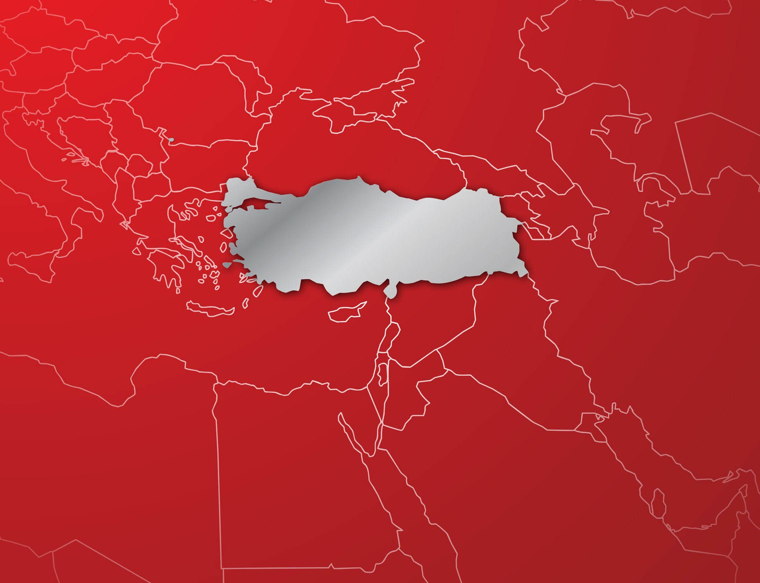
PROJECTS COMPLETED
COMPLETED PROJECTS
HAMZABEYLİ
SARP
KAPIKULE
HABUR
CİLVEGÖZÜ
NUSAYBİN
2013; entering-exiting from Turkish land borders;
Trucks/vehicles: %72
Passengers: %69
Notes:
ON THE MAP, YOU SEE THE BORDER GATES, THAT HAVE BEEN COMPLETED.
HABUR, IS OUR BORDER GATE WITH IRAQ, CILVEGOZU, IS OUR BORDER GATE WITH SYRIA, SARP, IS WITH GEORGIA, HAMZABEYLI AND KAPIKULE, ARE WITH BULGARIA.

Slide 9
Investment Made So Far
$200.000.000
Tax Paid to Government
$125.000.000
Notes:
UNTIL NOW, 200 MILLION DOLLARS OF INVESTMENT, HAVE BEEN REALIZED BY GTI.
MOREOVER, 60 MILLION DOLLARS OF, ADDITIONAL TAX REVENUE, HAVE BEEN PAID TO THE STATE.

Slide 10
PROJECTS COMPLETED
RECENT PROJECTS
HALKALI LOGISTICS CENTER
ÇILDIR – AKTAŞ BORDER GATE
DİLUCU BORDER GATE
KAPIKÖY BORDER GATE
ESENDERE BORDER GATE
$245.000.000 additional investment
Notes:
ON THE MAP YOU CAN SEE THAT WE ARE WORKING OVER 13 MORE PROJECTS WHICH 5 OF THEM ARE ON THE CONSTRUCTION STAGE.

Slide 11
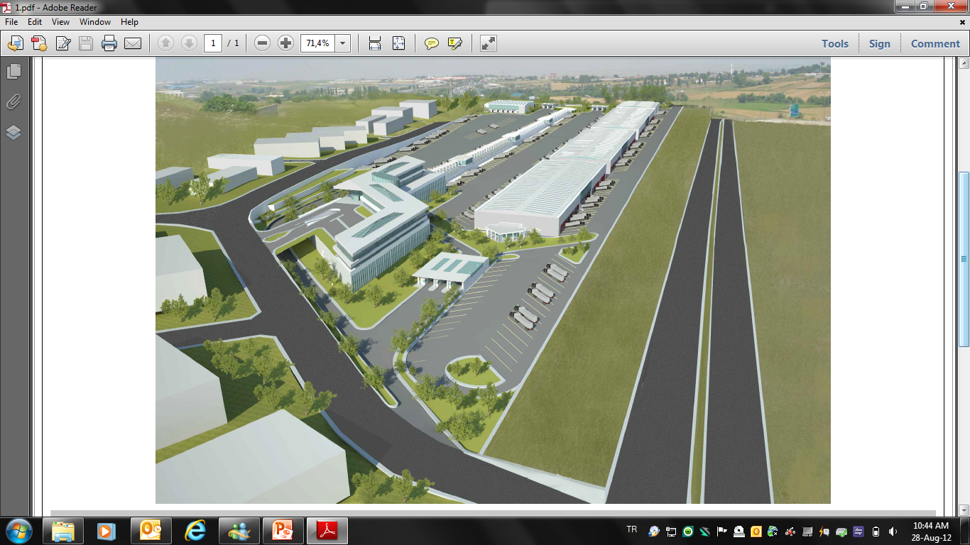
HALKALI LOGISTISC CENTER

Slide 12
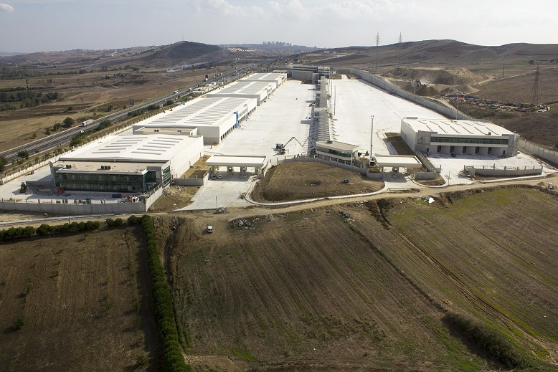
HALKALI LOGISTICS CENTER

Slide 13
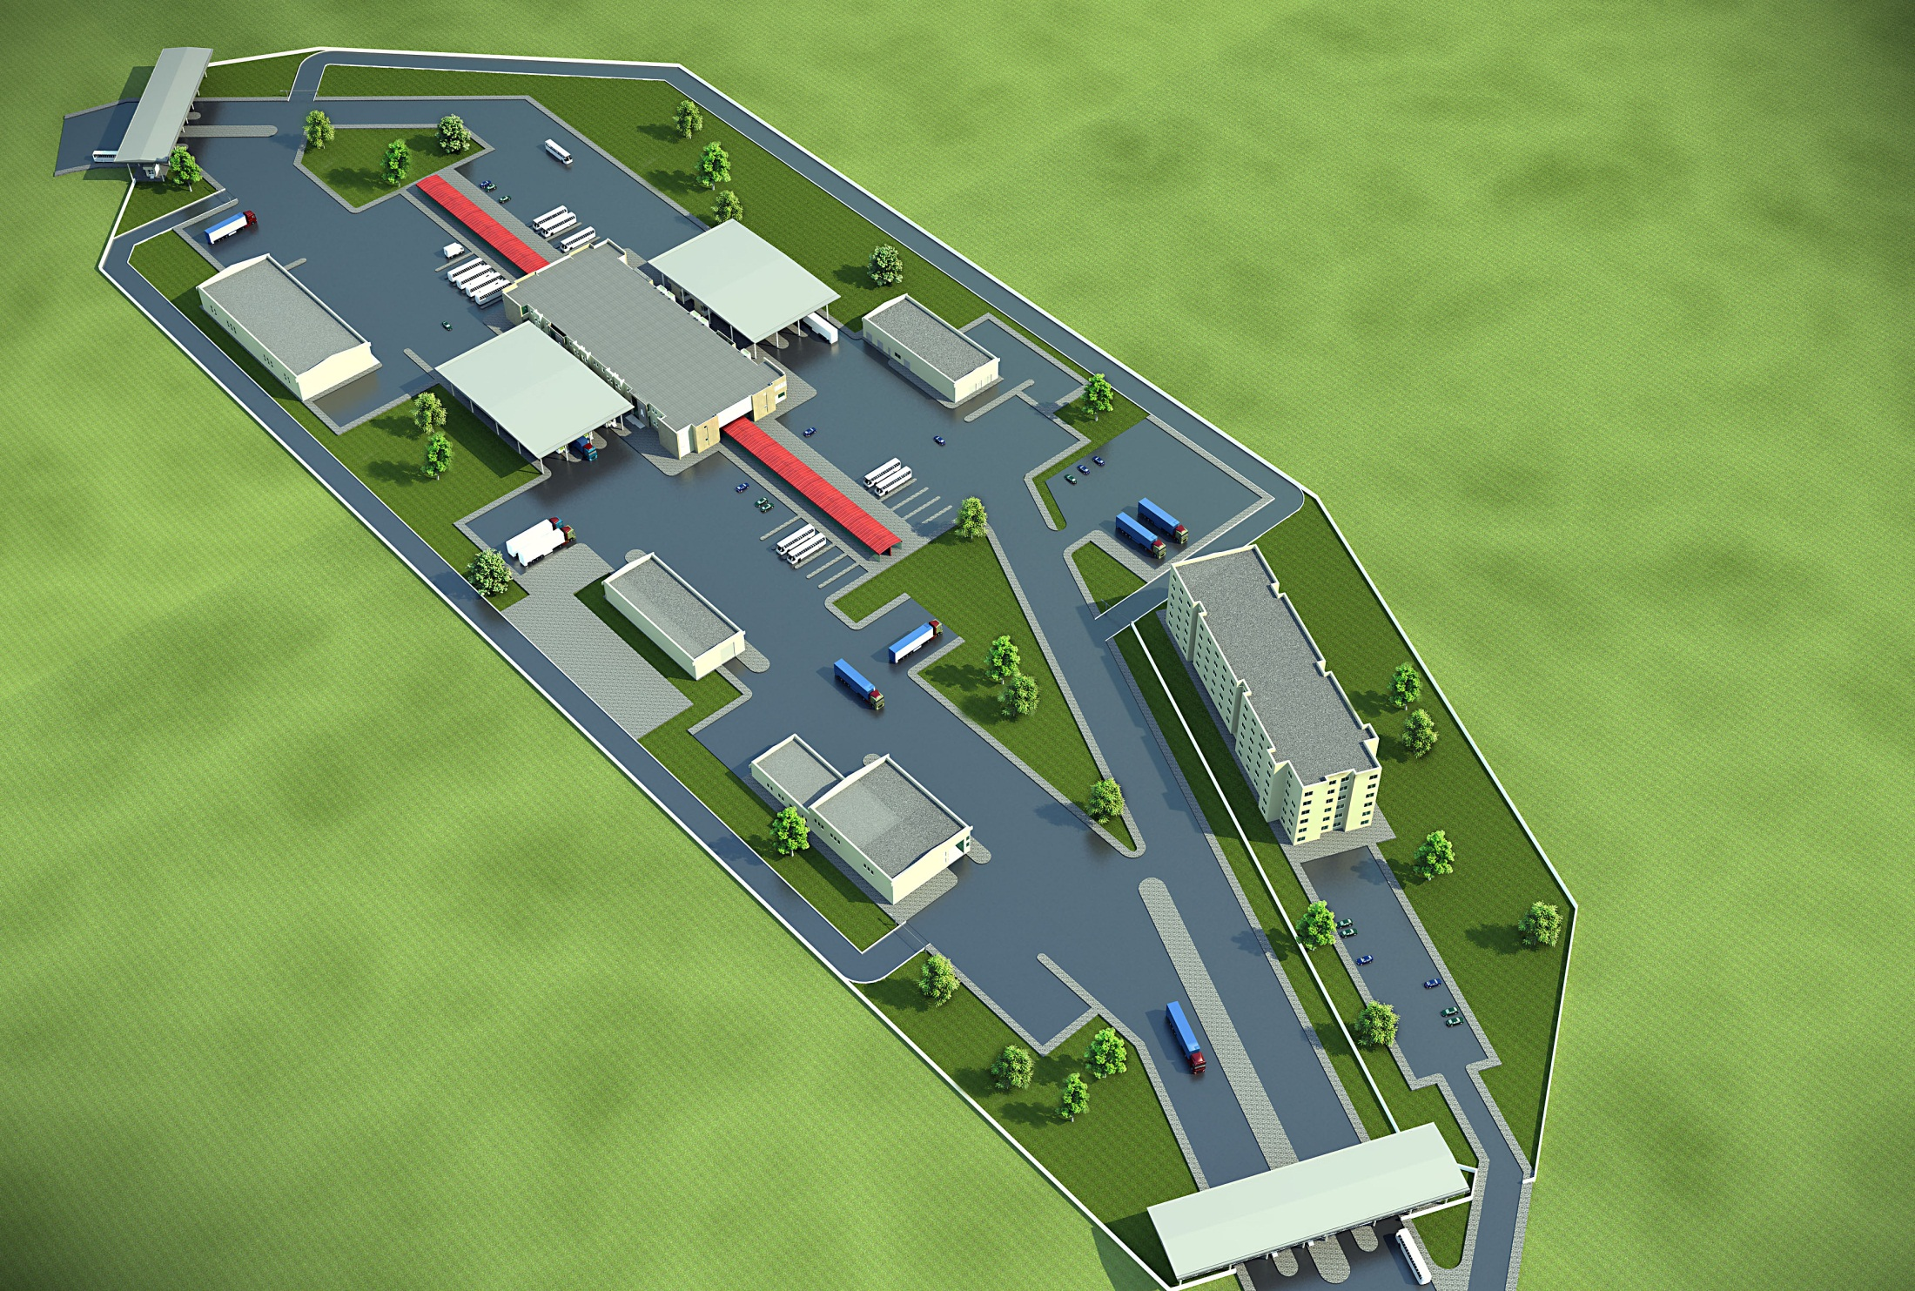
DİLUCU BORDER GATE

Slide 14
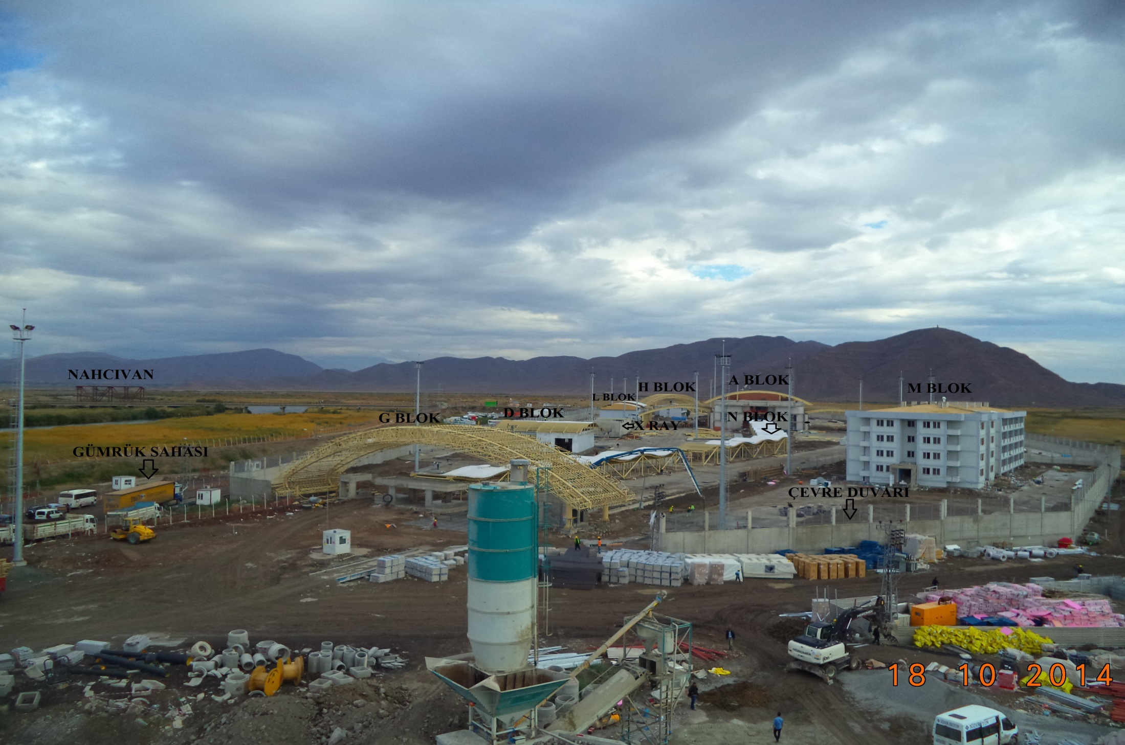
DİLUCU BORDER GATE

Slide 15
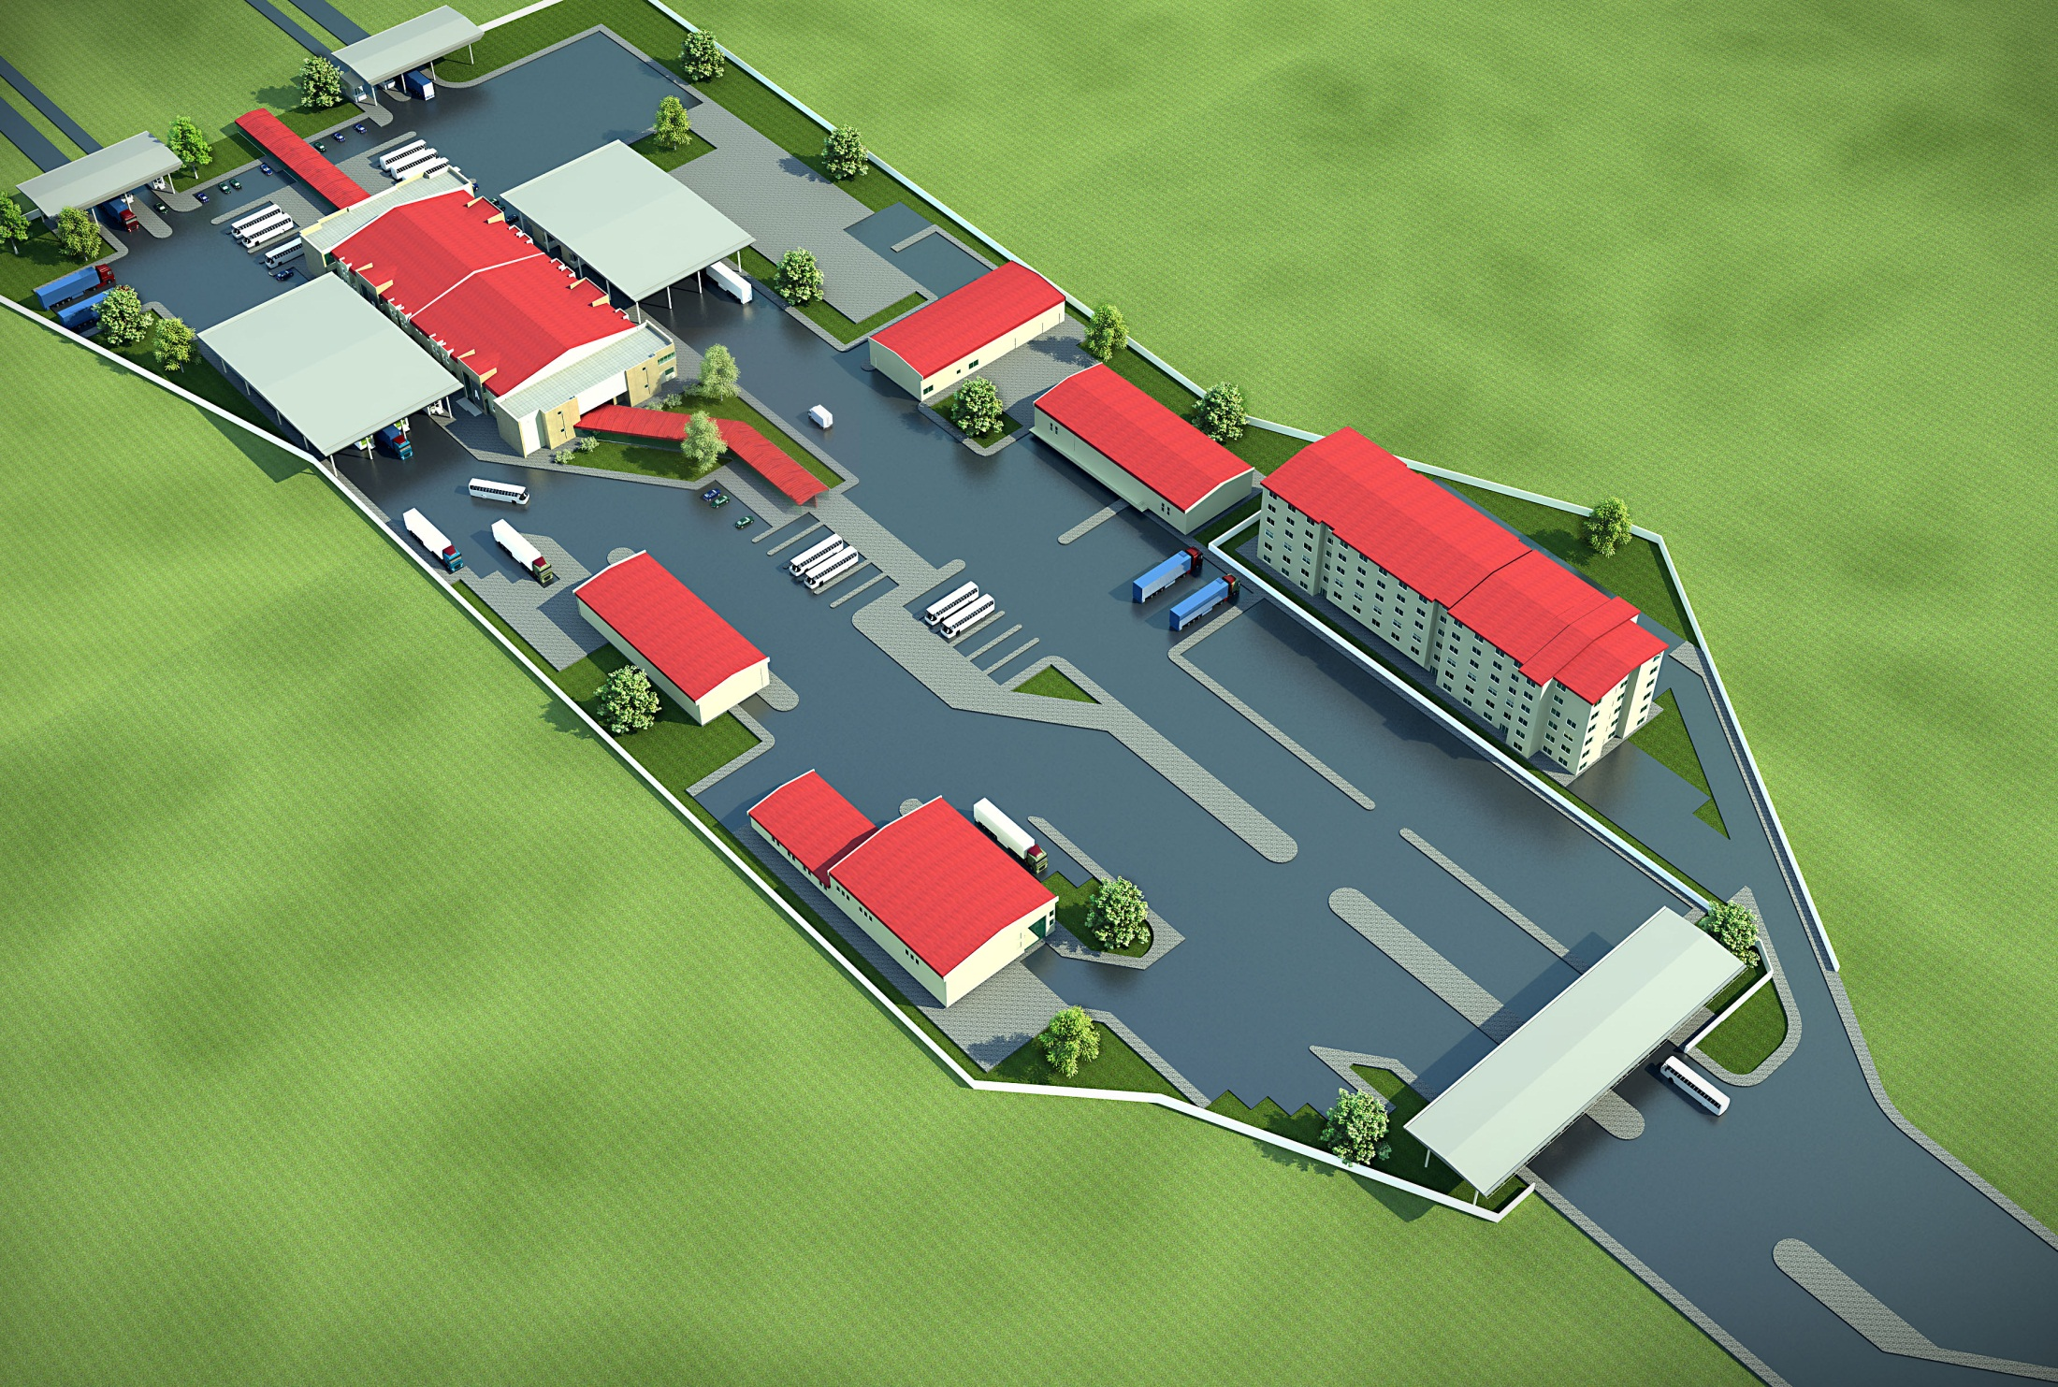
ESENDERE BORDER GATE

Slide 16
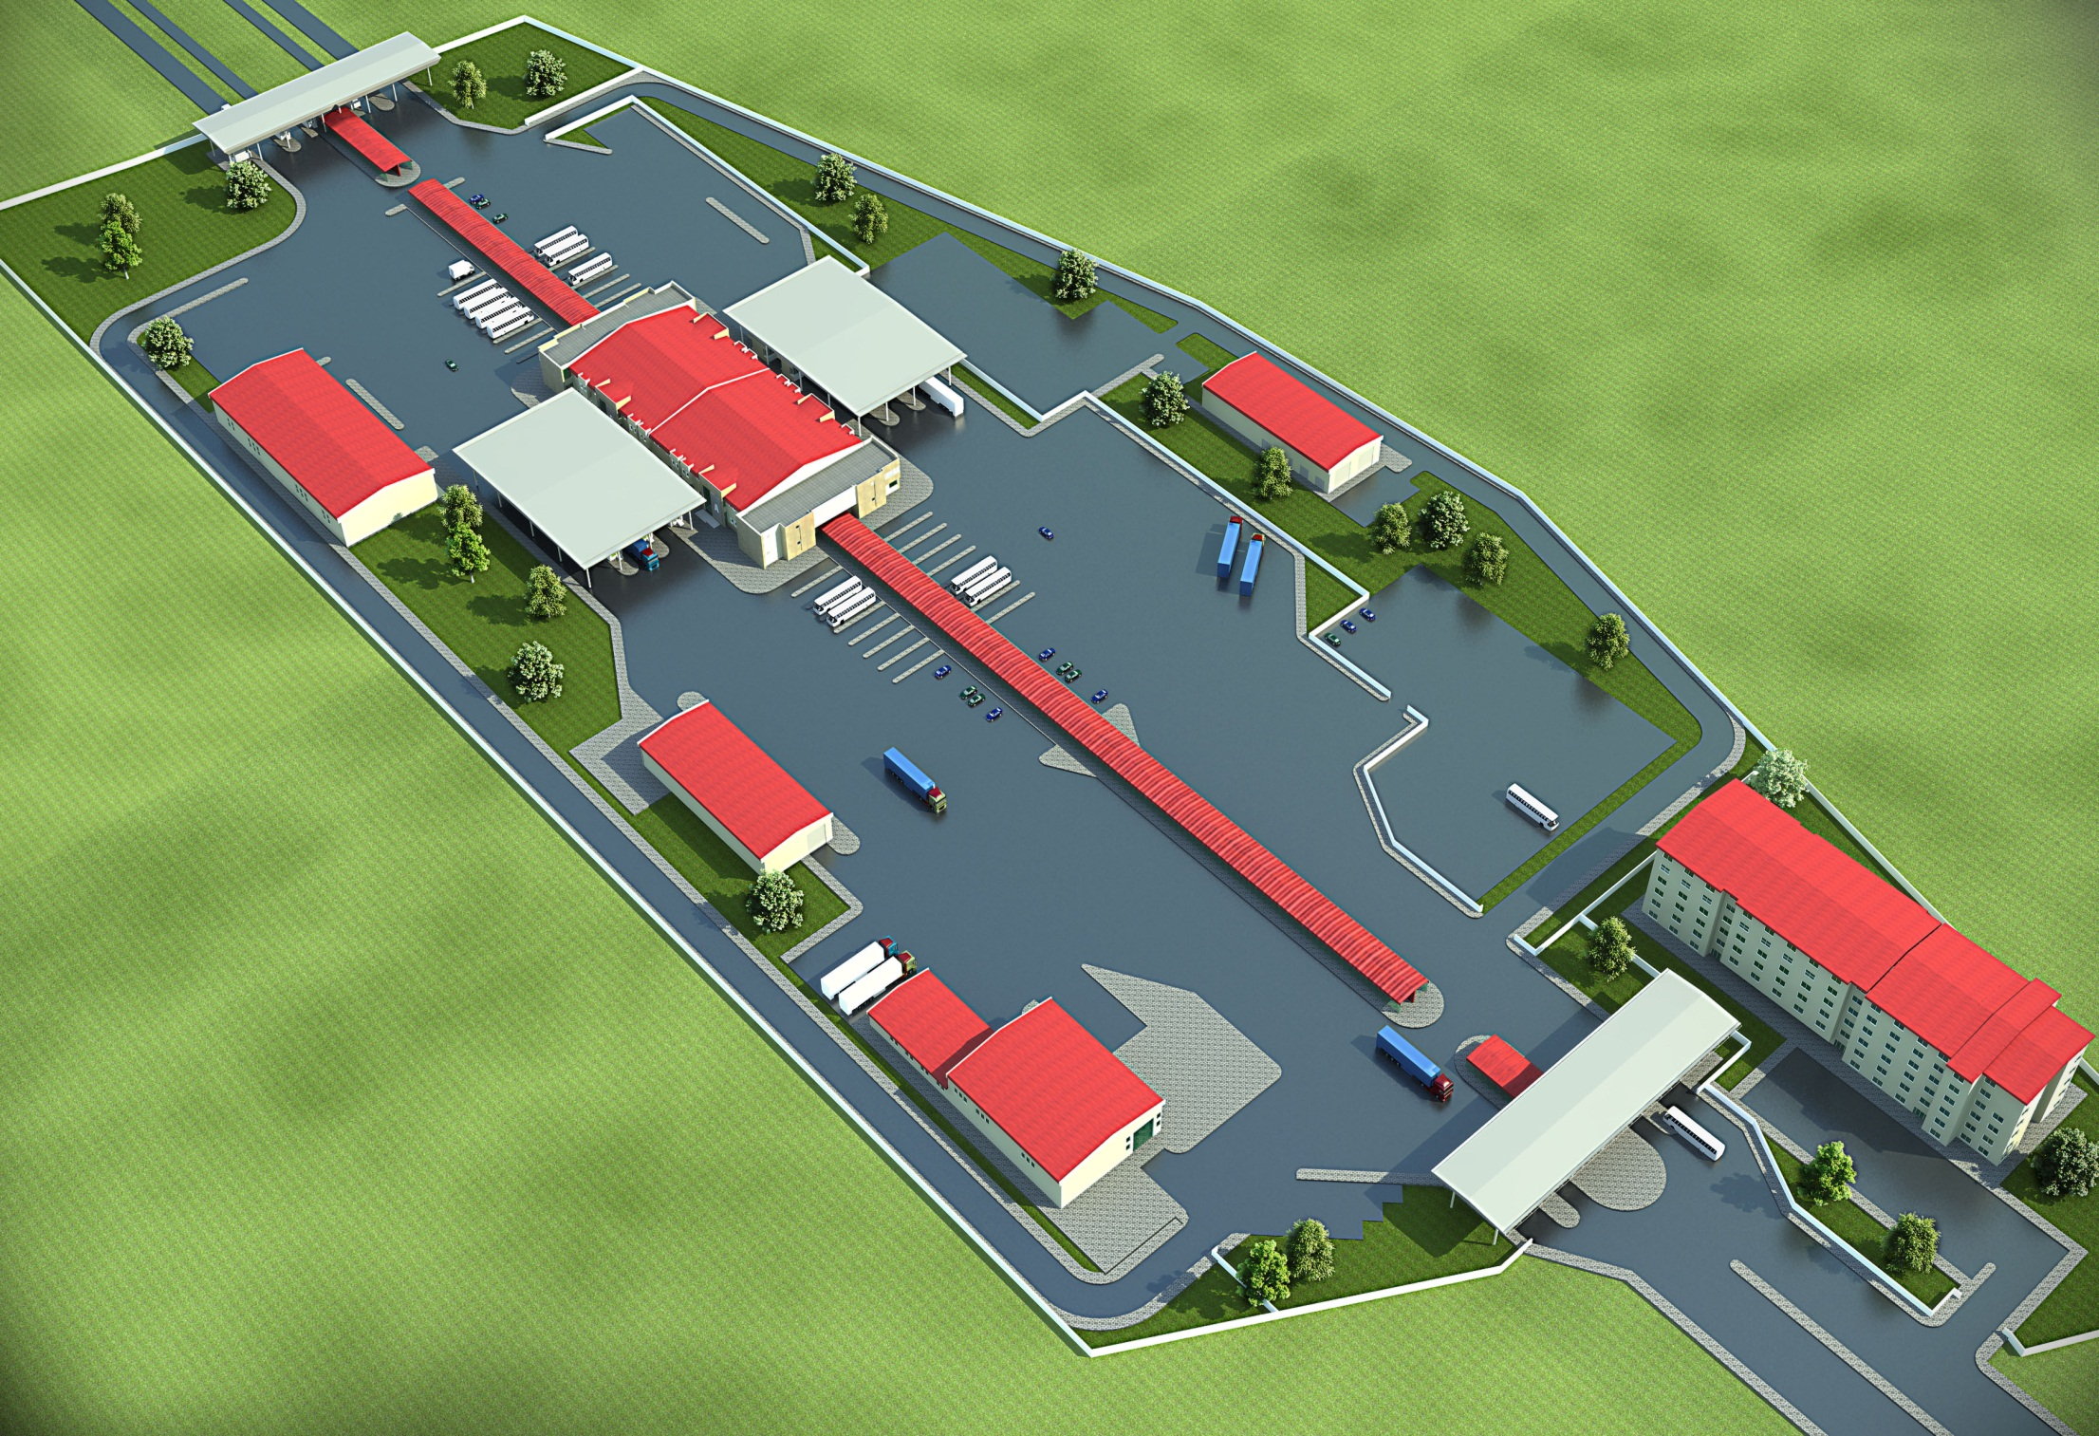
ÇILDIR - AKTAŞ BORDER GATE

Slide 17
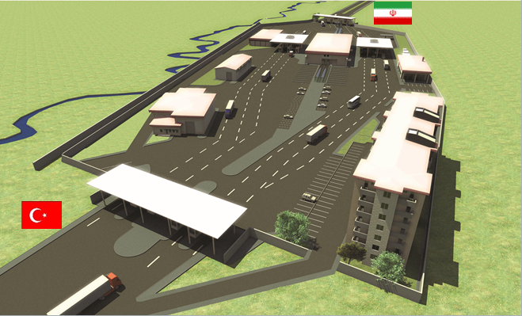
KAPIKÖY BORDER GATE

Slide 18
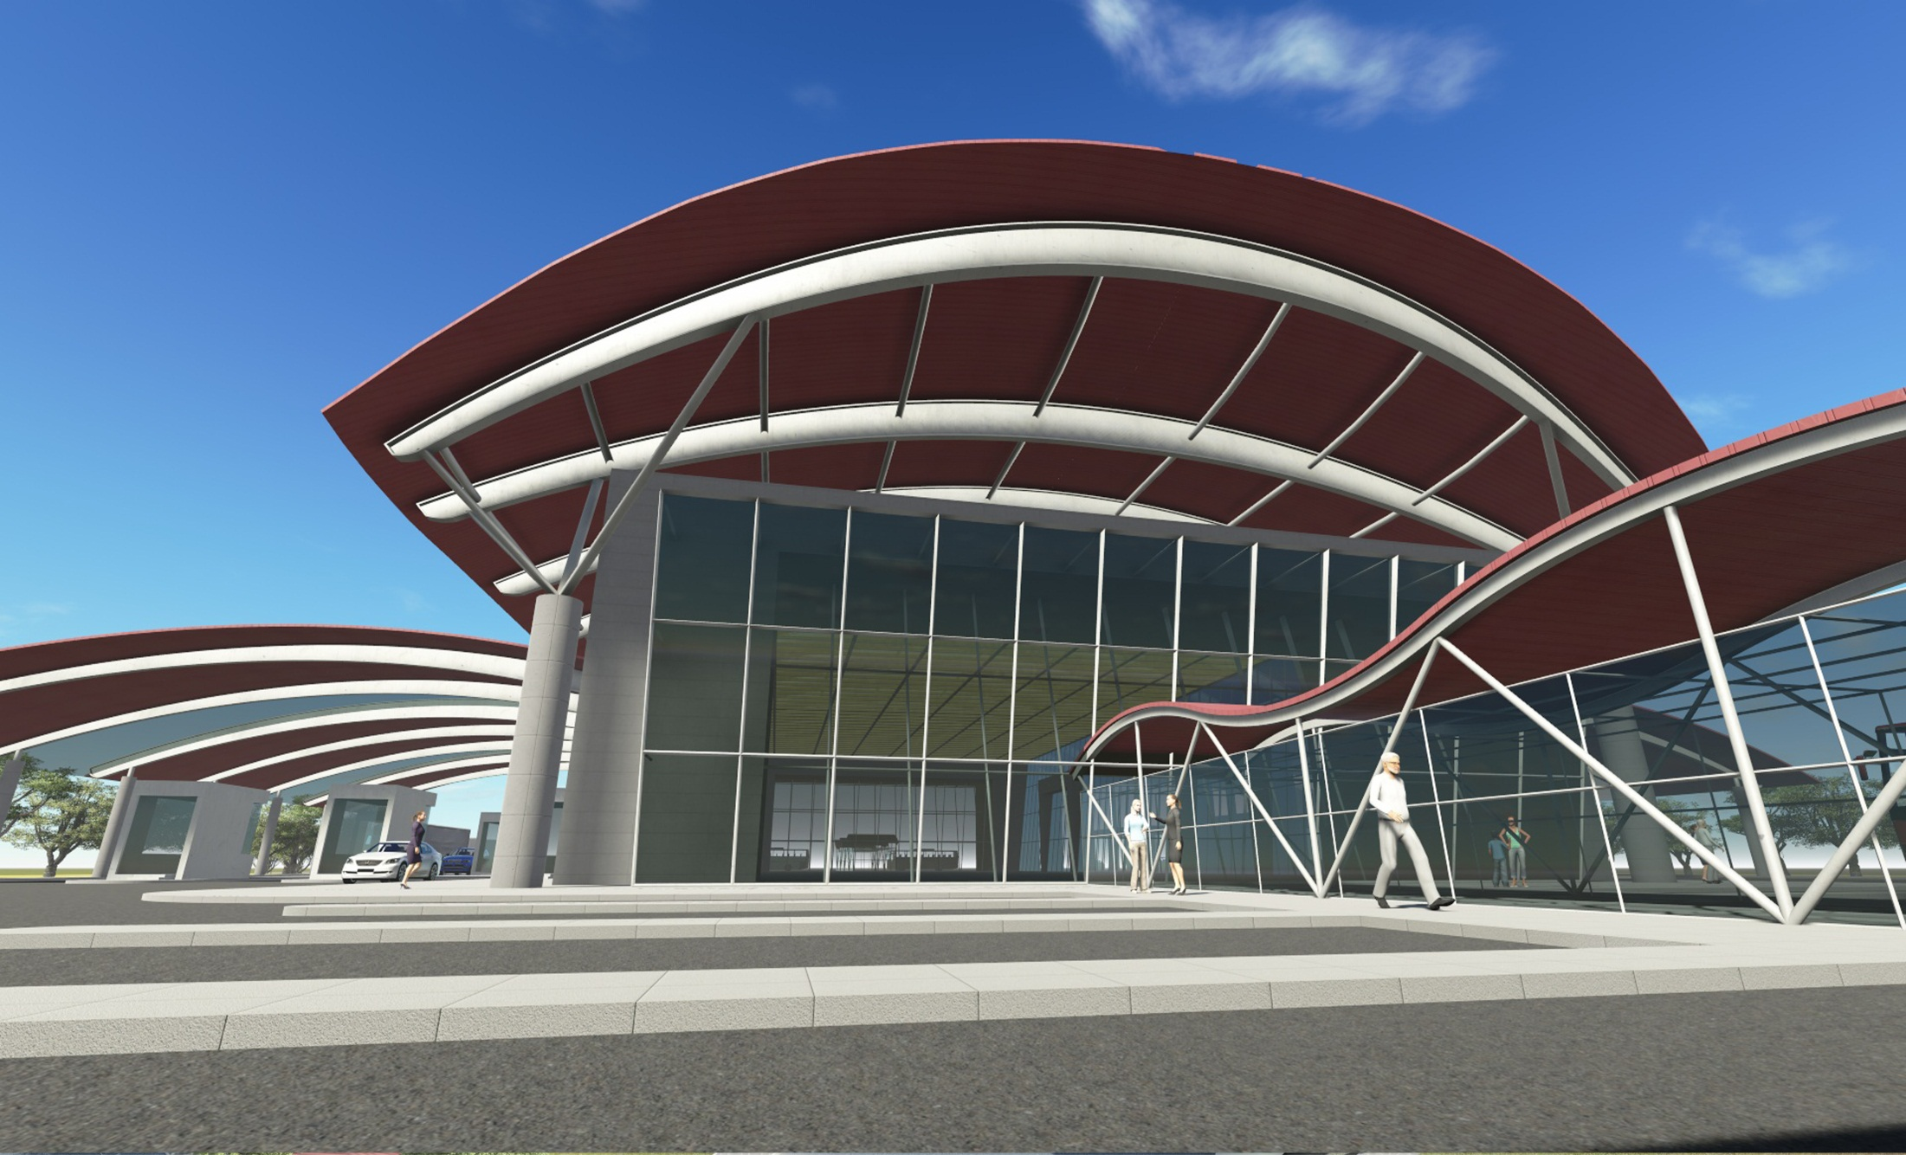

Slide 19
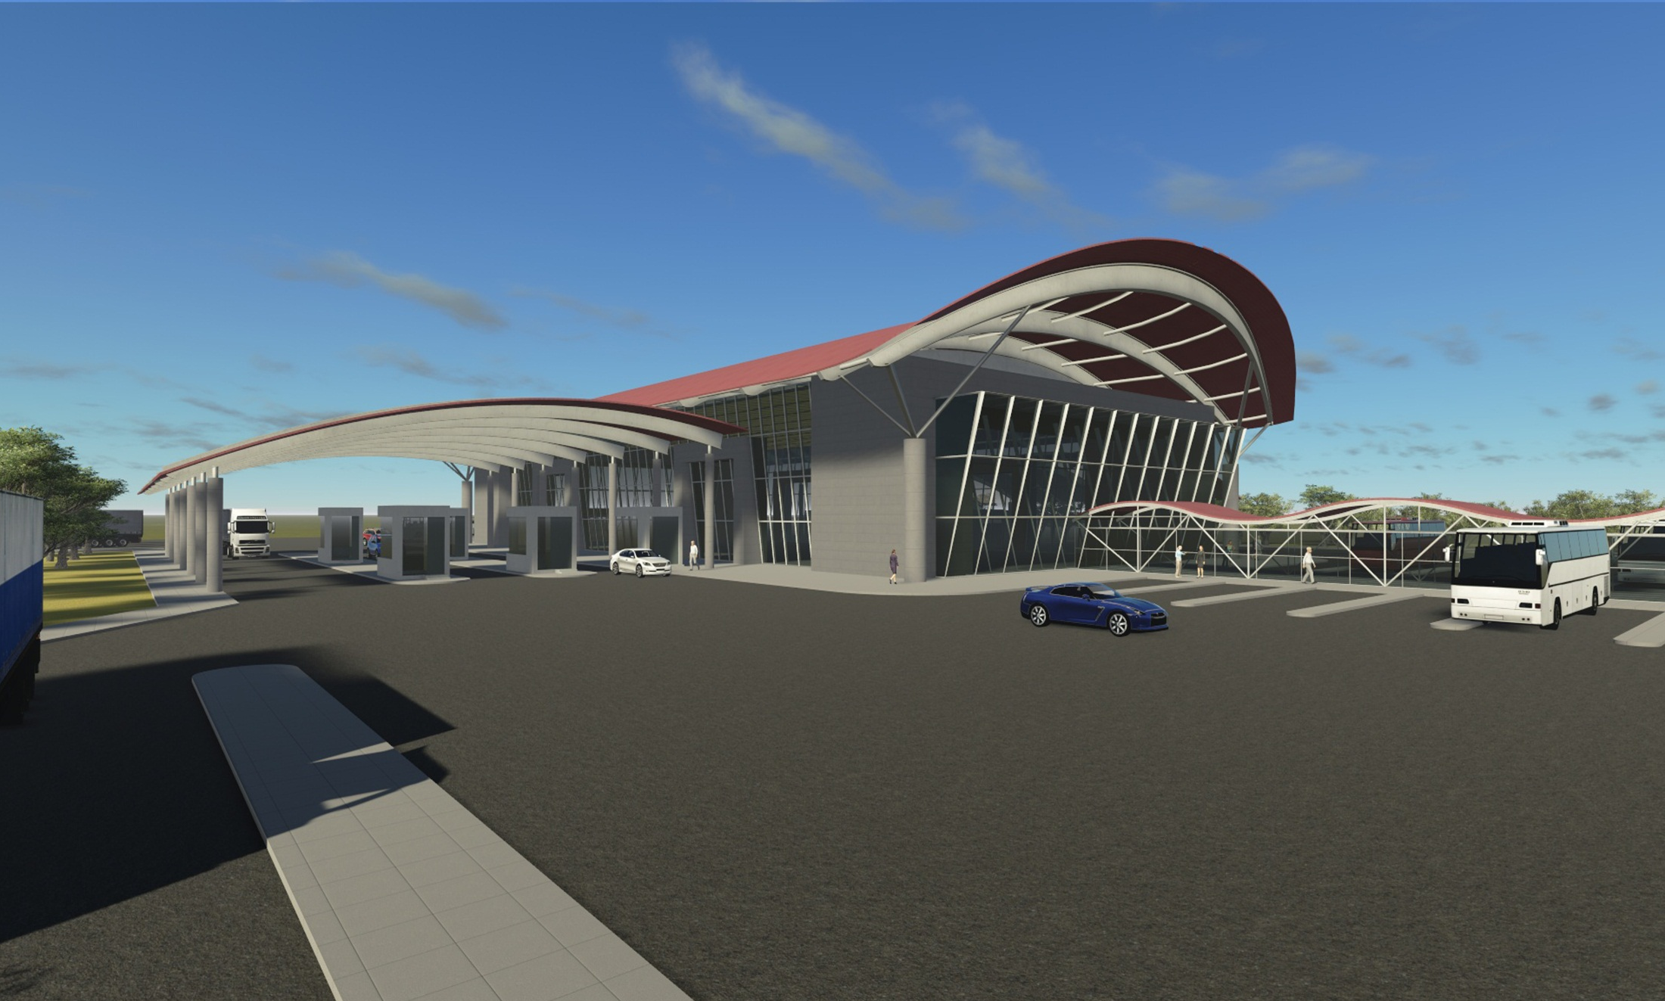

Slide 20
OUTCOMES
Trade facilitation;
More rapid and effective service
Decreased border waiting times
No more queues
Effective fight with smuggling and illegal traffic
User satisfaction (driver, officer, passenger)
Notes:
AT THIS POINT, I WOULD LIKE TO MOVE TO, ANOTHER CONCEPT, MODERN SILK ROAD.

Slide 21
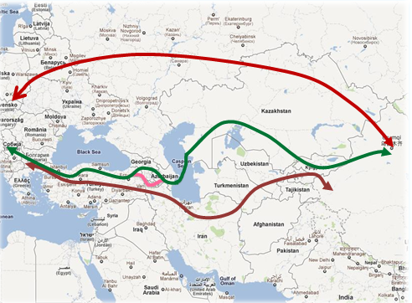
SILK ROAD
Projects with Iran and Syria
Northern Corridor: 6.500 km / 12-14 days
Central Corridor: 5.100 km / 14-18 days
Southern Corridor: 4.000 km / 12-14 days
Notes:
AT THIS POINT, I WOULD LIKE TO MOVE TO, ANOTHER CONCEPT, MODERN SILK ROAD.

Slide 22
KAPIKULE BORDER GATE
Turkey – Bulgaria
Notes:
NOW I WOULD LIKE TO GIVE BRIEF INFORMATION ABOUT THE PROJECTS WE HAVE COMPLETED.

Slide 23
KAPIKULE BORDER GATE (Before Modernization)
Notes:
YOU NOW SEE A PICTURE FROM KAPIKULE BEFORE MODERNIZATION.

Slide 24
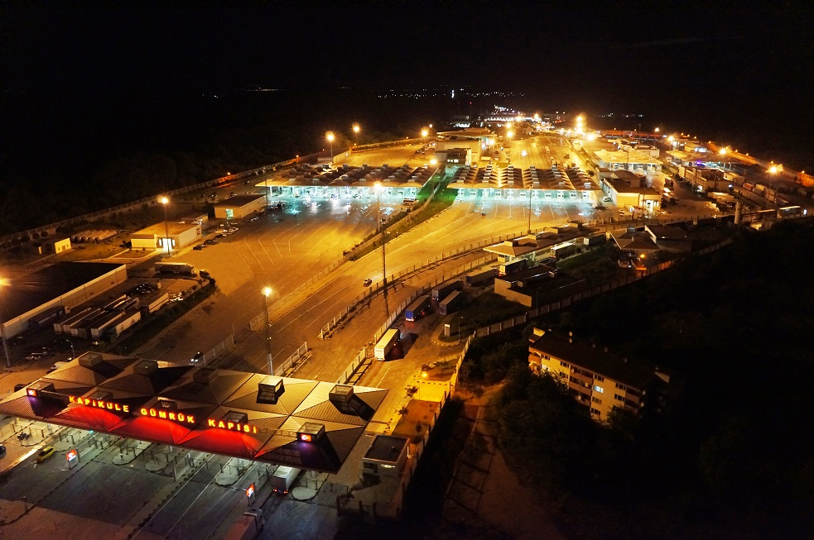
KAPIKULE BORDER GATE (After Modernization)

Slide 25
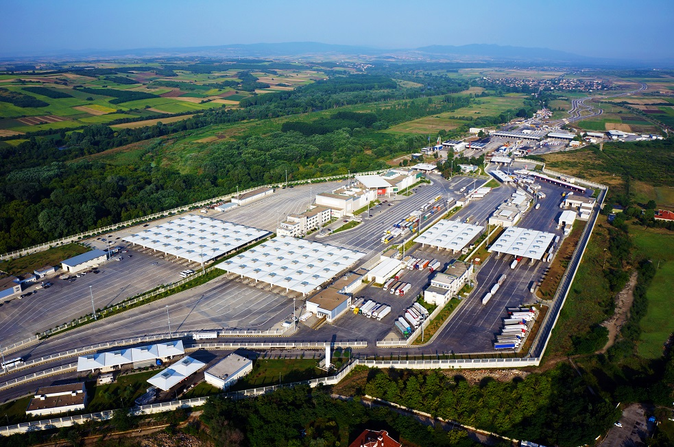
KAPIKULE BORDER GATE (After Modernization)

Slide 26
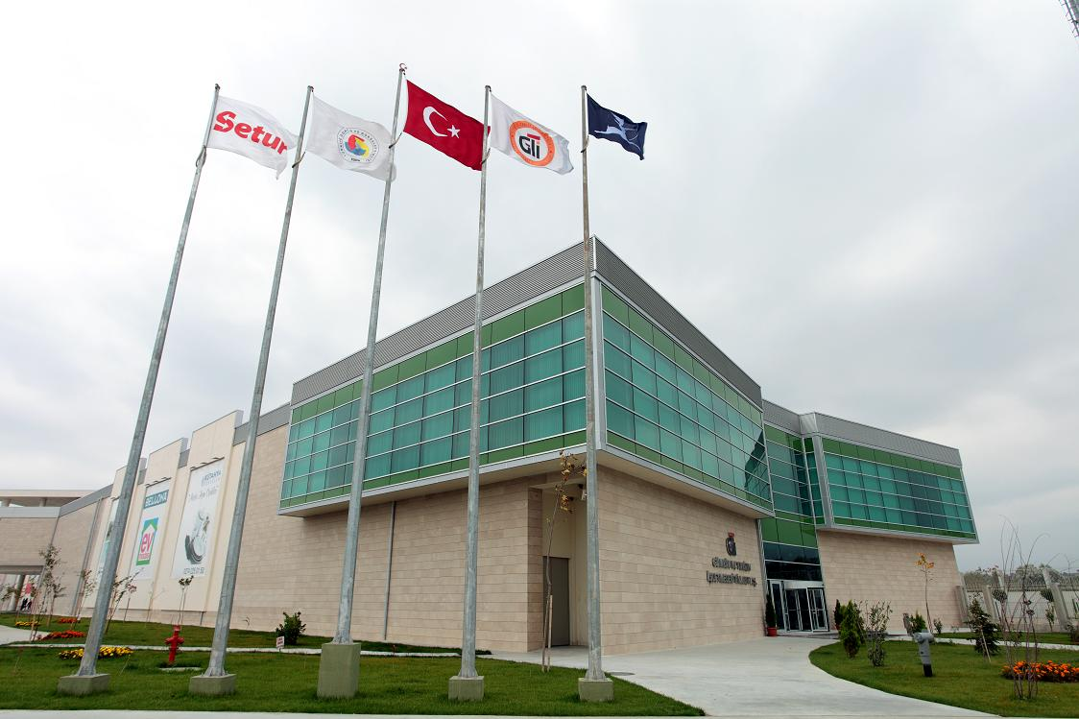
KAPIKULE BORDER GATE (After Modernization)
Notes:
AND THESE ARE TAKEN AFTER MODERNIZATION.

Slide 27
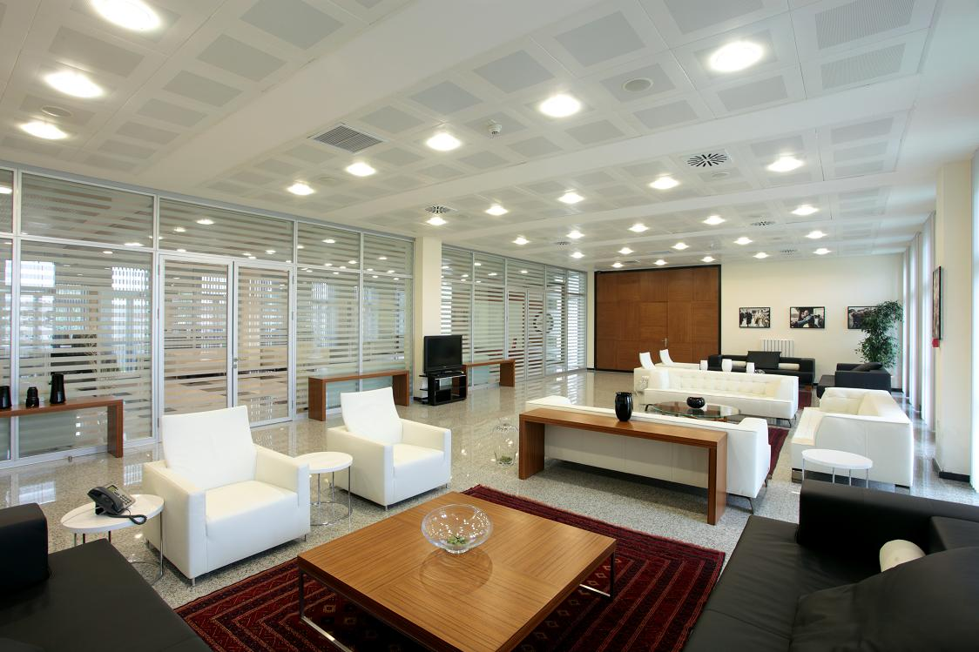
KAPIKULE BORDER GATE (After Modernization)

Slide 28
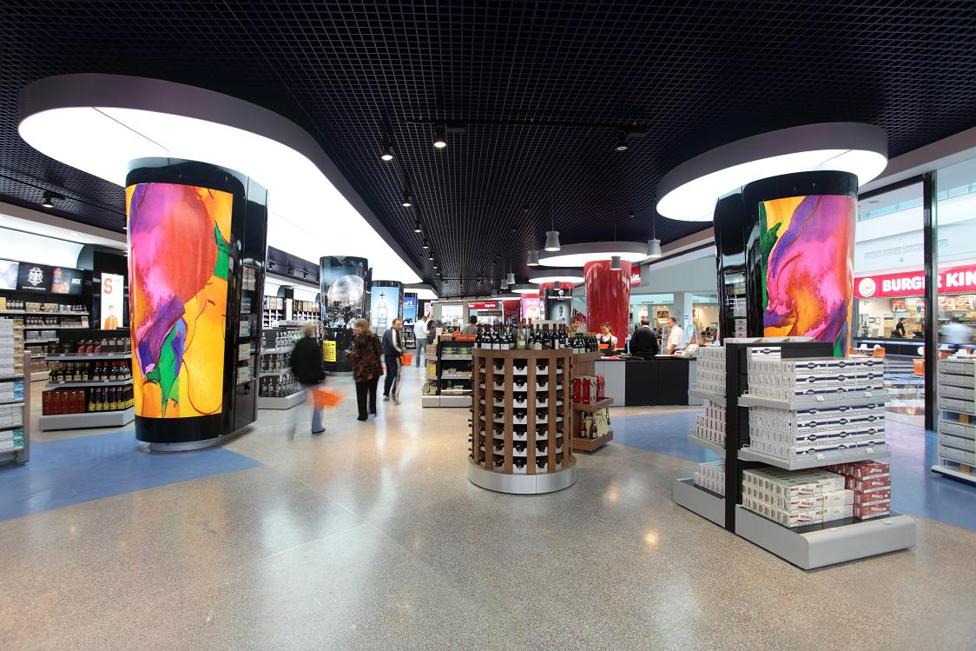
KAPIKULE BORDER GATE (After Modernization)

Slide 29
HABUR BORDER GATE
Turkey - Iraq
Notes:
HABUR BORDER GATE IS OUR BORDER WITH IRAQ.

Slide 30
HABUR BORDER GATE (Before Modernization)
Notes:
THE PICTURE IS TAKEN BEFORE MODERNIZATION.

Slide 31
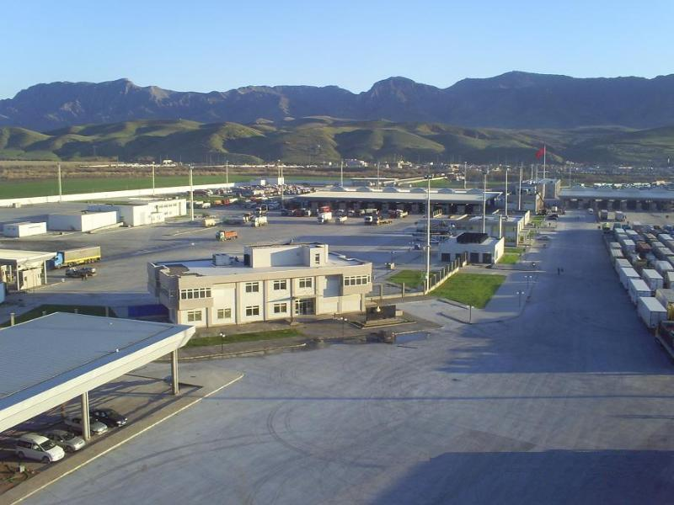
HABUR BORDER GATE (After Modernization)
Notes:
AND THESE ARE AFTER.

Slide 32
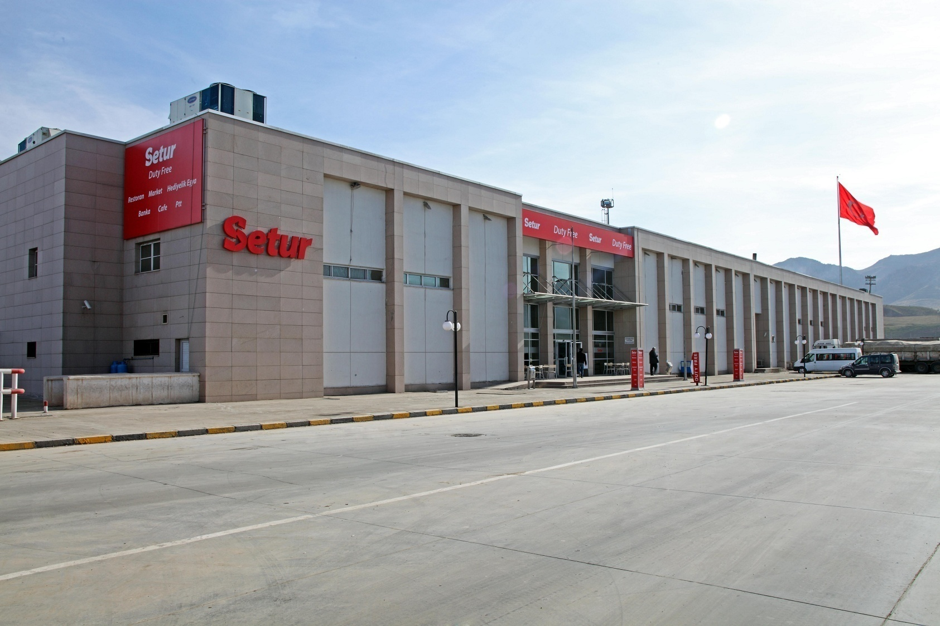
HABUR BORDER GATE (After Modernization)

Slide 33
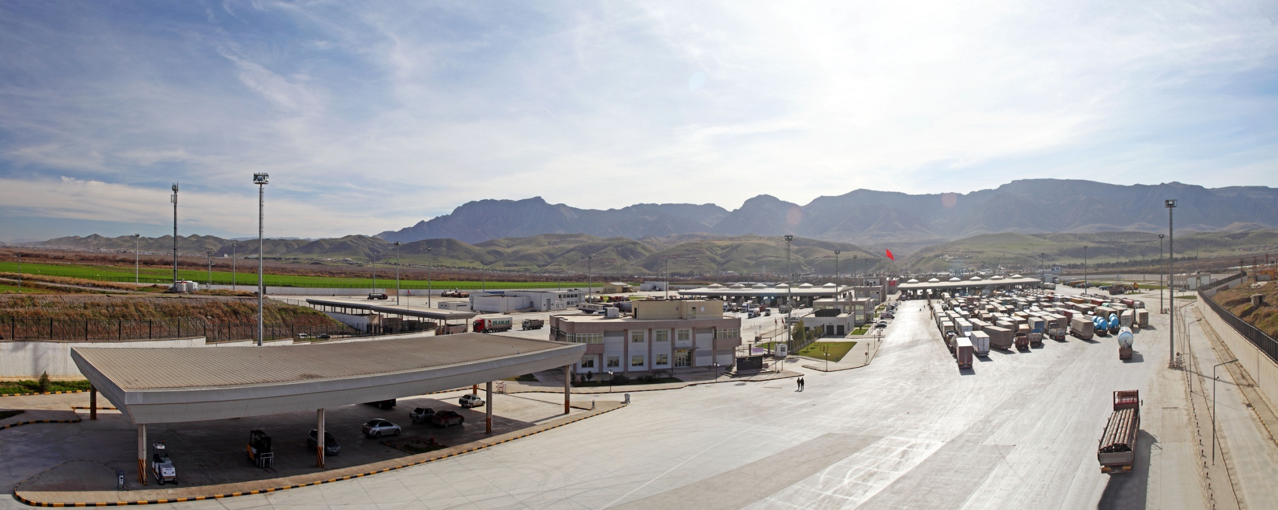
HABUR BORDER GATE (After Modernization)

Slide 34
CİLVEGÖZÜ BORDER GATE
Turkey – Syria
Notes:
CILVEGOZU BORDER GATE IS THE BUSIEST GATE WIYTH SYRIA.

Slide 35
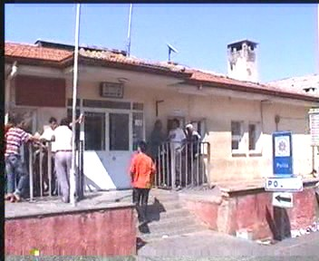
CİLVEGÖZÜ BORDER GATE (Before Modernization)
Notes:
THIS PICTURE IS TAKEN BEFORE MODERNIZATION.

Slide 36
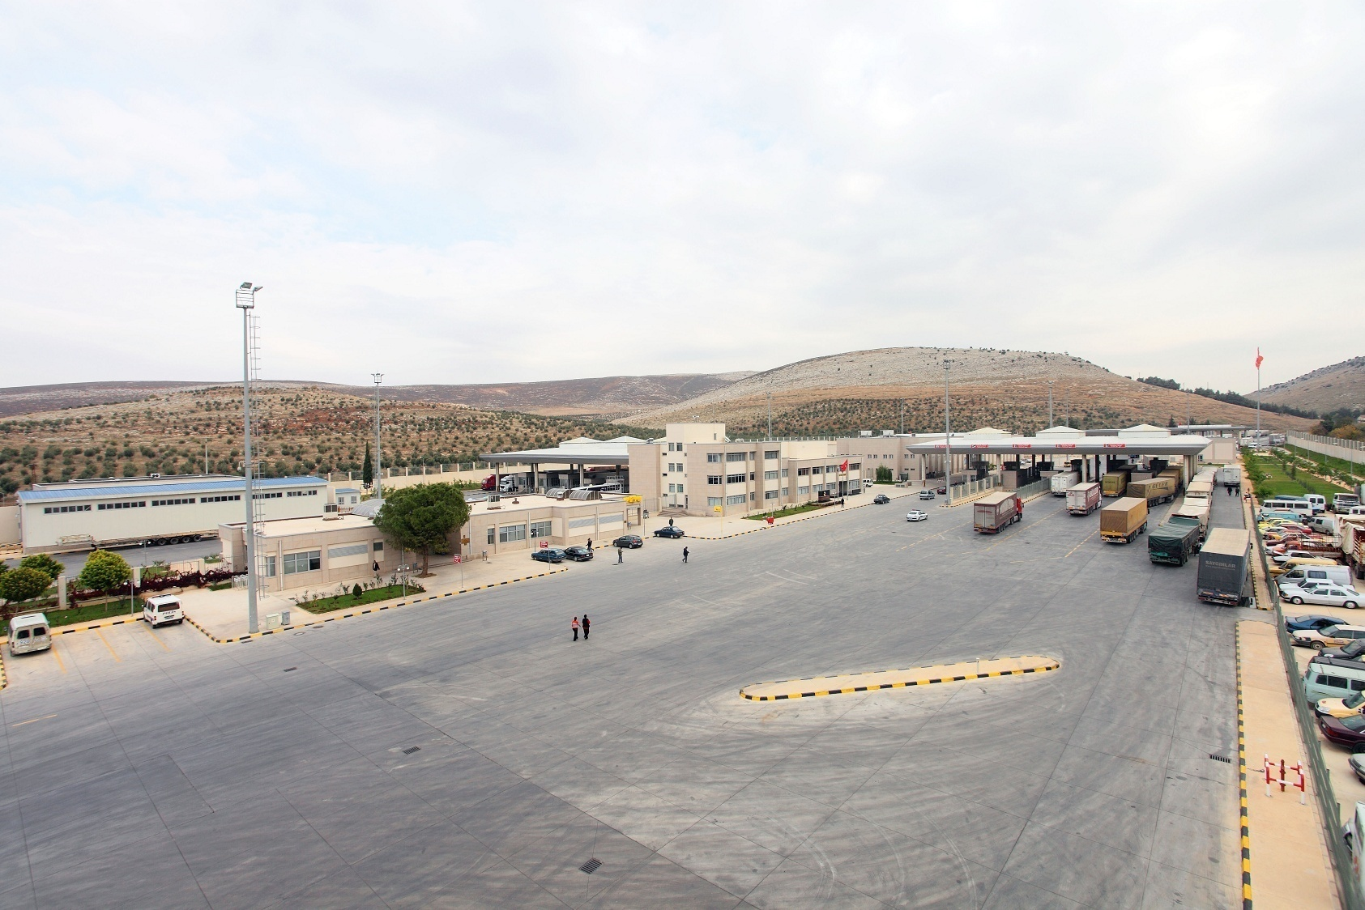
CİLVEGÖZÜ BORDER GATE (After Modernization)
Notes:
AND THESE ARE AFTER.

Slide 37
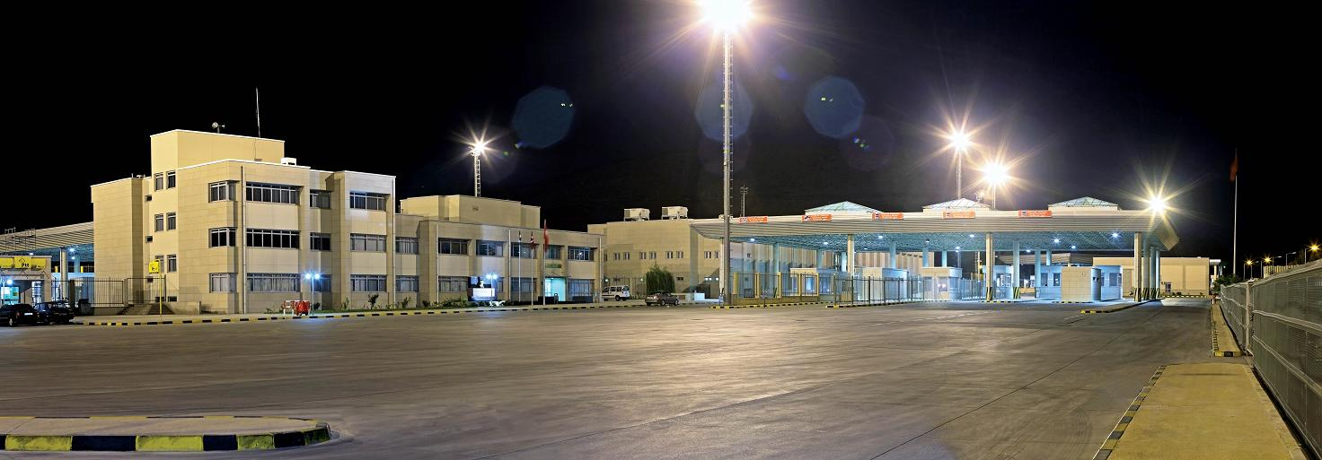
CİLVEGÖZÜ BORDER GATE (After Modernization)

Slide 38
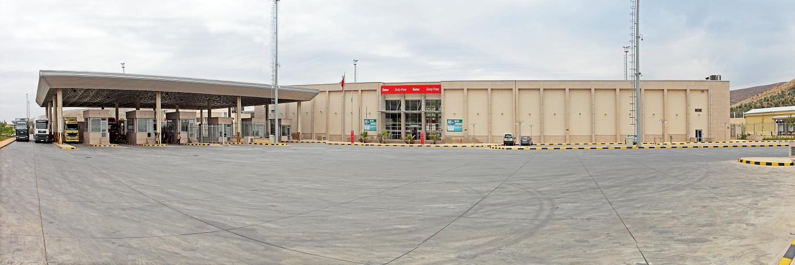
CİLVEGÖZÜ BORDER GATE (After Modernization)

Slide 39
SARP BORDER GATE
Turkey - Georgia
Notes:
SARP BORDER GATE IS WITH GEORGIA.

Slide 40
SARP BORDER GATE (Before Modernization)
Notes:
PLEASE HAVE A LOOK AT THE DRAMATIC CHANGE.

Slide 41
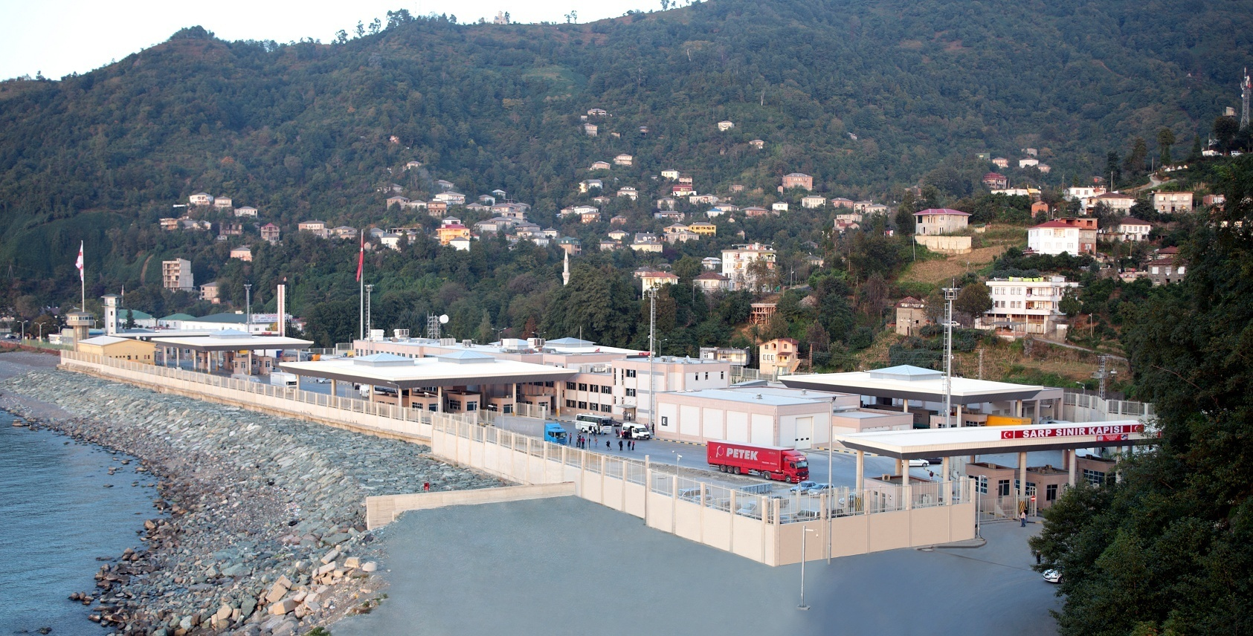
SARP BORDER GATE (After Modernization)

Slide 42
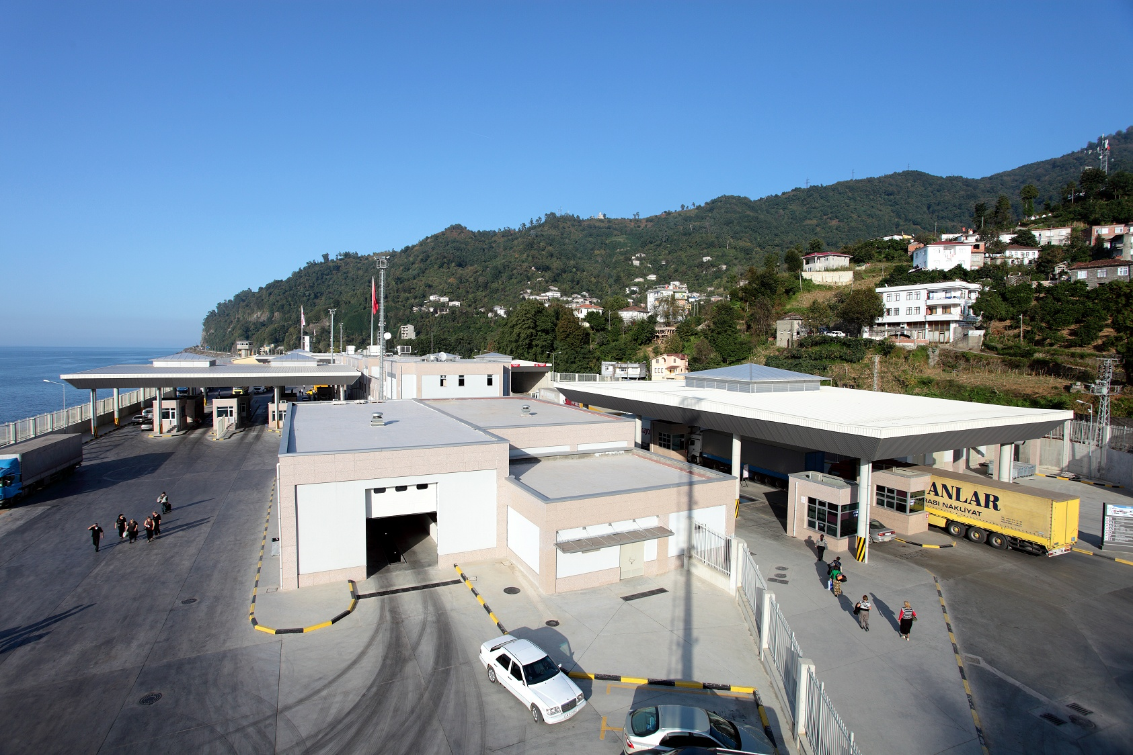
SARP BORDER GATE (After Modernization)

Slide 43
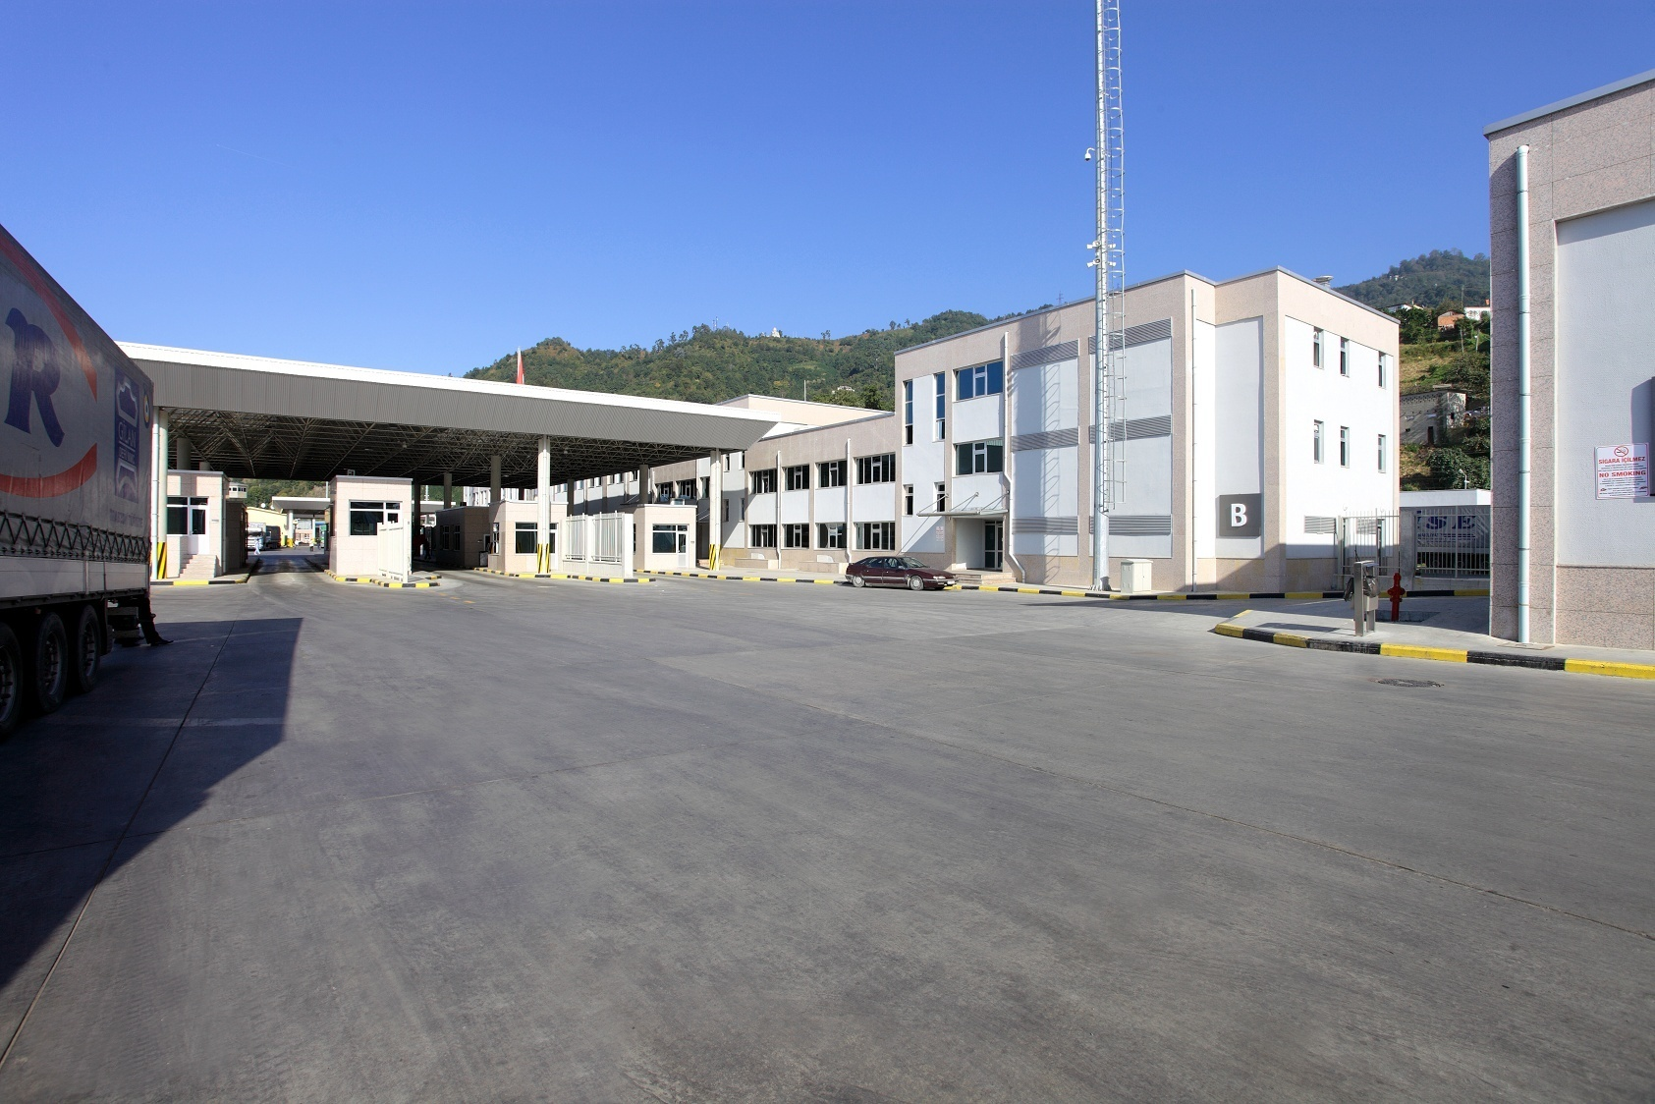
SARP BORDER GATE (After Modernization)

Slide 44
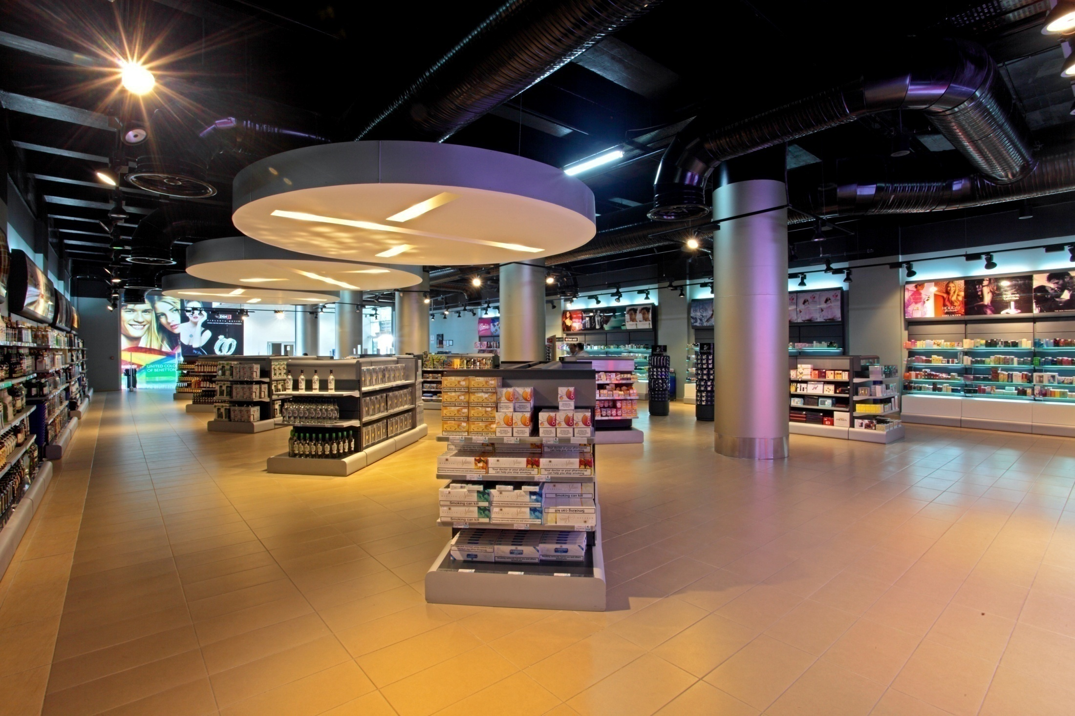
SARP BORDER GATE (After Modernization)

Slide 45
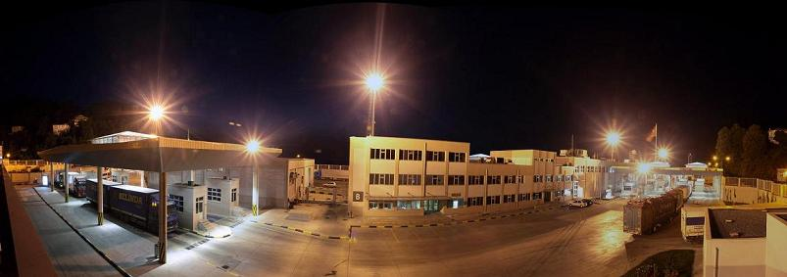
SARP BORDER GATE (After Modernization)

Slide 46
HAMZABEYLİ BORDER GATE
Turkey - Bulgaria
Notes:
THE LAST COMLETED IS HAMZABEYLI BORDER GATE.

Slide 47
HAMZABEYLİ BORDER GATE (Before Modernization)

Slide 48
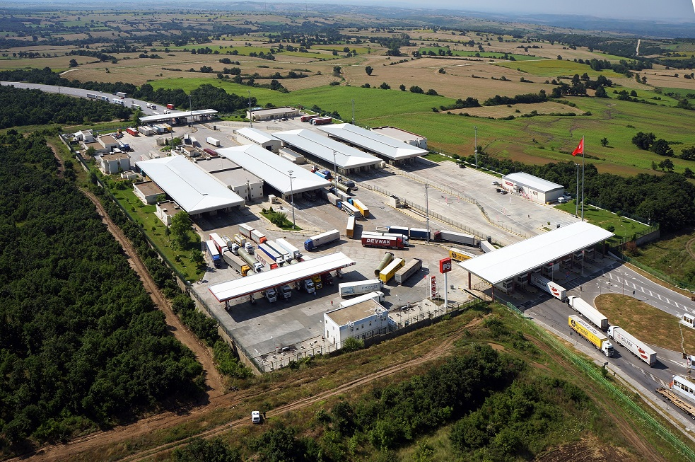
HAMZABEYLİ BORDER GATE (After Modernization)

Slide 49
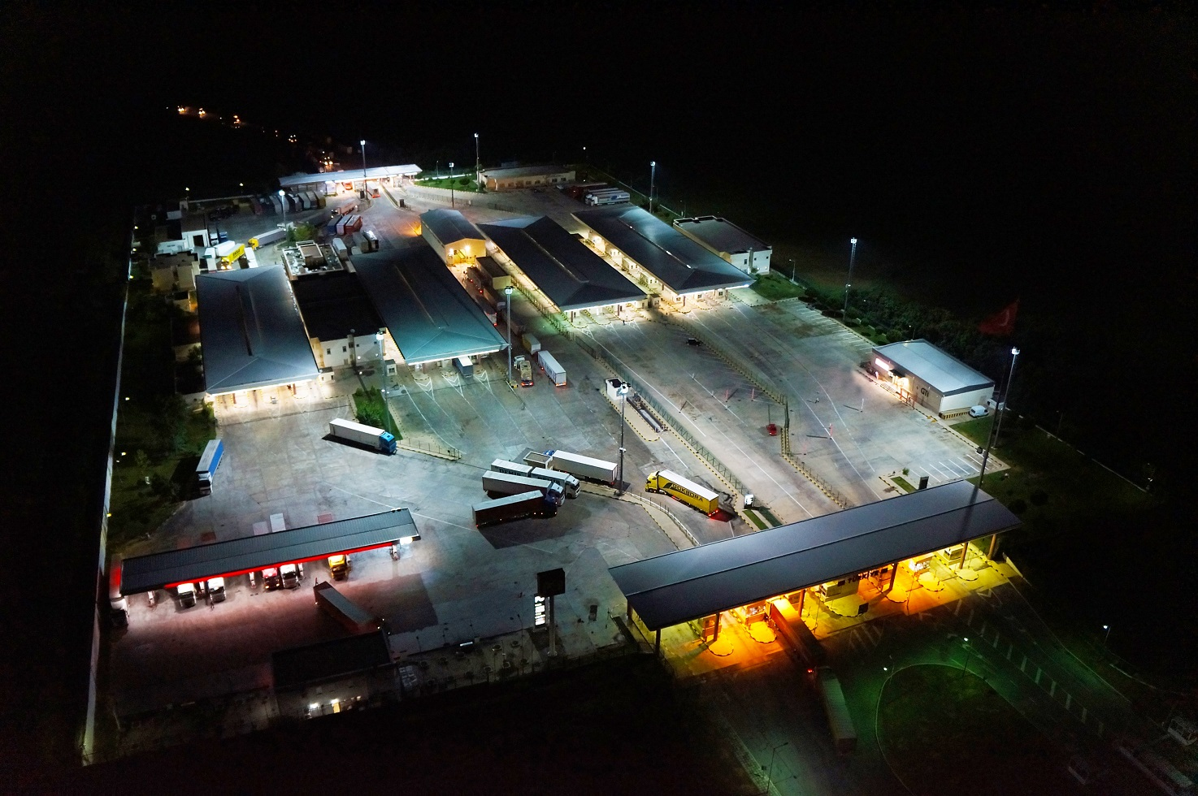
HAMZABEYLİ BORDER GATE (After Modernization)

Slide 50
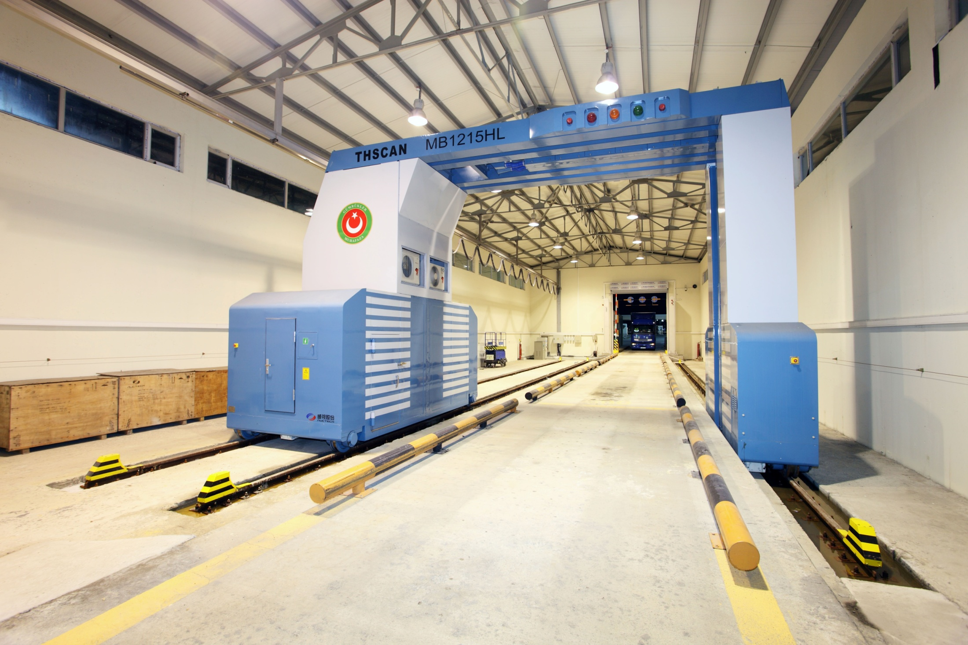
HAMZABEYLİ BORDER GATE (After Modernization)

Slide 51
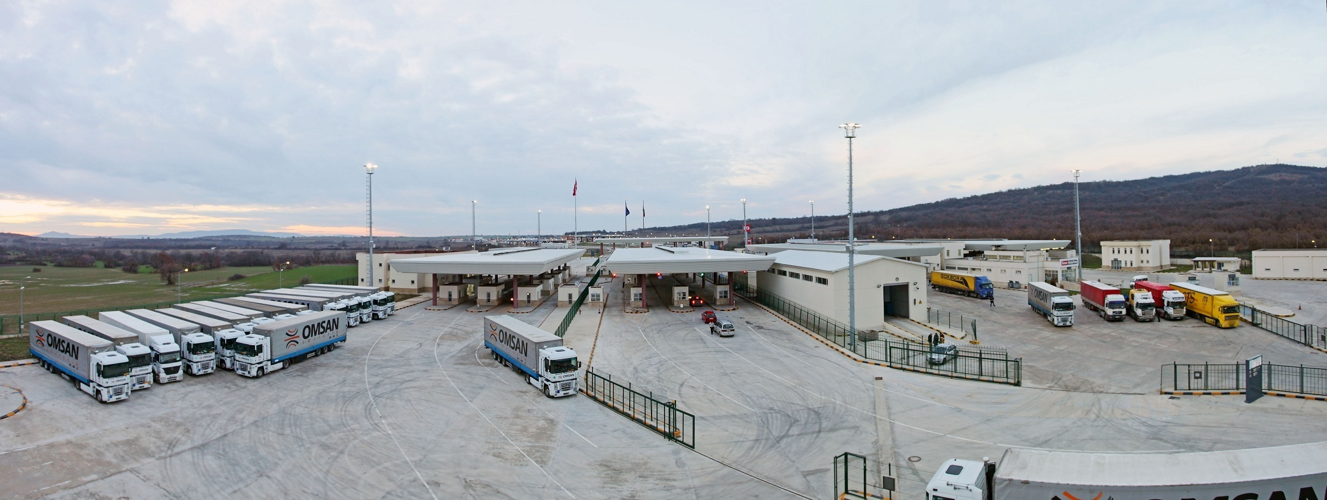
HAMZABEYLİ BORDER GATE (After Modernization)

Slide 52
THANK YOU
www.gtias.com.tr
Notes:
THANK YOU VERY MUCH FOR YOUR ATTENTION.

